Slide 1

Bonus-Malus Theory
Jean Lemaire
Wharton School

Slide 2
Bonus-malus systems
A priori classification variables: age, sex, type and use of car, territory
A posteriori variables: deductibles, credibility, bonus-malus
Bonus malus =
  Answer to heterogeneity of behavior of drivers in each cell
  Answer to adverse selection
  Inducement to drive more carefully
Strongly influenced by regulatory environment and culture

Slide 5

BMS as they should be: Bayesian analysis
Observed distribution of third-party liability motor insurance claims
Mean: $\overline{x}$ = 0.1011
Variance: $s^{2}$ = 0.1074
Number of claims | Observed policies
0 | 96,978
1 | 9,240
2 | 704
3 | 43
4 | 9
5+ | 0
Total | 106,974

Slide 6
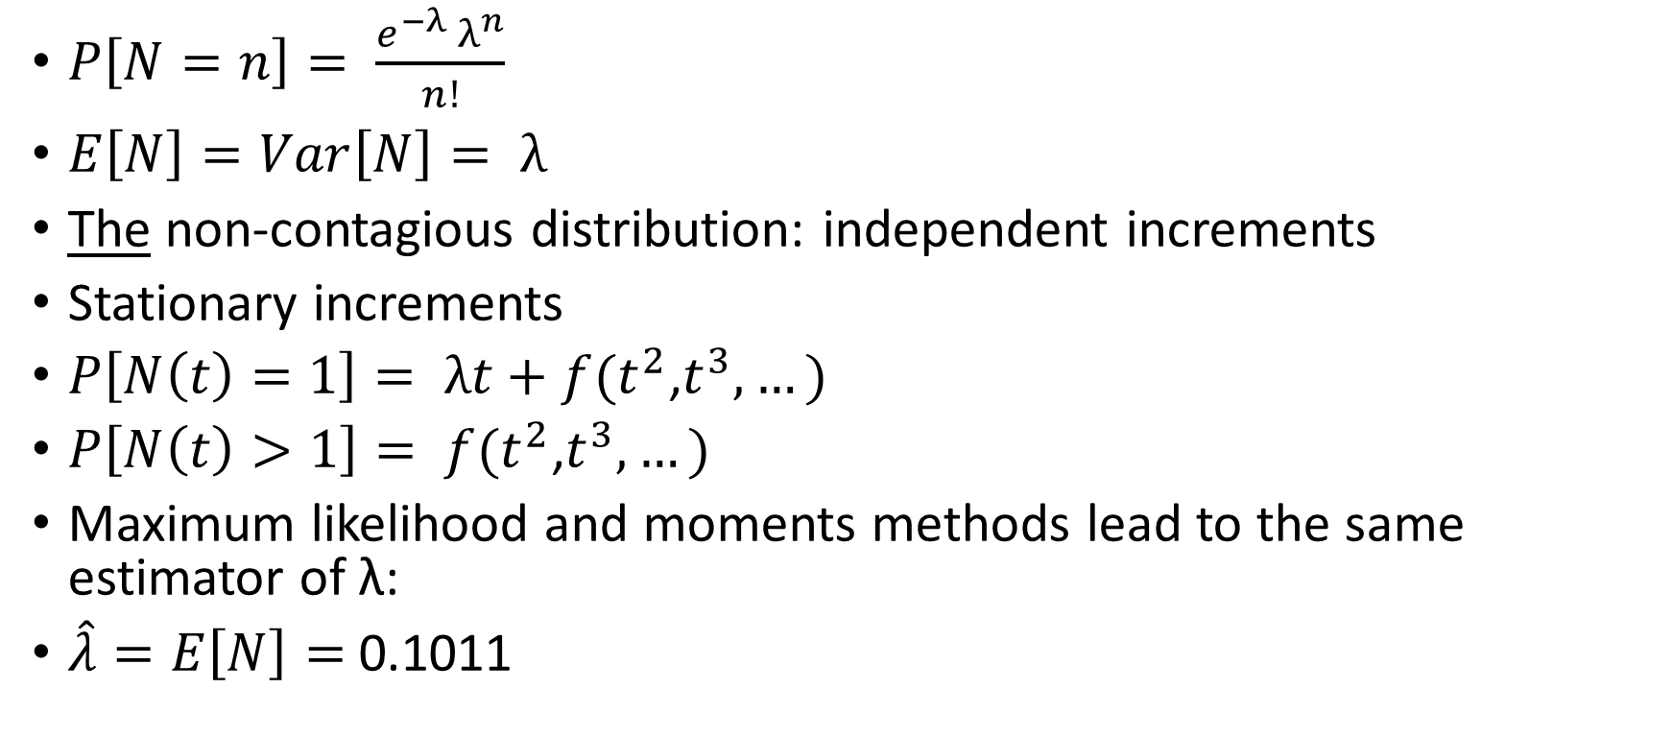
Poisson fit
$P\left[N=n\right]= \frac{e^{−λ }λ^{n}}{n!}$
$E\left[N\right]=Var\left[N\right]= λ$
The non-contagious distribution: independent increments
Stationary increments
$P\left[N\left(t\right)=1\right]= λt+f(t^{2}$,$t^{3},…)$
$P\left[N\left(t\right)>1\right]= f(t^{2}$,$t^{3},…)$
Maximum likelihood and moments methods lead to the same estimator of λ:
$\hat{λ}=E\left[N\right]=$0.1011

Slide 7
Non-contagious model: Poisson fit
Number of claims
Observed policies
Poisson fit
0
96,978
96,689.6
1
9,240
9,773.5
2
704
493.9
3
43
16.6
4
9
0.4
5+
0
0
Total
106,974
106,974

Slide 8
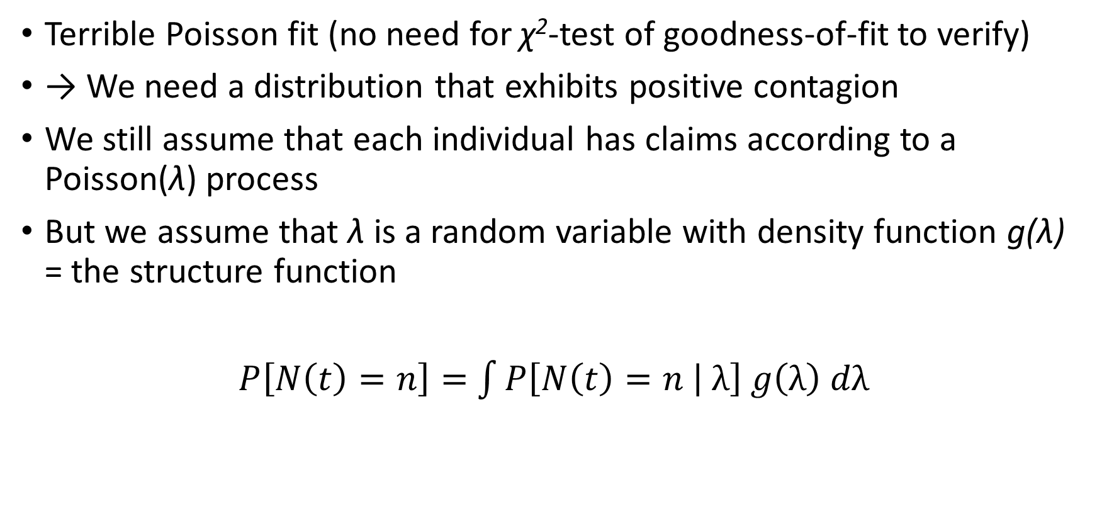
Mixed Poisson distributions
Terrible Poisson fit (no need for χ²-test of goodness-of-fit to verify)
→ We need a distribution that exhibits positive contagion
We still assume that each individual has claims according to a Poisson(λ) process
But we assume that λ is a random variable with density function g(λ) = the structure function
$P\left[N\left(t\right)=n\right]=$ $\int{P\left[N\left(t\right)=n | λ\right] g\left(λ\right) dλ}$

Slide 9
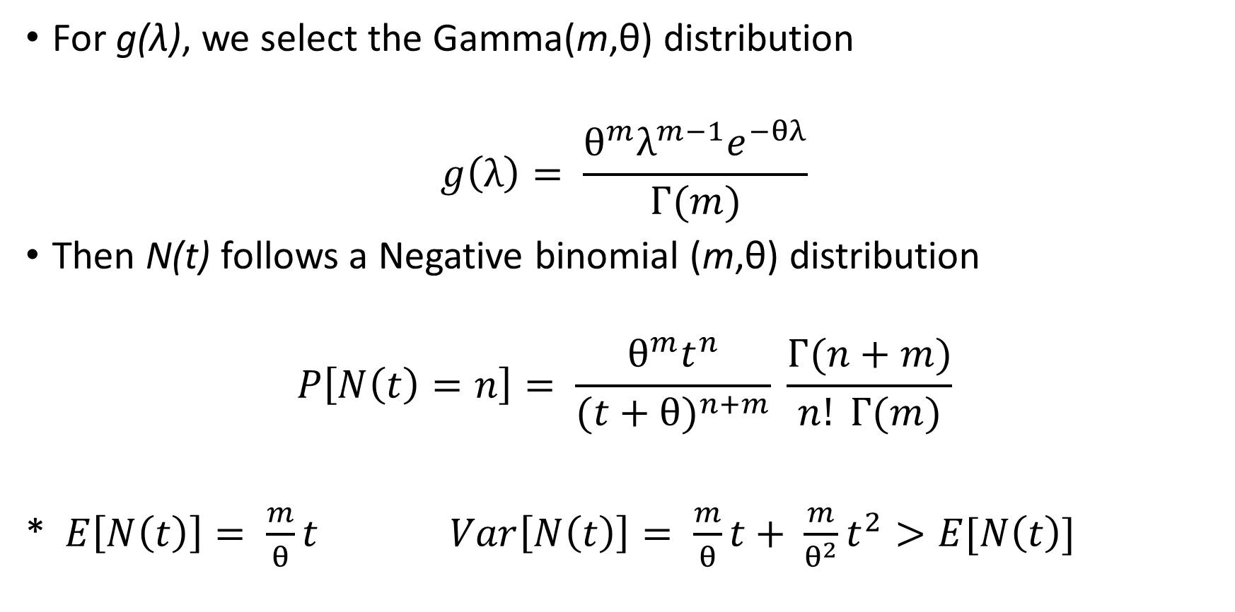
Negative binomial distribution
For g(λ), we select the Gamma(m,θ) distribution
$$g\left(λ\right)= \frac{θ^{m}λ^{m−1}e^{−θλ}}{Г(m)}$$
Then N(t) follows a Negative binomial (m,θ) distribution
$$P\left[N\left(t\right)=n\right]= \frac{θ^{m}t^{n}}{{(t+θ)}^{n+m}} \frac{Г(n+m)}{n! Г(m)}$$
* $E\left[N\left(t\right)\right]= \frac{m}{θ}t$ $Var\left[N\left(t\right)\right]= \frac{m}{θ}t+ \frac{m}{θ^{2}}t^{2}>E[N\left(t\right)]$

Slide 10

How to best calculate NB probabilities when t=1?
Recursively:
$$P\left[N=0\right]= \frac{θ^{m}}{{(1+θ)}^{m}}$$
$$P\left[N=n+1\right]= \frac{n+m}{(n+1)(1+θ)} P[N=n]$$

Slide 11

How to estimate parameters? Moments method
$\overline{x}$ = 0.1011 = $E\left[N\right]= \frac{m}{θ}$
$s^{2}$ = 0.1074 =$Var\left[N\right]= \frac{m}{θ}+ \frac{m}{θ^{2}}$
→ $\hat{m}=1.6049$ and $\hat{θ}=$15.8778

Slide 12
Contagious model: Negative Binomial fit
Number of claims
Observed policies
Poisson fit
Negative Binomial
fit
0
96,978
96,689.6
96,985.5
1
9,240
9,773.5
9,222.5
2
704
493.9
711.7
3
43
16.6
50.7
4
9
0.4
3.6
5+
0
0
0
Total
106,974
106,974
106,974

Slide 13
Example 1: Deaths by horse kicks in the ten corps of the Prussian Army, 1875-1894
N | Observed | Poisson | Neg Bin
0 | 109 | 108.67 | 111.99
1 | 65 | 66.29 | 61.80
2 | 22 | 20.22 | 20.00
3 | 3 | 4.11 | 4.95
4 | 1 | 0.72 | 1.04
5+ | 0 | 0.00 | 0.22
Total – Chi-Square | 200 | 0.33 | 1.24

Slide 14
Example 2: Number of major international wars, 1500-1931
n | Observed | Poisson | Neg Bin
0 | 223 | 216.22 | 222.71
1 | 142 | 149.65 | 141.35
2 | 48 | 51.79 | 50.72
3 | 15 | 11.95 | 13.54
4 | 4 | 2.07 | 2.99
5+ | 0 | 0.32 | 0.69
Total – Chi-square | 432 | 2.74 | 0.34

Slide 15
Example 3: Number of runs per half-innings, Baseball World Series, 1947-1960
n | Observed | Poisson | Neg Bin
0 | 1,023 | 865.66 | 1,017.94
1 | 222 | 417.37 | 227.27
2 | 87 | 100.63 | 86.38
3 | 32 | 16.17 | 37.35
4 | 18 | 1.95 | 17.13
5 | 11 | 0.19 | 8.12
6 | 6 | 0.01 | 3.94
7+ | 3 | 0.00 | 3.89
Total – Chi-square | 1,402 | 735.20 | 2.16

Slide 16
Example 4: Number of goals per team, English first division football, 1967-68
n | Observed | Poisson | Neg Bin
0 | 225 | 203.73 | 225.71
1 | 293 | 308.02 | 297.05
2 | 224 | 232.85 | 214.71
3 | 114 | 117.35 | 112.73
4 | 41 | 44.36 | 48.04
5 | 15 | 13.41 | 17.62
6 | 9 | 3.38 | 5.77
7+ | 3 | 0.90 | 2.37
Total – Chi-square | 924 | 17.75 | 3.87

Slide 17
Example 5: Number of goals per team, National Ice Hockey League, 1966-67
n | Observed | Poisson | Neg Bin
0 | 29 | 21.36 | 27.32
1 | 71 | 63.63 | 68.66
2 | 82 | 94.77 | 91.63
3 | 89 | 94.09 | 86.31
4 | 65 | 70.06 | 64.34
5 | 45 | 41.74 | 40.38
6 | 24 | 20.72 | 22.17
7 | 7 | 8.82 | 10.93
8 | 4 | 3.28 | 4.92
9 | 1 | 1.09 | 2.06
10+ | 3 | 0.44 | 1.28
Total – Chi-square | 420 | 9.21 | 3.38

Slide 18
Example 6: Number of dental cavities in twelve-year old children
n | Observed | Poisson | Neg Bin
0 | 63 | 13.02 | 52.56
1 | 29 | 32.90 | 31.55
2 | 12 | 41.58 | 21.50
3 | 15 | 35.03 | 15.23
4 | 8 | 22.14 | 11.00
5 | 9 | 11.19 | 8.03
6 | 5 | 4.71 | 5.90
7 | 4 | 1.70 | 4.37
8 | 6 | 0.54 | 3.24
9 | 2 | 0.15 | 2.41
10 | 3 | 0.04 | 1.80
11 | 3 | 0.00 | 1.35
12 | 2 | 0.00 | 1.01
13+ | 2 | 0.00 | 3.05
Total – Chi-square | 163 | 391.90 | 9.38

Slide 19
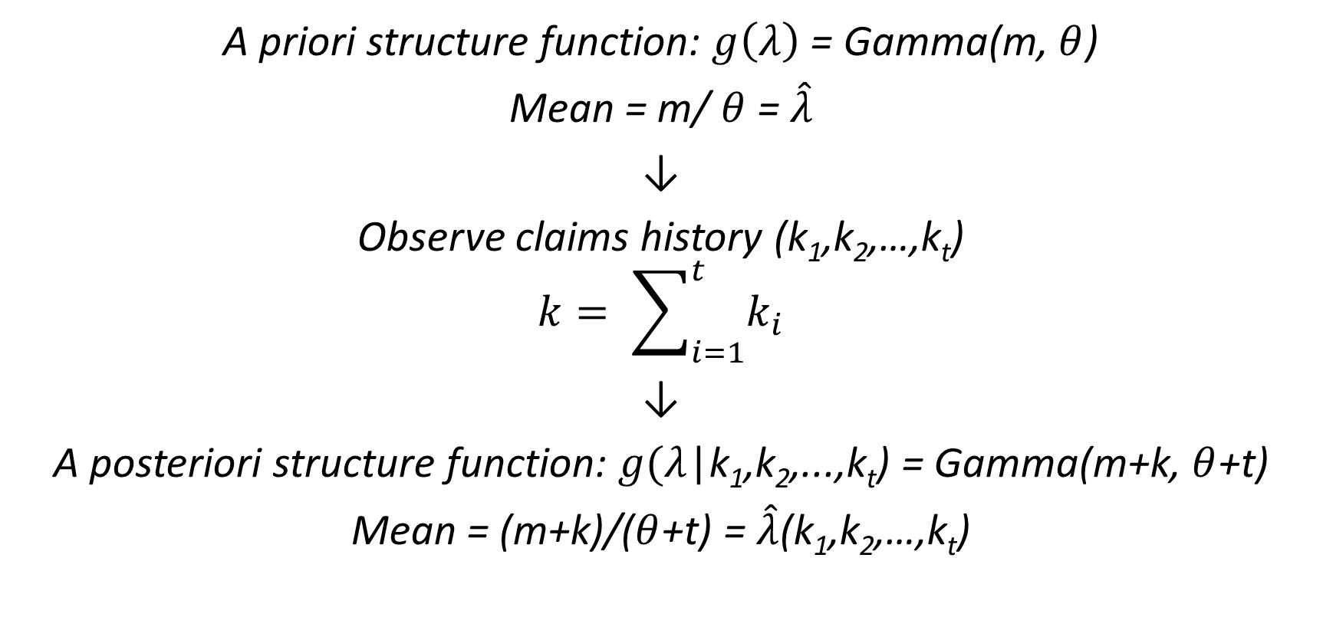
The Gamma, when combined with Poisson, is stable a posteriori
A priori structure function: $g\left(λ\right)$ = Gamma(m, $θ$)
Mean = m/ $θ$ = $\hat{λ}$
↓
Observe claims history (k₁,k₂,…,k_{t})
$$k= \sum_{i=1}^{t}{k_{i}}$$
↓
A posteriori structure function: $g(λ$|k₁,k₂,...,k_{t}) = Gamma(m+k, $θ$+t)
Mean = (m+k)/($θ$+t) = $\hat{λ}$(k₁,k₂,…,k_{t})

Slide 20
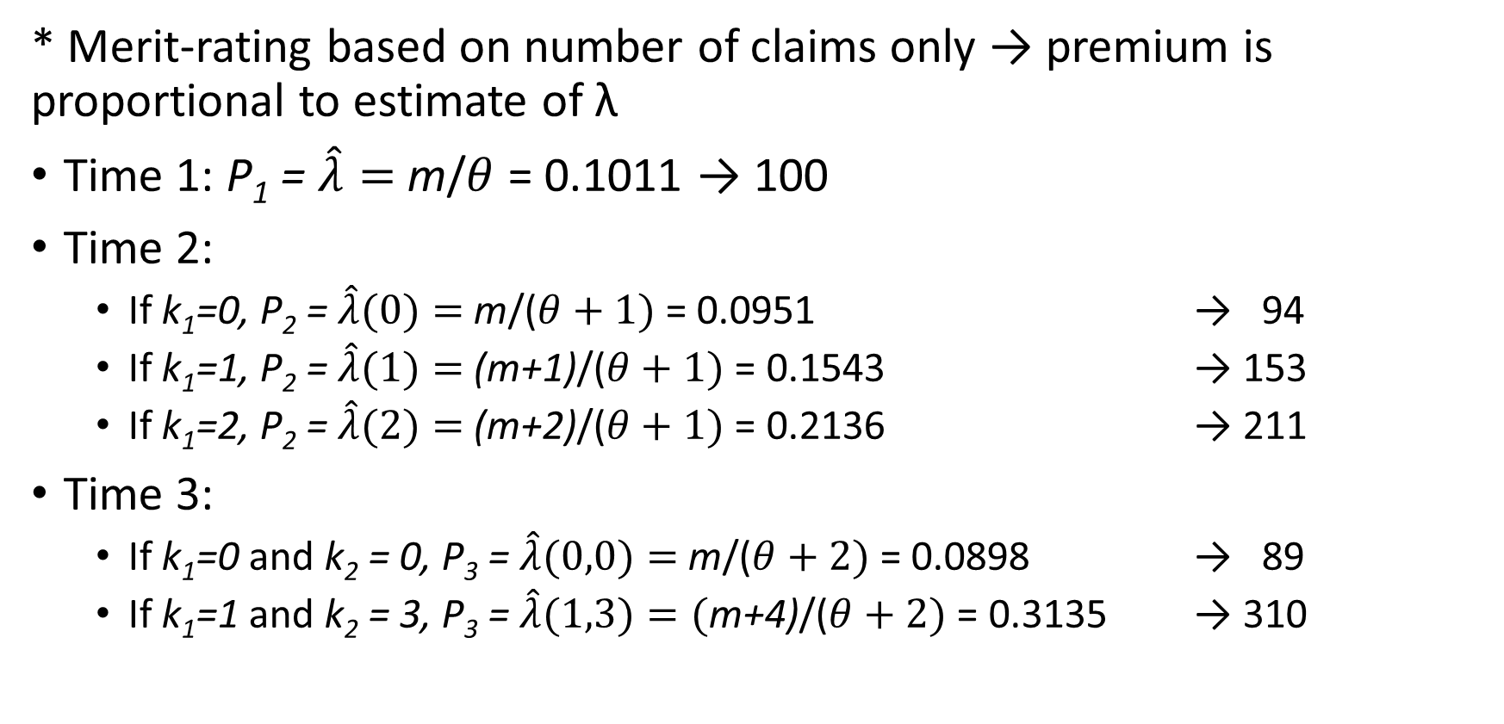

Optimal BMS: Premium = (m+k)/($θ$+t)
* Merit-rating based on number of claims only → premium is proportional to estimate of λ
Time 1: P₁ = $\hat{λ}=$m/$θ$ = 0.1011 → 100
Time 2:
  If k₁=0, P₂ = $\hat{λ}(0)=$m/($θ+1)$ = 0.0951 → 94
  If k₁=1, P₂ = $\hat{λ}(1)=$(m+1)/($θ+1)$ = 0.1543 → 153
  If k₁=2, P₂ = $\hat{λ}(2)=$(m+2)/($θ+1)$ = 0.2136 → 211
Time 3:
  If k₁=0 and k₂ = 0, P₃ = $\hat{λ}(0,0)=$m/($θ+2)$ = 0.0898 → 89
  If k₁=1 and k₂ = 3, P₃ = $\hat{λ}(1,3)=($m+4)/($θ+2)$ = 0.3135 → 310

Slide 21
Optimal BMS with Negative Binomial model
Year | Claims
 | 0 | 1 | 2 | 3 | 4
0 | 100
1 | 94 | 153 | 211 | 269 | 329
2 | 89 | 144 | 199 | 255 | 310
3 | 84 | 137 | 189 | 241 | 294
4 | 80 | 130 | 179 | 229 | 279
5 | 76 | 123 | 171 | 218 | 266
6 | 73 | 118 | 163 | 208 | 253
7 | 69 | 113 | 156 | 199 | 242

Slide 22
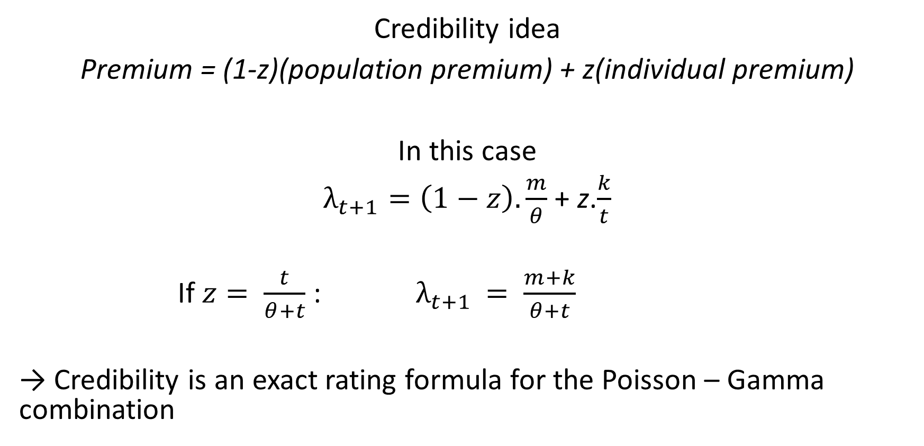
Link with credibility theory
Credibility idea
Premium = (1-z)(population premium) + z(individual premium)
In this case
$λ_{t+1}=\left(1−z\right).\frac{m}{θ}$ + z.$\frac{k}{t}$
If $z= \frac{t}{θ+t}$ : $λ_{t+1 }= \frac{m+k}{θ+t}$
→ Credibility is an exact rating formula for the Poisson – Gamma combination

Slide 23
This “optimal BMS” is
Fair (as it results from the application of Bayes theorem)
Financially balanced (the average income of the insurer stays at 100, year after year)
BUT
It is not acceptable to regulators and managers, as the harsh penalties
  Encourage uninsured driving
  Suggest hit-and-run behavior
  Induce policyholders to leave the company after one accident
  → In practice, another approach, based on Markov Chains, is used

Slide 24
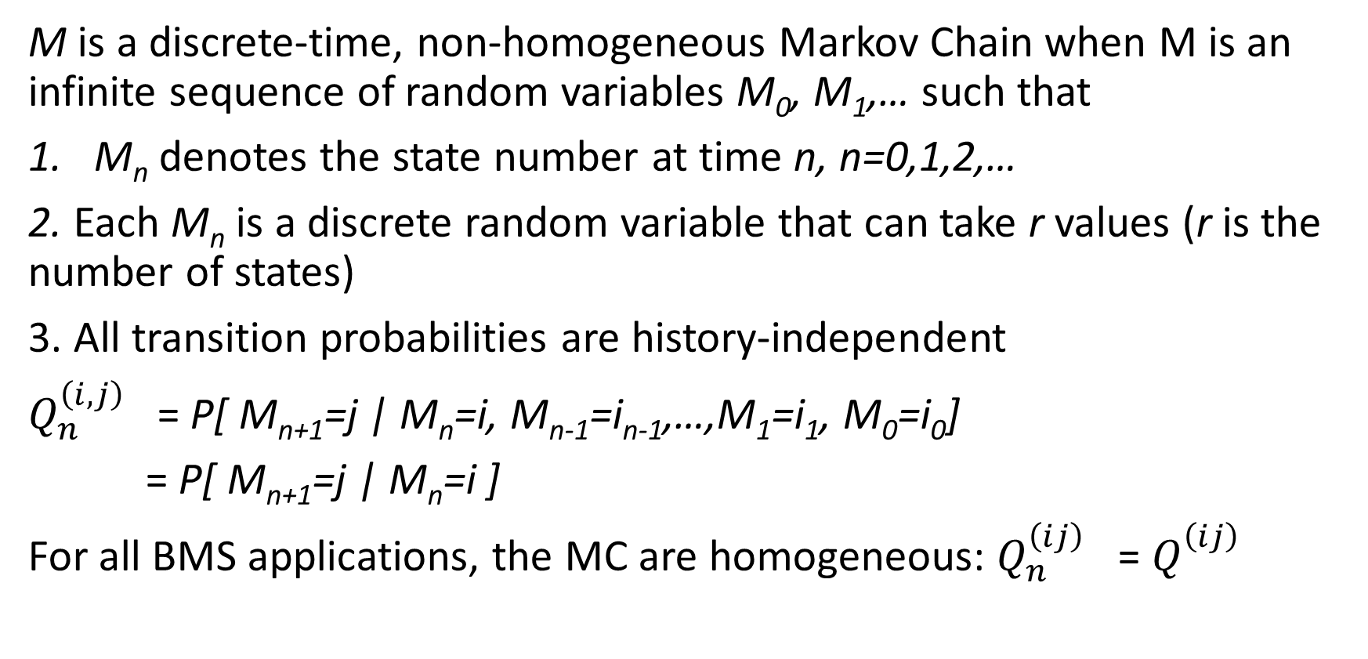
BMS as they are: definition of Markov Chain (MC)
M is a discrete-time, non-homogeneous Markov Chain when M is an infinite sequence of random variables M₀, M₁,… such that
M_{n} denotes the state number at time n, n=0,1,2,…
2. Each M_{n} is a discrete random variable that can take r values (r is the number of states)
3. All transition probabilities are history-independent
$Q_{n}^{\left(i,j\right)}$ = P[ M_{n+1}=j | M_{n}=i, M_{n-1}=i_{n-1},…,M₁=i₁, M₀=i₀]
= P[ M_{n+1}=j | M_{n}=i ]
For all BMS applications, the MC are homogeneous: $Q_{n}^{\left(ij\right)}$ = $Q_{}^{\left(ij\right)}$

Slide 25
Malaysian BMS
Class | Premium level | Class after
 |  | 0 claim | 1+ claim
6 | 100 | 5 | 6
5 | 75 | 4 | 6
4 | 70 | 3 | 6
3 | 62 | 2 | 6
2 | 55 | 1 | 6
1 | 45 | 1 | 6

Slide 26
p = P(0 claim) q = P(1 or more claim)
Class | 6 | 5 | 4 | 3 | 2 | 1
6 | q | p | 0 | 0 | 0 | 0
5 | q | 0 | p | 0 | 0 | 0
4 | q | 0 | 0 | p | 0 | 0
3 | q | 0 | 0 | 0 | p | 0
2 | q | 0 | 0 | 0 | 0 | p
1 | q | 0 | 0 | 0 | 0 | p

Slide 27
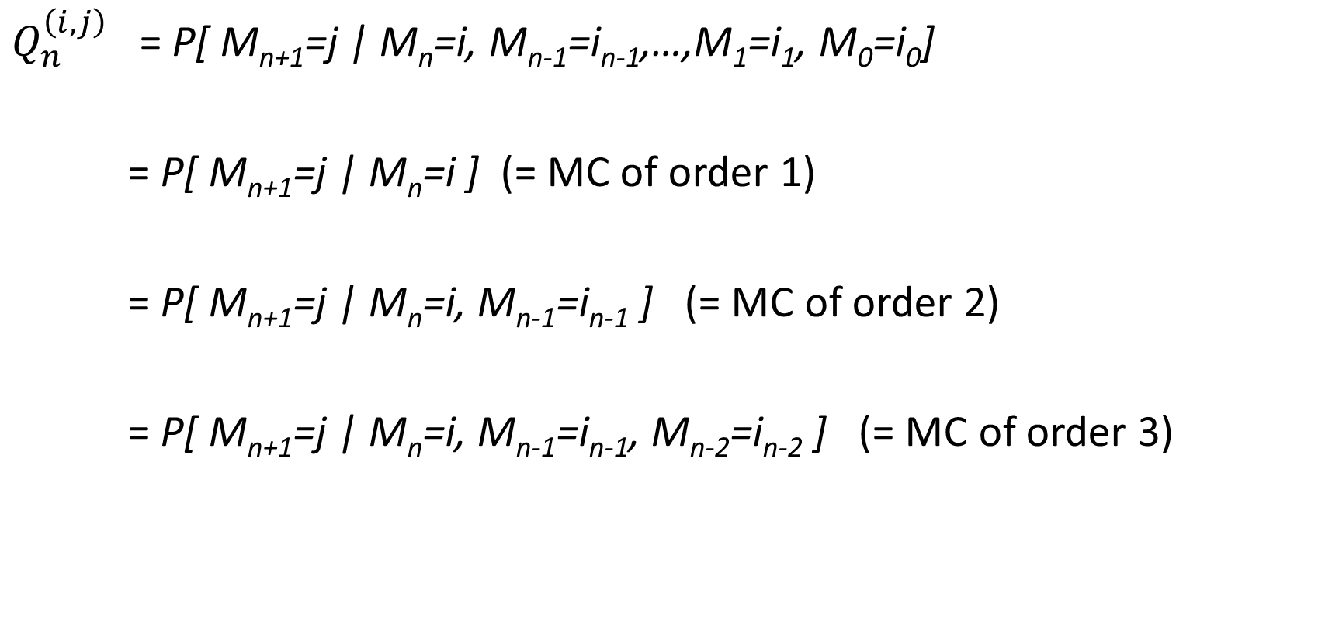
MC of higher order
$Q_{n}^{\left(i,j\right)}$ = P[ M_{n+1}=j | M_{n}=i, M_{n-1}=i_{n-1},…,M₁=i₁, M₀=i₀]
= P[ M_{n+1}=j | M_{n}=i ] (= MC of order 1)
= P[ M_{n+1}=j | M_{n}=i, M_{n-1}=i_{n-1} ] (= MC of order 2)
= P[ M_{n+1}=j | M_{n}=i, M_{n-1}=i_{n-1}, M_{n-2}=i_{n-2} ] (= MC of order 3)

Slide 28
Old Belgian BMS
18 classes
Premium levels: 200, 160, 140, 130, 120, 115, 110, 105, 100,
100, 95, 90, 85, 80, 75, 70, 65, 60
Starting class: 100 for business users, 85 for commuters
One bonus class per claim-free year
Two penalty classes for the first claim
Three penalty classes for any other claim in the same year
BUT special rule: nobody can pay more than 100 after four consecutive claim-free years
→ This is a Markov Chain of order four

Slide 29
Transforming a MC of order 4 into a MC of order 1
Class
Class after x accidents
0
1
2
18
17.1
18
18
17.0
16.1
18
18
17.1
16.2
18
18
16.0
15.1
18
18
16.1
15.2
18
18
16.2
15.3
18
18
15.0
14.1
17.0
18
15.1
14.2
17.0
18
15.2
14.3
17.0
18
15.3
10
17.0
18
etc
…

Slide 30
Japanese BMS
Class | Premium | Class after x claims
 |  | 0 | 1 | 2 | 3 | 4 | 5
16 | 150 | 15 | 16 | 16 | 16 | 16 | 16
15 | 140 | 14 | 16 | 16 | 16 | 16 | 16
14 | 130 | 13 | 16 | 16 | 16 | 16 | 16
13 | 120 | 12 | 16 | 16 | 16 | 16 | 16
12 | 110 | 11 | 15 | 16 | 16 | 16 | 16
11 | 100 | 10 | 14 | 16 | 16 | 16 | 16
10 | 90 | 9 | 13 | 16 | 16 | 16 | 16
9 | 80 | 8 | 12 | 15 | 16 | 16 | 16
8 | 70 | 7 | 11 | 14 | 16 | 16 | 16
7 | 60 | 6 | 10 | 13 | 16 | 16 | 16
6 | 50 | 5 | 9 | 12 | 15 | 16 | 16
5 | 45 | 4 | 8 | 11 | 14 | 16 | 16
4 | 42 | 3 | 7 | 10 | 13 | 16 | 16
3 | 40 | 2 | 6 | 9 | 12 | 15 | 16
2 | 40 | 1 | 5 | 8 | 11 | 14 | 16
1 | 40 | 1 | 4 | 7 | 10 | 13 | 16

Slide 31
Japanese BMS transition matrix
 | 16 | 15 | 14 | 13 | 12 | 11 | 10 | 9 | 8 | 7 | 6 | 5 | 4 | 3 | 2 | 1
16 | 1-p₀ | p₀ | 0 | 0 | 0 | 0 | 0 | 0 | 0 | 0 | 0 | 0 | 0 | 0 | 0 | 0
15 | 1-p₀ | 0 | p₀ | 0 | 0 | 0 | 0 | 0 | 0 | 0 | 0 | 0 | 0 | 0 | 0 | 0
14 | 1-p₀ | 0 | 0 | p₀ | 0 | 0 | 0 | 0 | 0 | 0 | 0 | 0 | 0 | 0 | 0 | 0
13 | 1-p₀ | 0 | 0 | 0 | p₀ | 0 | 0 | 0 | 0 | 0 | 0 | 0 | 0 | 0 | 0 | 0
12 | 1-p₀-p₁ | p₁ | 0 | 0 | 0 | p₀ | 0 | 0 | 0 | 0 | 0 | 0 | 0 | 0 | 0 | 0
11 | 1-p₀-p₁ | 0 | p₁ | 0 | 0 | 0 | p₀ | 0 | 0 | 0 | 0 | 0 | 0 | 0 | 0 | 0
10 | 1-p₀-p₁ | 0 | 0 | p₁ | 0 | 0 | 0 | p₀ | 0 | 0 | 0 | 0 | 0 | 0 | 0 | 0
9 | 1-p₀-p₁-p₂ | p₂ | 0 | 0 | p₁ | 0 | 0 | 0 | p₀ | 0 | 0 | 0 | 0 | 0 | 0 | 0
8 | 1-p₀-p₁-p₂ | 0 | p₂ | 0 | 0 | p₁ | 0 | 0 | 0 | P₀ | 0 | 0 | 0 | 0 | 0 | 0
7 | 1-p₀-p₁-p₂ | 0 | 0 | p₂ | 0 | 0 | p₁ | 0 | 0 | 0 | p₀ | 0 | 0 | 0 | 0 | 0
6 | 1-p₀-p₁-p₂-p₃ | p₃ | 0 | 0 | p₂ | 0 | 0 | p₁ | 0 | 0 | 0 | p₀ | 0 | 0 | 0 | 0
5 | 1-p₀-p₁-p₂-p₃ | 0 | p₃ | 0 | 0 | p₂ | 0 | 0 | P₁ | 0 | 0 | 0 | p₀ | 0 | 0 | 0
4 | 1-p₀-p₁-p₂-p₃ | 0 | 0 | p₃ | 0 | 0 | p₂ | 0 | 0 | p₁ | 0 | 0 | 0 | p₀ | 0 | 0
3 | 1-p₀-p₁-p₂-p₃-p₄ | p₄ | 0 | 0 | p₃ | 0 | 0 | p₂ | 0 | 0 | p₁ | 0 | 0 | 0 | p₀ | 0
2 | 1-p₀-p₁-p₂-p₃-p₄ | 0 | p₄ | 0 | 0 | p₃ | 0 | 0 | P₂ | 0 | 0 | p₁ | 0 | 0 | 0 | p₀
1 | 1-p₀-p₁-p₂-p₃-p₄ | 0 | 0 | p₄ | 0 | 0 | p₃ | 0 | 0 | p₂ | 0 | 0 | p₁ | 0 | 0 | p₀

Slide 32
Japanese BMS transition matrix
 | 16 | 15 | 14 | 13 | 12 | 11 | 10 | 9 | 8 | 7 | 6 | 5 | 4 | 3 | 2 | 1
16 | .0952 | .9048 | 0 | 0 | 0 | 0 | 0 | 0 | 0 | 0 | 0 | 0 | 0 | 0 | 0 | 0
15 | .0952 | 0 | .9048 | 0 | 0 | 0 | 0 | 0 | 0 | 0 | 0 | 0 | 0 | 0 | 0 | 0
14 | .0952 | 0 | 0 | .9048 | 0 | 0 | 0 | 0 | 0 | 0 | 0 | 0 | 0 | 0 | 0 | 0
13 | .0952 | 0 | 0 | 0 | .9048 | 0 | 0 | 0 | 0 | 0 | 0 | 0 | 0 | 0 | 0 | 0
12 | .0047 | .0905 | 0 | 0 | 0 | .9048 | 0 | 0 | 0 | 0 | 0 | 0 | 0 | 0 | 0 | 0
11 | .0047 | 0 | .0905 | 0 | 0 | 0 | .9048 | 0 | 0 | 0 | 0 | 0 | 0 | 0 | 0 | 0
10 | .0047 | 0 | 0 | .0905 | 0 | 0 | 0 | .9048 | 0 | 0 | 0 | 0 | 0 | 0 | 0 | 0
9 | .0002 | .0045 | 0 | 0 | .0905 |  | 0 | 0 | .9048 | 0 | 0 | 0 | 0 | 0 | 0 | 0
8 | .0002 | 0 | .0045 | 0 | 0 | .0905 |  | 0 | 0 | .9048 | 0 | 0 | 0 | 0 | 0 | 0
7 | .0002 | 0 | 0 | .0045 | 0 | 0 | .0905 | 0 | 0 | 0 | .9048 | 0 | 0 | 0 | 0 | 0
6 | 0 | .0002 | 0 | 0 | .0045 | 0 | 0 | .0905 | 0 | 0 | 0 | .9048 | 0 | 0 | 0 | 0
5 | 0 | 0 | .0002 | 0 | 0 | .0045 | 0 | 0 | .0905 | 0 | 0 | 0 | .9048 | 0 | 0 | 0
4 | 0 | 0 | 0 | .0002 | 0 | 0 | .0045 | 0 | 0 | .0905 | 0 | 0 | 0 | .9048 | 0 | 0
3 | 0 | 0 | 0 | 0 | .0002 | 0 | 0 | .0045 | 0 | 0 | .0905 | 0 | 0 | 0 | .9048 | 0
2 | 0 | 0 | 0 | 0 | 0 | .0002 | 0 | 0 | .0045 | 0 | 0 | .0905 | 0 | 0 | 0 | .9048
1 | 0 | 0 | 0 | 0 | 0 | 0 | .0002 | 0 | 0 | .0045 | 0 | 0 | .0905 | 0 | 0 | .9048

Slide 33
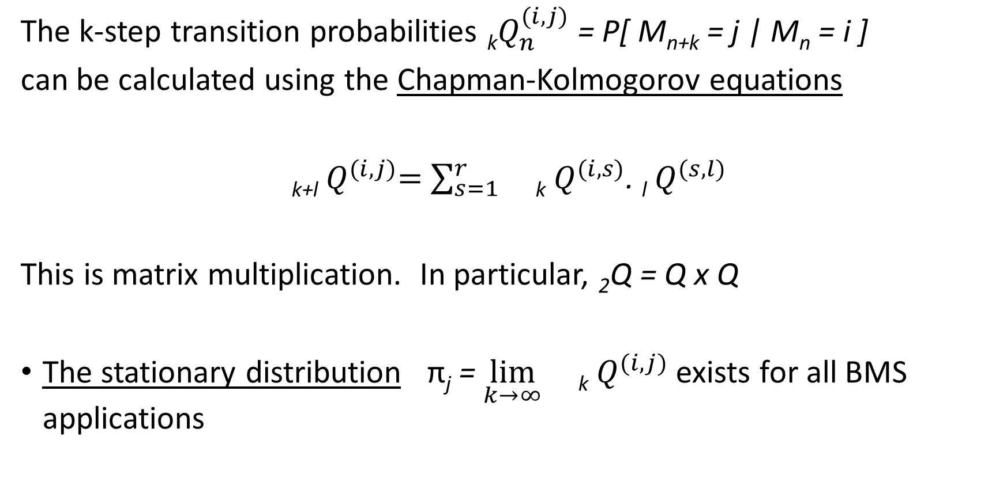
The k-step transition matrix
The k-step transition probabilities _{k}$Q_{n}^{(i,j)}$ = P[ M_{n+k} = j | M_{n} = i ]
can be calculated using the Chapman-Kolmogorov equations
_{k+l}${ Q}^{(i,j)}=$ $\sum_{s=1}^{r}{}$_{k} $Q^{(i,s)}$. _{l} $Q^{(s,l)}$
This is matrix multiplication. In particular, ₂Q = Q x Q
The stationary distribution π_{j} = $\lim_{k→∞}{}$_{k} $Q^{(i,j)}$exists for all BMS applications

Slide 34
Japanese four-step transition matrix
 | 16 | 15 | 14 | 13 | 12 | 11 | 10 | 9 | 8 | 7 | 6 | 5 | 4 | 3 | 2 | 1
16 | .0952 | .0861 | .0779 | .0705 | .6703 | 0 | 0 | 0 | 0 | 0 | 0 | 0 | 0 | 0 | 0 | 0
15 | .0281 | .1531 | .0779 | .0705 | 0 | .6703 | 0 | 0 | 0 | 0 | 0 | 0 | 0 | 0 | 0 | 0
14 | .0281 | .0191 | .2120 | .0705 | 0 | 0 | .6703 | 0 | 0 | 0 | 0 | 0 | 0 | 0 | 0 | 0
13 | .0281 | .0191 | .0109 | .2716 | 0 | 0 | 0 | .6703 | 0 | 0 | 0 | 0 | 0 | 0 | 0 | 0
12 | .0248 | .0224 | .0109 | .0035 | .2681 | 0 | 0 | 0 | .6703 | 0 | 0 | 0 | 0 | 0 | 0 | 0
11 | .0047 | .0358 | .0176 | .0035 | 0 | .2681 | 0 | 0 | 0 | .6703 | 0 | 0 | 0 | 0 | 0 | 0
10 | .0047 | .0023 | .0410 | .0135 | 0 | 0 | .2681 | 0 | 0 | 0 | .6703 | 0 | 0 | 0 | 0 | 0
9 | .0046 | .0024 | .0008 | .0403 | .0134 | 0 | 0 | .2681 | 0 | 0 | 0 | .6703 | 0 | 0 | 0 | 0
8 | .0025 | .0042 | .0010 | .0001 | .0402 | .0134 | 0 | 0 | .2681 | 0 | 0 | 0 | .6703 | 0 | 0 | 0
7 | .0005 | .0029 | .0041 | .0004 | 0 | .0402 | .0134 | 0 | 0 | .2681 | 0 | 0 | 0 | .6703 | 0 | 0
6 | .0005 | .0002 | .0027 | .0040 | .0004 | 0 | .0402 | .0134 | 0 | 0 | .2681 | 0 | 0 | 0 | .6703 | 0
5 | .0004 | .0003 | 0 | .0027 | .0040 | .0004 | 0 | .0402 | .0134 | 0 | 0 | .2681 | 0 | 0 | 0 | .6703
4 | .0001 | .0004 | .0002 | 0 | .0027 | .0040 | .0004 | 0 | .0402 | .0134 | 0 | 0 | .2681 | 0 | 0 | .6703
3 | 0 | 0 | .0004 | .0002 | 0 | .0027 | .0041 | .0003 | 0 | .0436 | .0101 | 0 | .0670 | .2011 | 0 | .6703
2 | 0 | 0 | 0 | .0004 | .0002 | 0 | .0035 | .0035 | .0002 | .0101 | .0369 | .0067 | .0670 | .0670 | .1341 | .6703
1 | 0 | 0 | 0 | .0002 | .0004 | .0001 | .0015 | .0035 | .0102 | .0102 | .0168 | .0235 | .0704 | .0670 | .0670 | .

Slide 35
Japanese 16-step transition matrix
 | 16 | 15 | 14 | 13 | 12 | 11 | 10 | 9 | 8 | 7 | 6 | 5 | 4 | 3 | 2 | 1
16 | .0071 | .0108 | .0115 | .0128 | .0508 | .0328 | .0265 | .0272 | .1594 | .0465 | .0362 | .0348 | .2709 | .0259 | .0235 | .2231
15 | .0043 | .0112 | .0137 | .0131 | .0104 | .0635 | .0360 | .0274 | .0140 | .1827 | .0452 | .0348 | .0287 | .2682 | .0235 | .2231
14 | .0043 | .0044 | .0164 | .0169 | .0108 | .0085 | .0791 | .0390 | .0143 | .0131 | .2058 | .0439 | .0287 | .0259 | .2657 | .2231
13 | .0042 | .0045 | .0041 | .0231 | .0164 | .0090 | .0073 | .0970 | .0280 | .0133 | .0119 | .2287 | .0377 | .0259 | .0235 | .4654
12 | .0032 | .0052 | .0043 | .0035 | .0275 | .0169 | .0078 | .0057 | .1032 | .0292 | .0121 | .0106 | .2467 | .0350 | .0235 | .4654
11 | .0015 | .0048 | .0060 | .0039 | .0029 | .0313 | .0174 | .0064 | .0047 | .1117 | .0280 | .0108 | .0529 | .2198 | .0326 | .4654
10 | .0015 | .0014 | .0063 | .0065 | .0034 | .0024 | .0348 | .0173 | .0054 | .0107 | .1129 | .0267 | .0531 | .0502 | .1931 | .4745
9 | .0014 | .0015 | .0012 | .0074 | .0069 | .0030 | .0029 | .0365 | .0173 | .0115 | .0144 | .1091 | .0689 | .0504 | .0477 | .6199
8 | .0009 | .0017 | .0014 | .0011 | .0084 | .0072 | .0037 | .0039 | .0372 | .0235 | .0150 | .0179 | .1463 | .0641 | .049 | .6199
7 | .0005 | .0013 | .0019 | .0014 | .0012 | .0090 | .0082 | .0047 | .0054 | .0437 | .0260 | .0185 | .0744 | .1242 | .0595 | .6201
6 | .0005 | .0005 | .0016 | .0022 | .0016 | .0016 | .0103 | .0092 | .0061 | .0148 | .0448 | .0282 | .0750 | .0692 | .1047 | .6297
5 | .0004 | .0005 | .0005 | .0019 | .0026 | .0020 | .0032 | .0115 | .0103 | .0154 | .0202 | .0443 | .0830 | .0697 | .0644 | .6701
4 | .0003 | .0005 | .0006 | .0008 | .0023 | .0029 | .0036 | .0051 | .0125 | .0191 | .0207 | .0248 | .0964 | .0755 | .0647 | .6701
3 | .0002 | .0004 | .0007 | .0009 | .0013 | .0028 | .0044 | .0054 | .0074 | .0210 | .0234 | .0252 | .0841 | .0837 | .0686 | .6704
2 | .0002 | .0003 | .0006 | .0010 | .0014 | .0020 | .0044 | .0061 | .0076 | .0176 | .0249 | .0269 | .0843 | .0769 | .0730 | .6728
1 | .0002 | .0003 | .0005 | .0009 | .0014 | .0020 | .0039 | .0061 | .0079 | .0177 | .0232 | .0276 | .0852 | .0770 | .0702 | .6757

Slide 36
Japanese 128-step transition matrix
 | 16 | 15 | 14 | 13 | 12 | 11 | 10 | 9 | 8 | 7 | 6 | 5 | 4 | 3 | 2 | 1
16 | .0003 | .0005 | .0007 | .0011 | .0017 | .0025 | .0045 | .0066 | .0088 | .0188 | .0240 | .0281 | .0860 | .0778 | .0703 | .6683
15 | .0003 | .0005 | .0007 | .0011 | .0017 | .0025 | .0045 | .0066 | .0088 | .0188 | .0240 | .0281 | .0859 | .0778 | .0704 | .6684
14 | .0003 | .0005 | .0007 | .0011 | .0017 | .0025 | .0045 | .0066 | .0088 | .0188 | .0240 | .0281 | .0859 | .0777 | .0704 | .6685
13 | .0003 | .0005 | .0007 | .0011 | .0017 | .0025 | .0045 | .0066 | .0088 | .0188 | .0240 | .0281 | .0859 | .0777 | .0703 | .6686
12 | .0003 | .0005 | .0007 | .0011 | .0017 | .0025 | .0045 | .0065 | .0088 | .0188 | .0240 | .0281 | .0859 | .0777 | .0703 | .6686
11 | .0003 | .0004 | .0007 | .0011 | .0017 | .0025 | .0045 | .0065 | .0088 | .0188 | .0240 | .0281 | .0859 | .0777 | .0703 | .6686
10 | .0003 | .0004 | .0007 | .0011 | .0017 | .0025 | .0045 | .0065 | .0088 | .0187 | .0240 | .0281 | .0859 | .0777 | .0703 | .6687
9 | .0003 | .0004 | .0007 | .0011 | .0017 | .0025 | .0045 | .0065 | .0088 | .0187 | .0240 | .0281 | .0859 | .0777 | .0703 | .6687
8 | .0003 | .0004 | .0007 | .0011 | .0017 | .0025 | .0045 | .0065 | .0088 | .0187 | .0240 | .0281 | .0859 | .0777 | .0703 | .6687
7 | .0003 | .0004 | .0007 | .0011 | .0017 | .0025 | .0045 | .0065 | .0088 | .0187 | .0240 | .0281 | .0859 | .0777 | .0703 | .6687
6 | .0003 | .0004 | .0007 | .0011 | .0017 | .0025 | .0045 | .0065 | .0088 | .0187 | .0240 | .0281 | .0859 | .0777 | .0703 | .6688
5 | .0003 | .0004 | .0007 | .0011 | .0017 | .0025 | .0045 | .0065 | .0088 | .0187 | .0240 | .0281 | .0859 | .0777 | .0703 | .6688
4 | .0003 | .0004 | .0007 | .0011 | .0017 | .0025 | .0045 | .0065 | .0088 | .0187 | .0240 | .0281 | .0859 | .0777 | .0703 | .6688
3 | .0003 | .0004 | .0007 | .0011 | .0017 | .0025 | .0045 | .0065 | .0088 | .0187 | .0240 | .0281 | .0859 | .0777 | .0703 | .6688
2 | .0003 | .0004 | .0007 | .0011 | .0017 | .0025 | .0045 | .0065 | .0088 | .0187 | .0240 | .0281 | .0859 | .0777 | .0703 | .6688
1 | .0003 | .0004 | .0007 | .0011 | .0017 | .0025 | .0045 | .0065 | .0088 | .0187 | .0240 | .0281 | .0859 | .0777 | .0703 | .6688

Slide 37

How to measure the rate of convergence?
Total variation: ${(TV)}_{n}= \sum{| }$_{n}$Q^{(i,j)}−$ $π_{j}|$
Years | Belgium | Japan | Taiwan | Switzerland
0 | 1.9913 | 1.9950 | 2.0000 | 1.9742
10 | 1.7769 | 1.1551 | 0.0000 | 1.0124
20 | 0.9120 | 0.3217 | 0.0000 | 0.3541
30 | 0.4209 | 0.0529 | 0.0000 | 0.1348
60 | 0.0382 | 0.0007 | 0.0000 | 0.0061

Slide 38
Major problem: financial imbalance
More than 81% of policyholders end up in classes 1, 2, or 3, and pay the minimum premium 40
Less than 0.5% of policyholders end up in the malus zone
Why? Penalties no severe enough
In a decade, on average, out of ten policyholders
  Nine have no claim → -9 classes
  One has a claim → +3 classes
  Total: - 6 classes
So the income of the insurer keeps decreasing
Very severe problem in Japan, but happens in all countries

Slide 39
Evolution of mean premium

Slide 40
INDEX OF TOUGHNESS
We want to
Compare existing BMS
Design new BMS
We will design an “Index of Toughness”
using 30 BMS in force around the world
by creating four tools to measure toughness

Slide 41
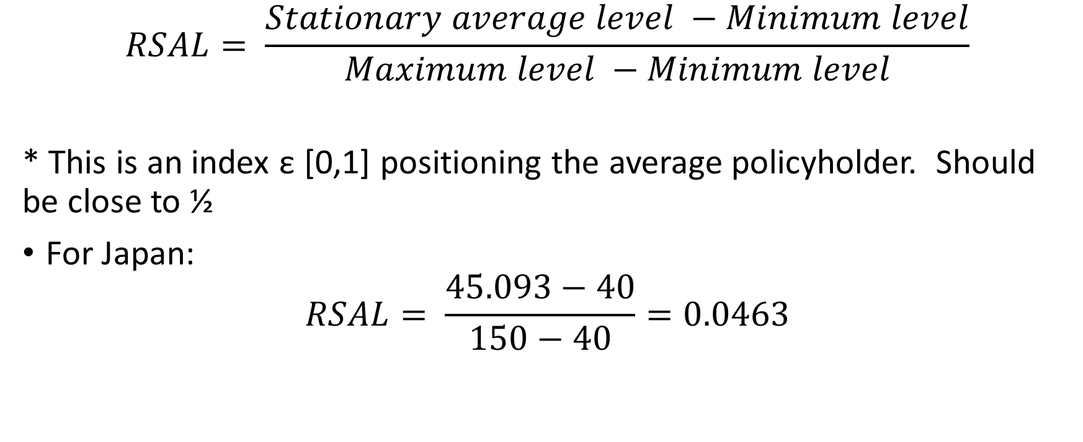
Tool #1: Relative Stationary Average Level (RSAL)
$$RSAL= \frac{Stationary average level −Minimum level}{Maximum level −Minimum level}$$
* This is an index ε [0,1] positioning the average policyholder. Should be close to ½
For Japan:
$$RSAL= \frac{45.093−40}{150−40}=0.0463$$

Slide 42
Tool # 1: Relative Stationary Average Level (%)
1 | Kenya | 28.79 |  | 16 | Germany (new) | 5.85
2 | Spain | 25.67 |  | 17 | Japan (new) | 4.63
3 | Malaysia | 21.17 |  | 18 | Belgium (new) | 4.05
4 | Finland (new) | 16.04 |  | 19 | Denmark | 3.78
5 | Sweden | 14.20 |  | 20 | Switzerland (old) | 2.90
6 | Netherlands | 11.78 |  | 21 | France | 2.12
7 | UK (protected) | 11.37 |  | 22 | Norway (new) | 2.11
8 | Taiwan | 9.55 |  | 23 | Brazil | 1.85
9 | Finland (old) | 8.46 |  | 24 | Korea | 1.37
10 | Hong Kong | 8.35 |  | 25 | Luxembourg (new) | 1.36
11 | Thailand | 8.03 |  | 26 | Italy (new) | 1.30
12 | UK (unprotected) | 7.07 |  | 27 | Luxembourg (old) | 1.01
13 | Portugal | 6.75 |  | 28 | Japan (old) | 0.88
14 | Norway (old) | 6.61 |  | 29 | Belgium (old) | 0.74
15 | Switzerland (new) | 6.47 |  | 30 | Italy (old) | 0.01

Slide 43
Surcharge for newcomers
Dividing the starting premium level (usually 100) by the stationary premium, we can measure the implicit surcharge paid by newcomers
The surcharge is more than 100% for 14 of the 30 BMS
with a maximum of 213% for Germany (new)
Since young drivers are usually penalized with a hefty explicit surcharge (sometimes +200% for young males), there is a risk of double-counting the same effect

Slide 44
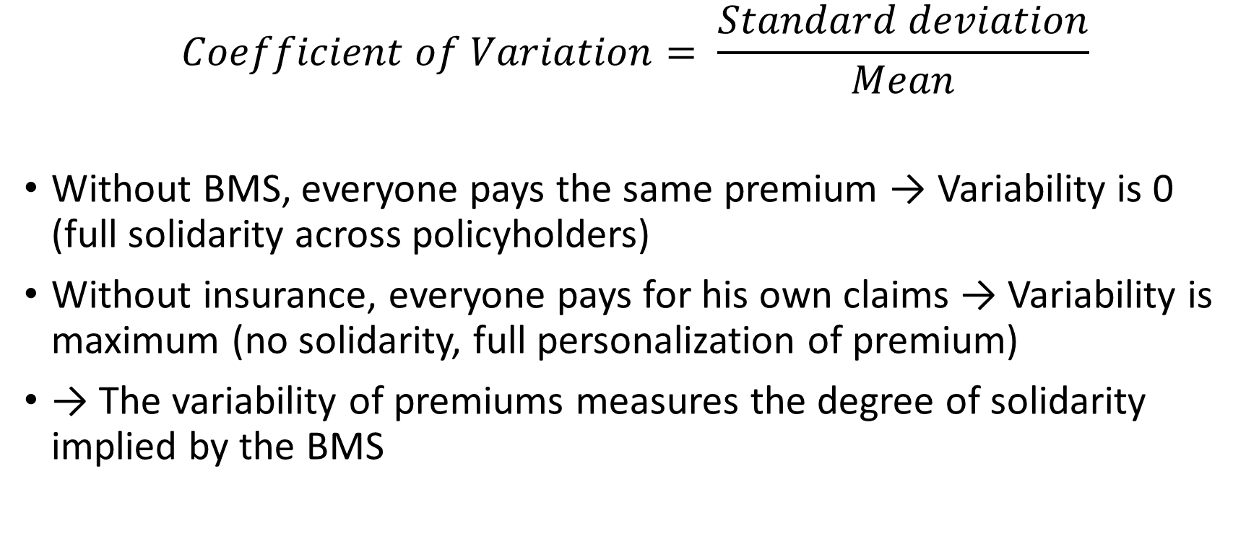
Tool #2: Premium variability (coef. of variation)
$$Coefficient of Variation= \frac{Standard deviation}{Mean}$$
Without BMS, everyone pays the same premium → Variability is 0 (full solidarity across policyholders)
Without insurance, everyone pays for his own claims → Variability is maximum (no solidarity, full personalization of premium)
→ The variability of premiums measures the degree of solidarity implied by the BMS

Slide 45
Variability of premiums with time

Slide 46
Variability of premiums with λ

Slide 47
Tool #2: Variability of payments (% of CV retained)
1 | Switzerland (new) | 7.18 |  | 16 | Luxembourg (new) | 3.35
2 | Norway (old) | 6.09 |  | 17 | Belgium (new) | 3.32
3 | Kenya | 5.99 |  | 18 | France | 3.20
4 | Finland (new) | 5.99 |  | 19 | Norway (new) | 3.20
5 | Sweden | 5.89 |  | 20 | Portugal | 3.06
6 | Netherlands | 5.50 |  | 21 | Thailand | 3.01
7 | Japan (new) | 5.13 |  | 22 | Spain | 2.40
8 | Taiwan | 4.94 |  | 23 | Korea | 1.99
9 | Malaysia | 4.80 |  | 24 | Japan (old) | 1.97
10 | Denmark | 4.71 |  | 25 | UK (protected) | 1.97
11 | Switzerland (old) | 4.21 |  | 26 | Luxembourg (old) | 1.68
12 | Finland (old) | 4.02 |  | 27 | Italy (new) | 1.46
13 | Germany (new) | 3.96 |  | 28 | Belgium (old) | 0.92
14 | Hong Kong | 3.93 |  | 29 | Brazil | 0.48
15 | UK (unprotected) | 3.78 |  | 30 | Italy (old) | 0.07

Slide 48
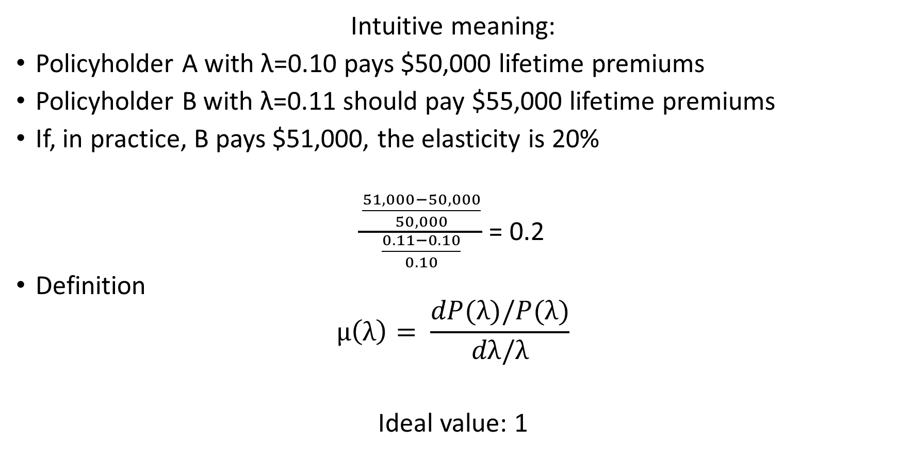
Tool #3: Elasticity of mean stationary premium with respect to claim frequency
Intuitive meaning:
Policyholder A with λ=0.10 pays $50,000 lifetime premiums
Policyholder B with λ=0.11 should pay $55,000 lifetime premiums
If, in practice, B pays $51,000, the elasticity is 20%
$\frac{\frac{51,000−50,000}{50,000}}{\frac{0.11−0.10}{0.10}}$ = 0.2
Definition
$$μ\left(λ\right)= \frac{dP(λ)/P(λ)}{dλ/λ}$$
Ideal value: 1

Slide 49
Elasticity as a function of λ

Slide 50
Tool #3: Elasticity
1 | Switzerland (new) | .449 |  | 16 | Taiwan | .136
2 | Finland (new) | .403 |  | 17 | Hong Kong | .133
3 | Sweden | .298 |  | 18 | UK (unprotected) | .129
4 | Netherlands | .275 |  | 19 | Norway (new) | .127
5 | Norway (old) | .263 |  | 20 | Portugal | .111
6 | Germany (new) | .257 |  | 21 | Thailand | .081
7 | Kenya | .237 |  | 22 | Spain | .079
8 | Japan (new) | .232 |  | 23 | Korea | .078
9 | Switzerland (old) | .208 |  | 24 | Italy (new) | .063
10 | France | .200 |  | 25 | Luxembourg (old) | .058
11 | Belgium (new) | .195 |  | 26 | Japan (old) | .052
12 | Finland (old) | .194 |  | 27 | UK (protected) | .051
13 | Luxembourg (new) | .183 |  | 28 | Belgium (old) | .024
14 | Malaysia | .165 |  | 29 | Brazil | .011
15 | Denmark | .165 |  | 30 | Italy (old) | .001

Slide 51
Tool #4: Average optimal retention
Bonus hunger effect: with a BMS, policyholders will pay small claims out-of-pocket and not report them to their company, in order to avoid future premium increases
The optimal strategy depends on many factors: current class, λ, discount factor, timing of claims
It can be calculated through dynamic programming techniques

Slide 53
Tool #4: Average optimal retentions (% of basic premium)
1 | Taiwan | 315.92 |  | 16 | Norway (new) | 95.83
2 | Kenya | 202.08 |  | 17 | Belgium (new) | 87.13
3 | Finland (new) | 199.84 |  | 18 | Luxembourg (new) | 83.81
4 | Norway (old) | 192.85 |  | 19 | Japan (new) | 81.04
5 | Switzerland (new) | 186.03 |  | 20 | Thailand | 76.20
6 | Sweden | 170.26 |  | 21 | France | 73.28
7 | Netherlands | 168.40 |  | 22 | Spain | 69.21
8 | Germany (new) | 158.29 |  | 23 | Korea | 62.28
9 | Malaysia | 146.12 |  | 24 | Luxembourg (old) | 41.87
10 | Finland (old) | 142.74 |  | 25 | UK (protected) | 40.45
11 | Portugal | 139.83 |  | 26 | Belgium (old) | 37.34
12 | Denmark | 128.58 |  | 27 | Italy (new) | 34.28
13 | Hong Kong | 111.01 |  | 28 | Japan (old) | 20.68
14 | UK (unprotected) | 110.88 |  | 29 | Brazil | 10.74
15 | Switzerland (old) | 108.87 |  | 30 | Italy (old) | 0.55

Slide 54
All four tools can be used to measure toughness, but they are correlated
Correlations between the four measures
→ We use factor analysis to summarize the data
 | RSAL | CV | Elasticity | Retention
RSAL | 1 | 0.4748 | 0.3168 | 0.4813
CV |  | 1 | 0.9009 | 0.8378
Elasticity |  |  | 1 | 0.6853
Retention |  |  |  | 1

Slide 55
Variance explained by each factor
Factor | Variance explained | Variance explained % | Cumulative variance explained %
1 | 2.9041 | 72.60 | 72.60
2 | 0.7483 | 18.71 | 91.41
3 | 0.2947 | 7.27 | 98.57
4 | 0.0488 | 1.43 | 100
Total | 4 | 100

Slide 56
Factor pattern: correlations between variables and factors
 | Factor 1 | Factor 2
RSAL | 0.6155 | 0.7777
Variability | 0.9673 | -0.1591
Elasticity | 0.8837 | -0.3428
Optimal retention | 0.8993 | 0.0243

Slide 58
Index of Toughness
1 | Switzerland (new) | 1.7917 |  | 16 | Spain | -0.1116
2 | Finland (new) | 1.7794 |  | 17 | Portugal | -0.1339
3 | Kenya | 1.6942 |  | 18 | Belgium (new) | -0.1604
4 | Sweden | 1.2791 |  | 19 | Luxembourg (new) | -0.2831
5 | Taiwan | 1.1585 |  | 20 | France | -0.2886
6 | Norway (old) | 1.0974 |  | 21 | Norway (new) | -0.3934
7 | Netherlands | 1.0610 |  | 22 | Thailand | -0.4754
8 | Malaysia | 0.7984 |  | 23 | UK (protected) | -0.8170
9 | Germany (new) | 0.5044 |  | 24 | Korea | -0.9310
10 | Finland (old) | 0.3427 |  | 25 | Luxembourg (old) | -1.1475
11 | Japan (new) | 0.2710 |  | 26 | Italy (new) | -1.2003
12 | Denmark | 0.1912 |  | 27 | Japan (old) | -1.2103
13 | Switzerland (old) | 0.1060 |  | 28 | Belgium (old) | -1.4146
14 | Hong Kong | 0.0100 |  | 29 | Brazil | -1.6210
15 | UK (unprotected) | -0.0683 |  | 30 | Italy (old) | -1.8248

Slide 60
Factor scores

Slide 61
“Index of toughness” and “CV” provide nearly the same information
 | Country | Toughness rank | CV rank | Country | Toughness rank | CV rank
 | Switzerland (new) | 1 | 1 | Spain | 16 | 22
 | Finland (new) | 2 | 4 | Portugal | 17 | 20
 | Kenya | 3 | 3 | Belgium (new) | 18 | 17
 | Sweden | 4 | 5 | Luxembourg (new) | 19 | 16
 | Taiwan | 5 | 8 | France | 20 | 18
 | Norway (old) | 6 | 2 | Norway (new) | 21 | 19
 | Netherlands | 7 | 6 | Thailand | 22 | 21
 | Malaysia | 8 | 9 | UK (protected) | 23 | 25
 | Germany (new) | 9 | 13 | Korea | 24 | 23
 | Finland (old) | 10 | 12 | Luxembourg (old) | 25 | 26
 | Japan (new) | 11 | 7 | Italy (new) | 26 | 27
 | Denmark | 12 | 10 | Japan (old) | 27 | 24
 | Switzerland (old) | 13 | 11 | Belgium (old) | 28 | 28
 | Hong Kong | 14 | 15 | Brazil | 29 | 29
 | UK (unprotected) | 15 | 14 | Italy (old) | 30 | 30

Slide 62
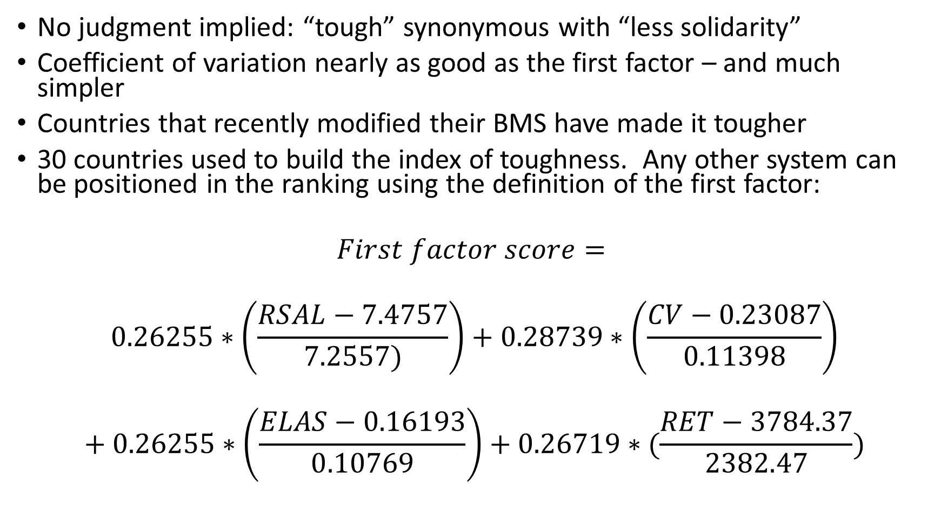
No judgment implied: “tough” synonymous with “less solidarity”
Coefficient of variation nearly as good as the first factor – and much simpler
Countries that recently modified their BMS have made it tougher
30 countries used to build the index of toughness. Any other system can be positioned in the ranking using the definition of the first factor:
$$First factor score=$$
$$0.26255∗\left(\frac{RSAL−7.4757}{7.2557)}\right)+0.28739∗\left(\frac{CV−0.23087}{0.11398}\right)$$
$$+ 0.26255∗\left(\frac{ELAS−0.16193}{0.10769}\right)+0.26719∗(\frac{RET−3784.37}{2382.47})$$

