Slide 1
ASTIN Worldwide
Non-Life
Reserving Practices Report
Report Presentation
Panama
Pierre MIEHE,
ASTIN Committee member, Head of NLRBP WP
August
2017

Slide 2

What is ASTIN?
Section for Actuarial STudies In Non-life insurance
Created in 1957 as the first section of the International Actuarial Association (IAA)
Main objective: promotion of actuarial research, particularly in non-life insurance
Publishes 2*/year the ASTIN Bulletin - the internationally renowned refereed scientific journal of the actuarial profession
ASTIN also organizes a yearly international colloquium. Last one Lisboa 06/2016, next one Panama 08/2017
ASTIN organizes seminars on non-life topics for people in countries with a developing actuarial profession
Also offers financial support to young researchers from such countries to attend ASTIN colloquia
And Working parties

Slide 3
Contents
Protocole
Africa: Kenya
Asia: Hong Kong
Europa: Austria
Latam: Brazil
Middle East: Lebanon
North America: Canada
Oceania: Australia
World results
Questions

Slide 4
Contents
Protocole
Africa: Kenya
Asia: Hong Kong
Europa: Austria
Latam: Brazil
Middle East: Lebanon
North America: Canada
Oceania: Australia
World results
Questions

Slide 5
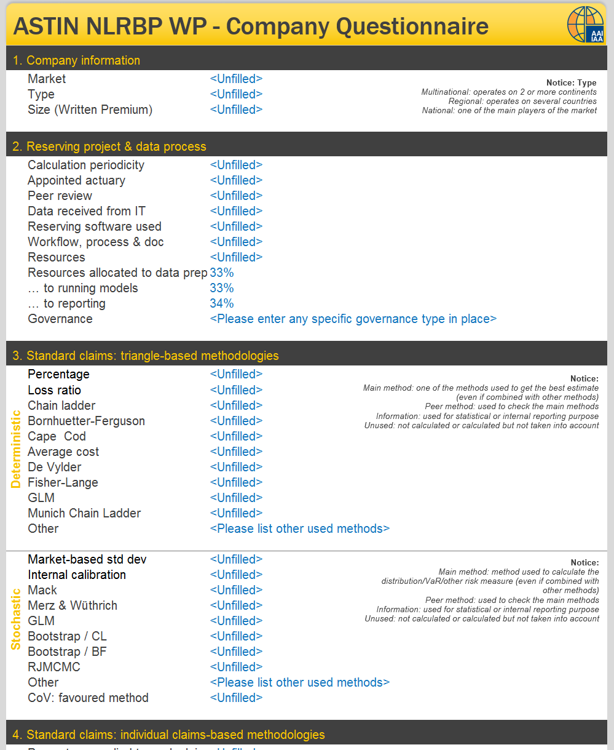
Protocole
Working Party launched on Q4 2015
Terms of Reference: targetting countries with total non-life written premium >1MUSD
Call for candidates in each of the target country. 42 nominations by ASTIN Committee.
Questionnaire with closed questions filled by insurance companies on a voluntary basis during Q1 2016

Slide 6
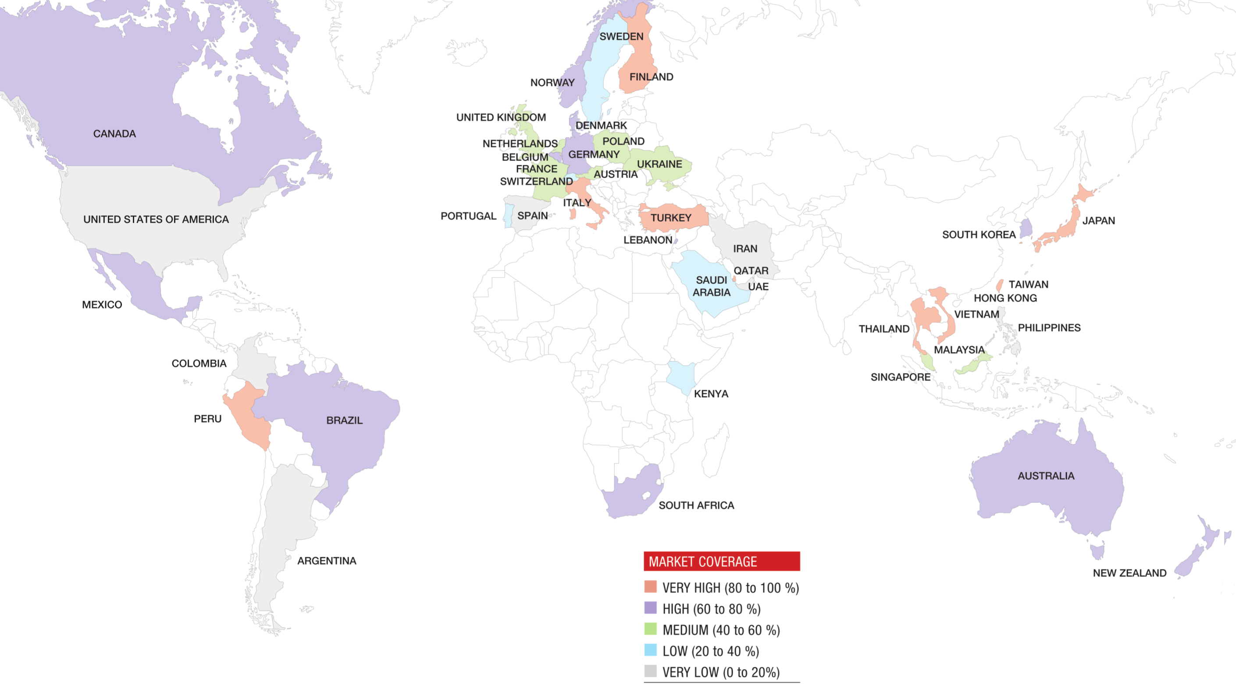
Protocole (2)
42 participating countries, representing 87% of NL World Premium Income

Slide 7

Protocole (3): the Report
100 pages detailing project results:
  Protocole
  World results
  39 country reports
  Sections on Solvency II, US Gaap and Future of Reserving

Slide 8
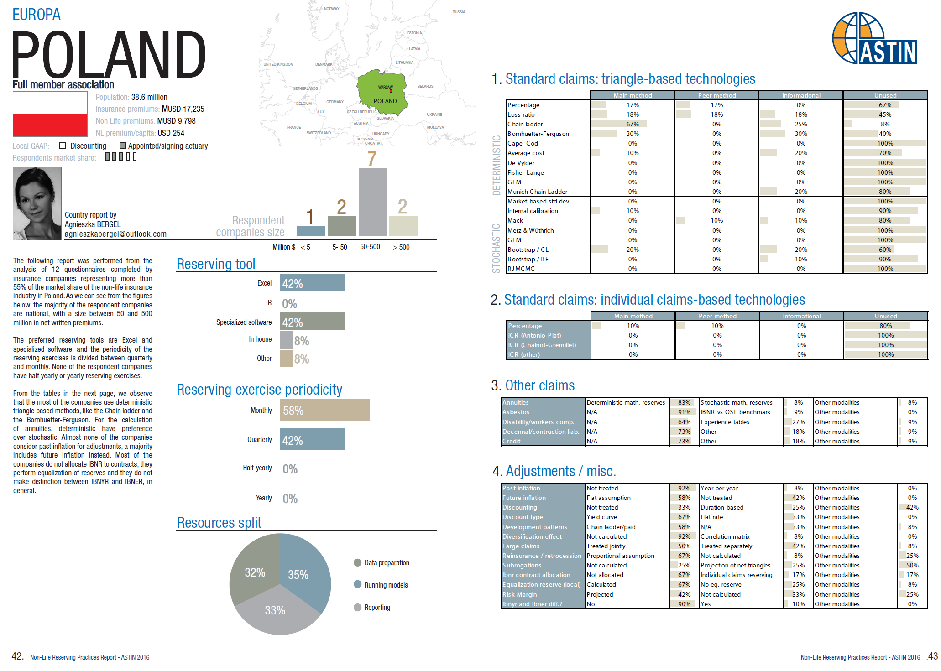
Country report sample

Slide 9
Contents
Protocole
Africa: Kenya
Asia: Hong Kong
Europa: Austria
Latam: Brazil
Middle East: Lebanon
North America: Canada
Oceania: Australia
World results
Questions

Slide 10
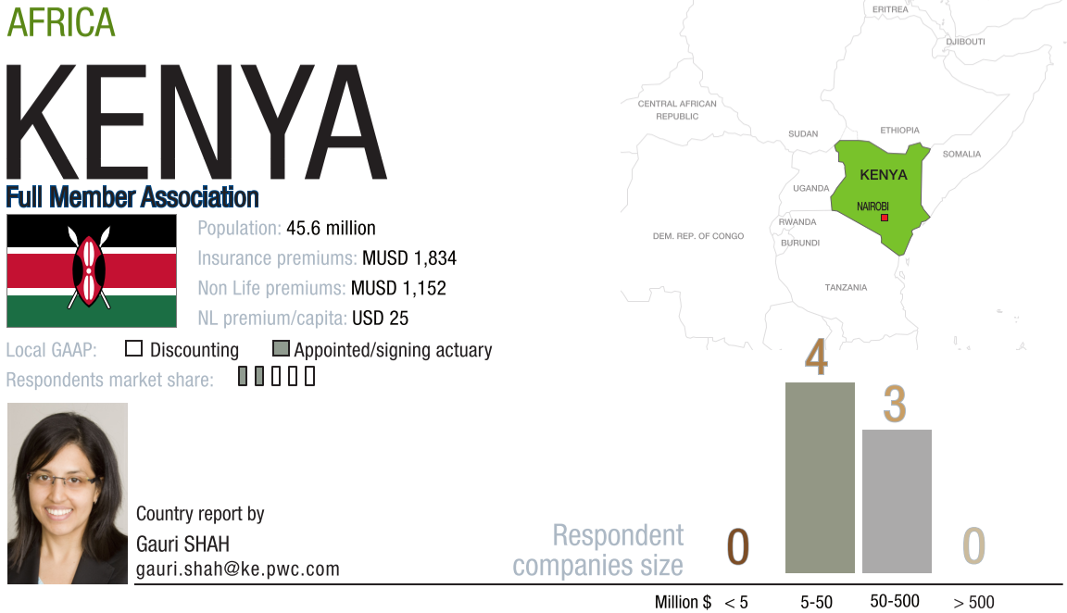
Africa: example of Kenya

Slide 11
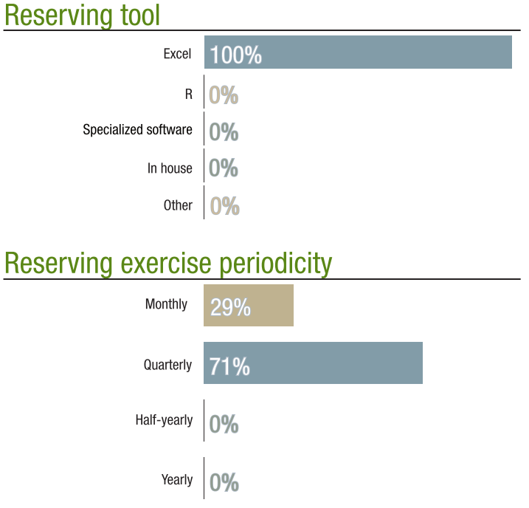
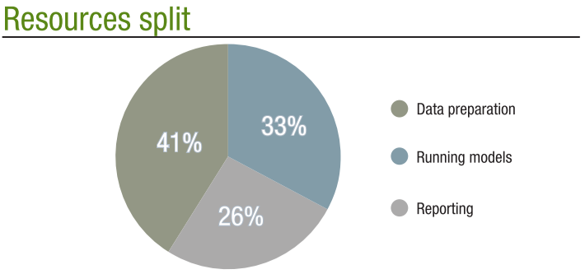
Kenya (2)

Slide 12
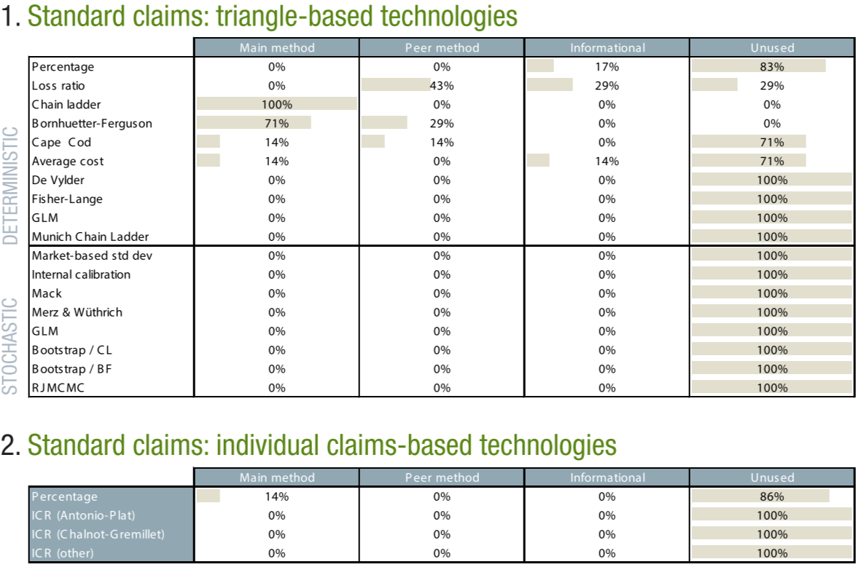
Kenya (3)

Slide 13
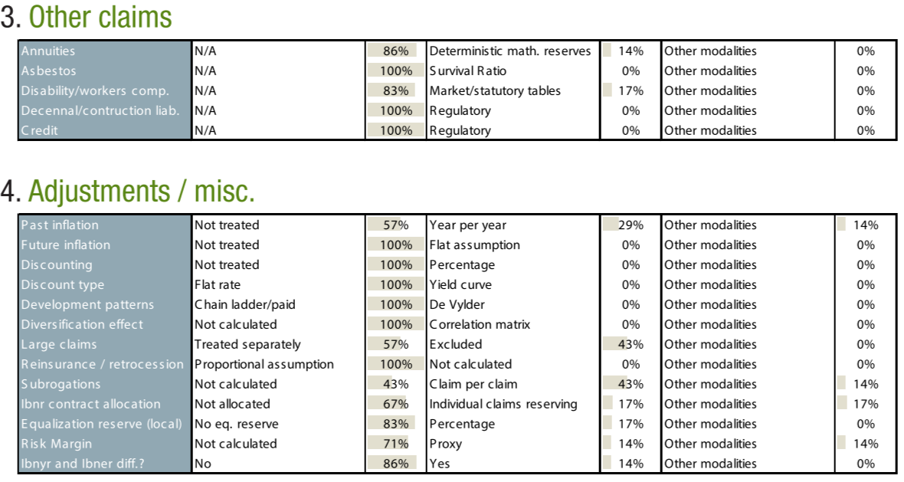
Kenya (4)

Slide 14
Contents
Protocole
Africa: Kenya
Asia: Hong Kong
Europa: Austria
Latam: Brazil
Middle East: Lebanon
North America: Canada
Oceania: Australia
World results
Questions

Slide 15
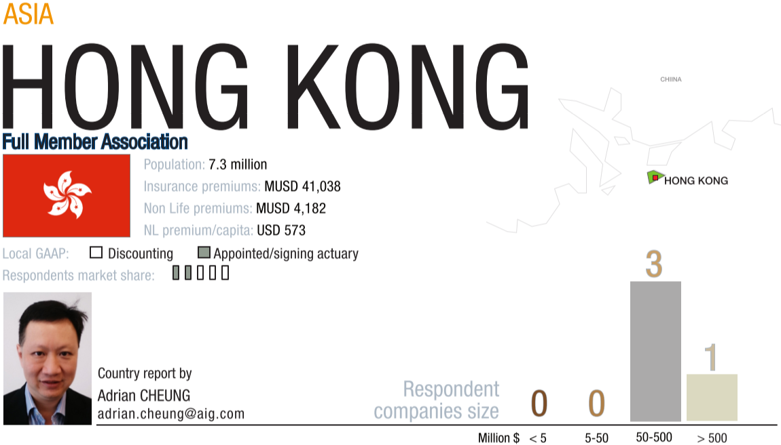
Asia: example of Hong Kong

Slide 16
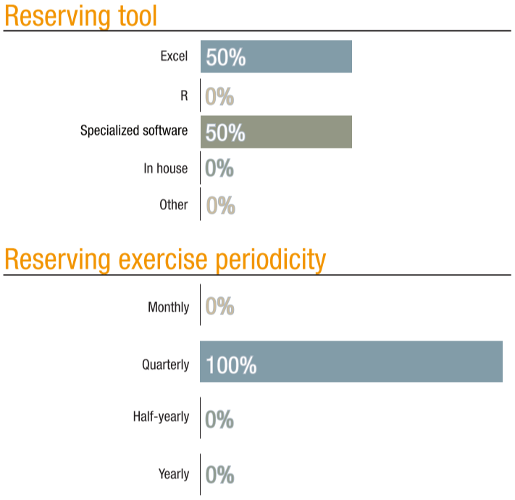
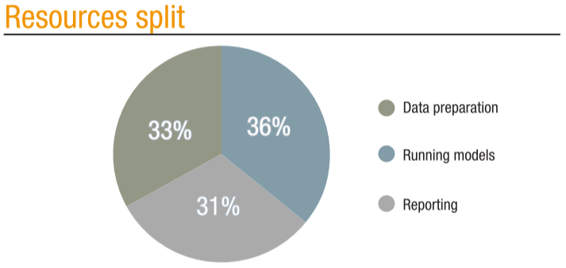
Hong Kong (2)

Slide 17
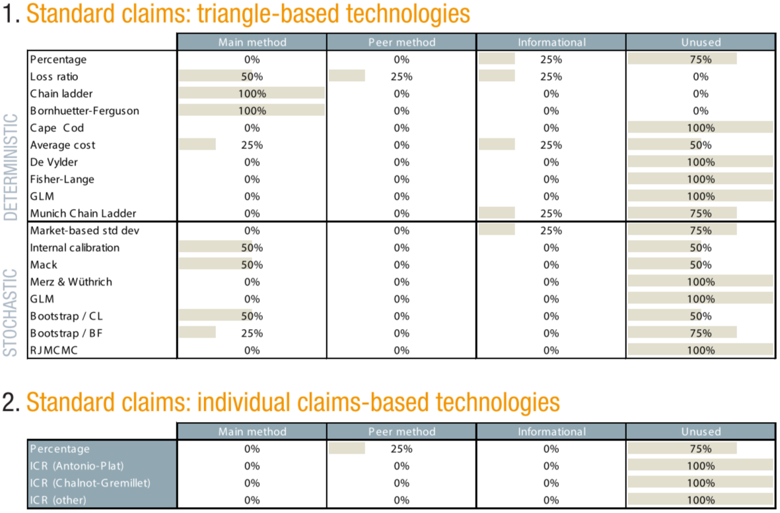
Hong Kong (3)

Slide 18
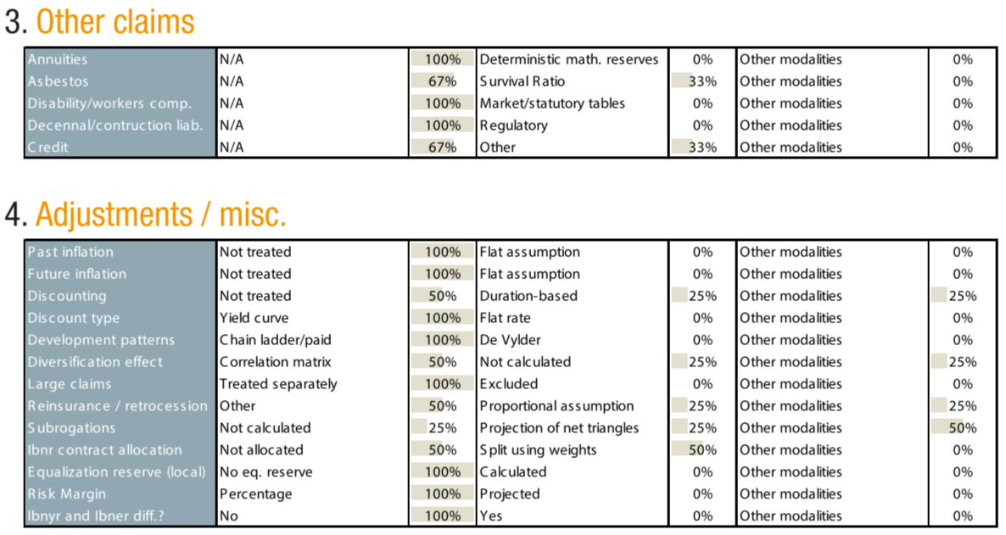
Hong Kong (4)

Slide 19
Contents
Protocole
Africa: Kenya
Asia: Hong Kong
Europa: Austria
Latam: Brazil
Middle East: Lebanon
North America: Canada
Oceania: Australia
World results
Questions

Slide 20
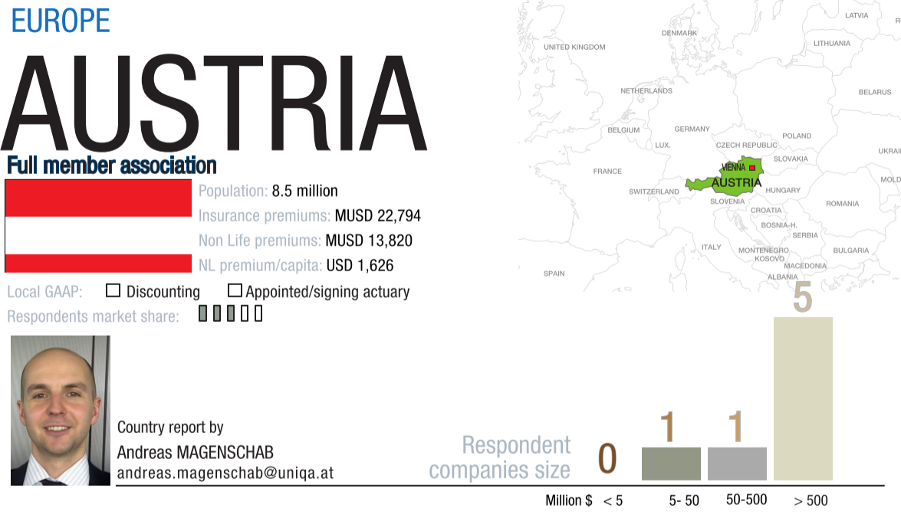
Europa: example of Austria

Slide 21
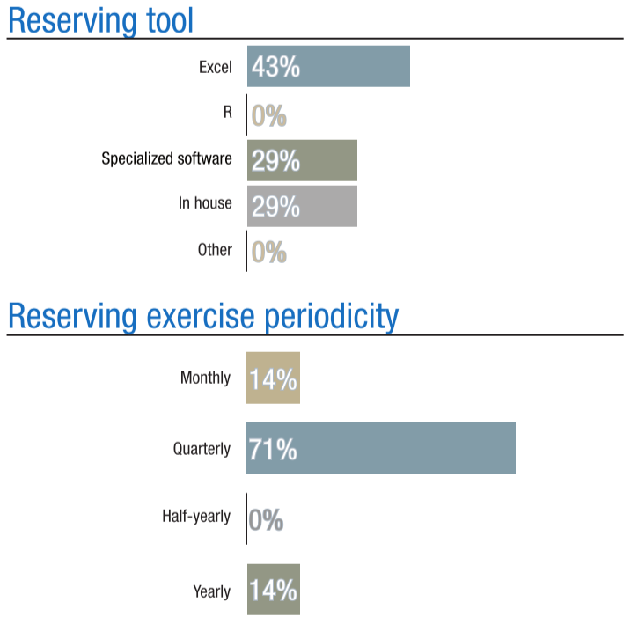
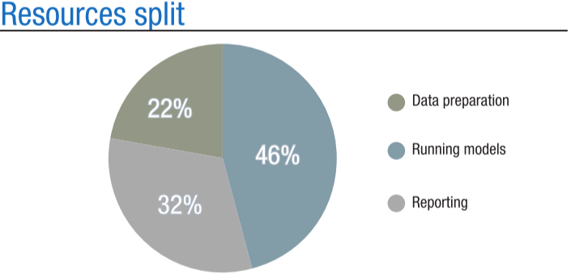
Austria (2)

Slide 22
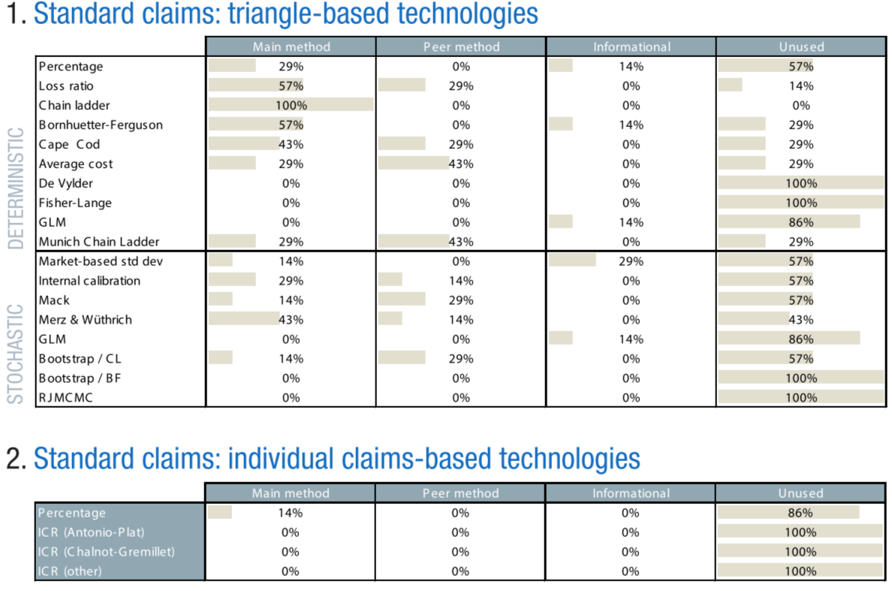
Austria (3)

Slide 23
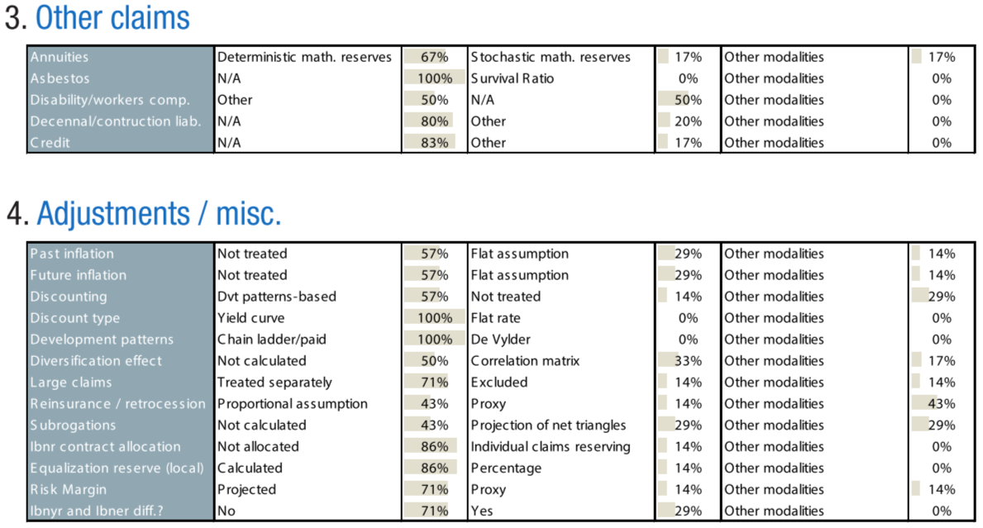
Austria (4)

Slide 24
Contents
Protocole
Africa: Kenya
Asia: Hong Kong
Europa: Austria
Latam: Brazil
Middle East: Lebanon
North America: Canada
Oceania: Australia
World results
Questions

Slide 25
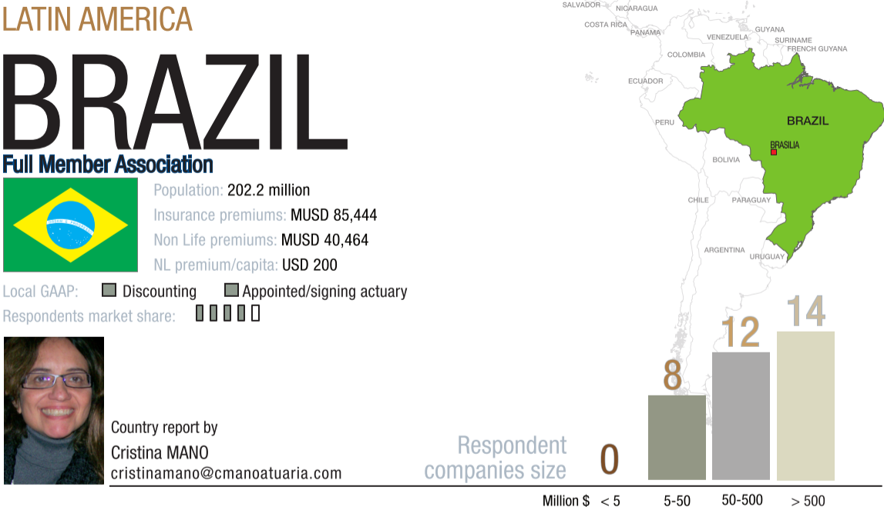
Latam: example of Brazil

Slide 26
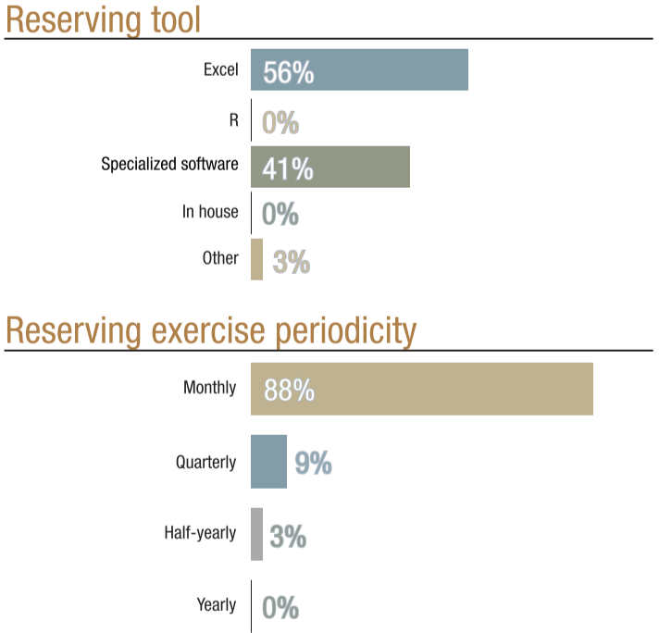
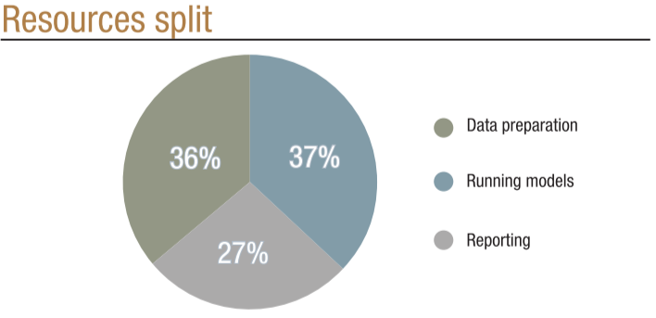
Brazil (2)

Slide 27
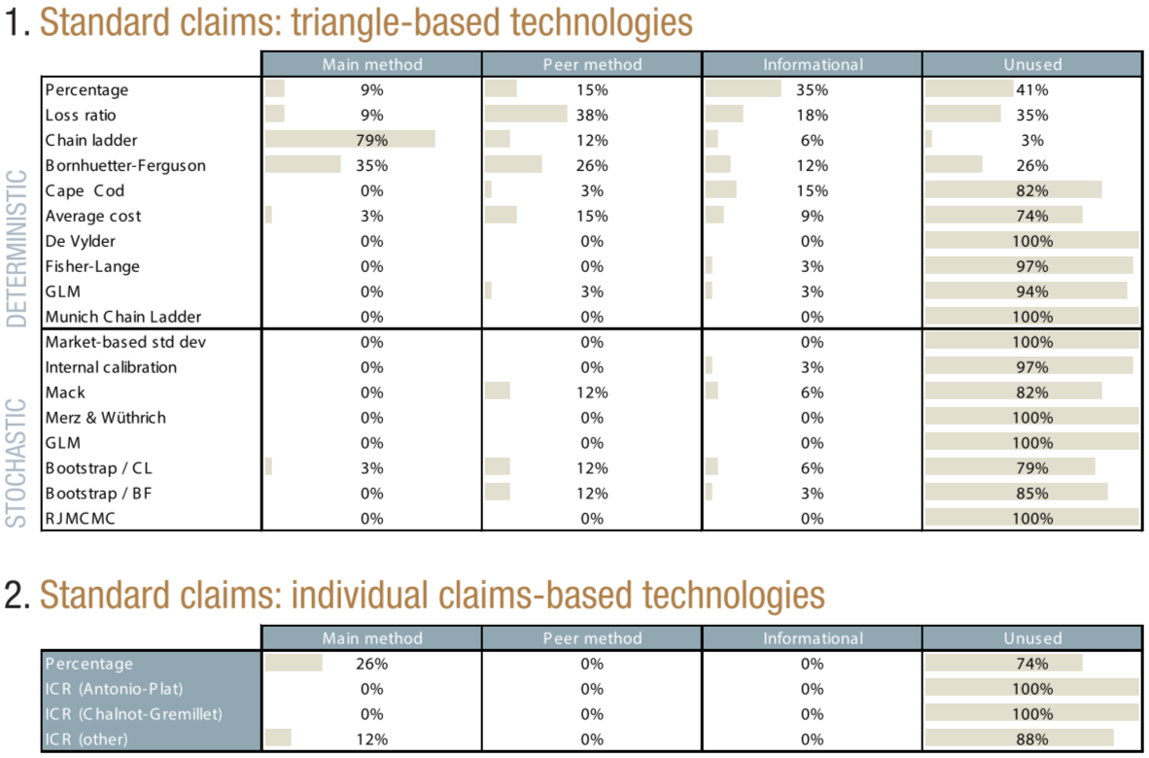
Brazil (3)

Slide 28
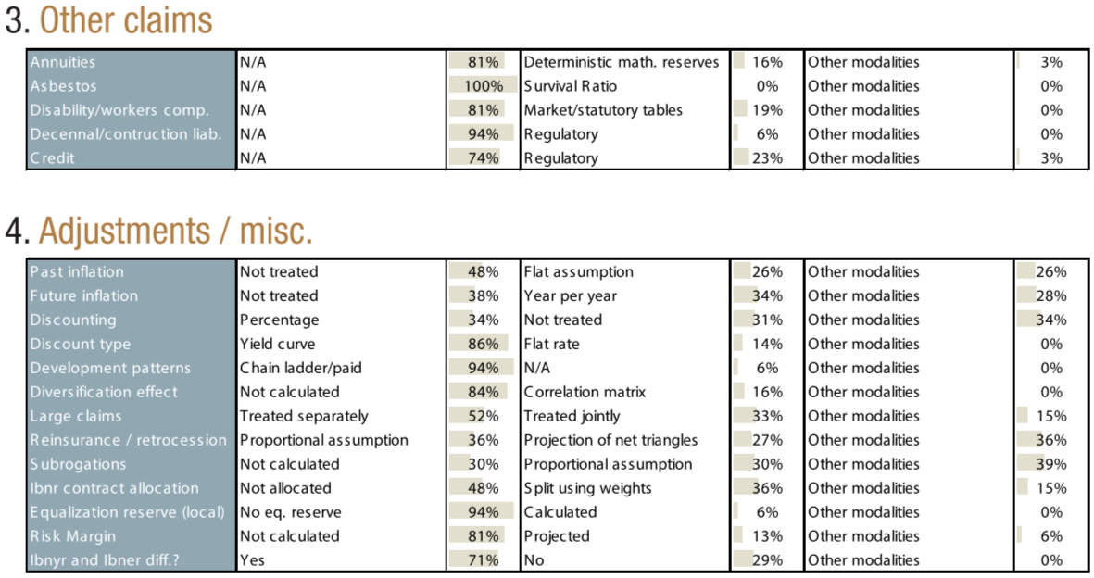
Brazil (4)

Slide 29
Contents
Protocole
Africa: Kenya
Asia: Hong Kong
Europa: Austria
Latam: Brazil
Middle East: Lebanon
North America: Canada
Oceania: Australia
World results
Questions

Slide 30
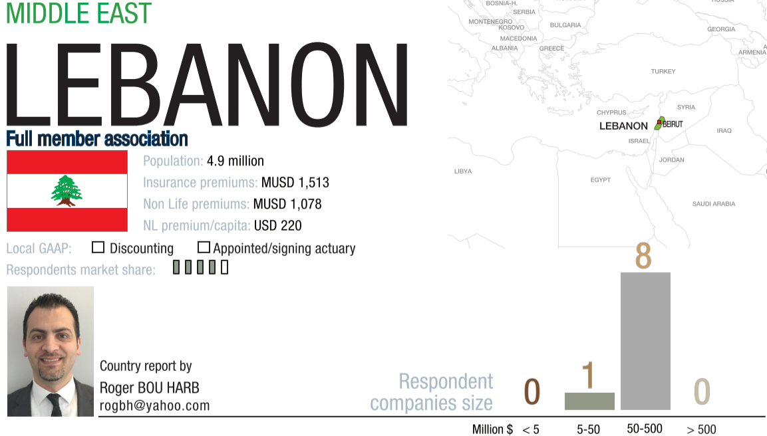
Middle East: example of Lebanon

Slide 31
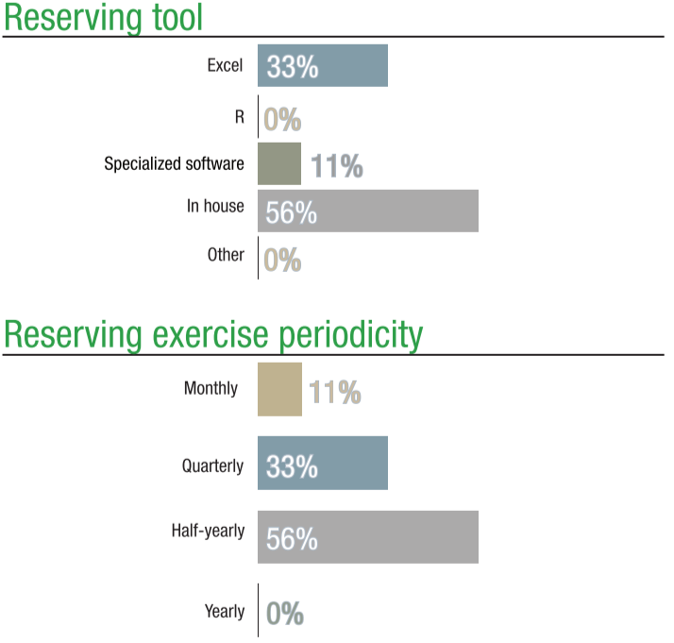
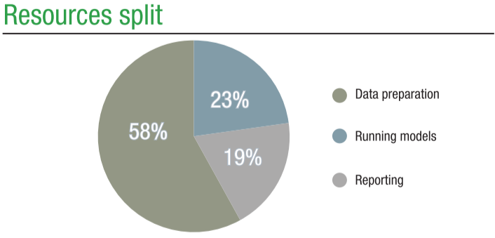
Lebanon (2)

Slide 32
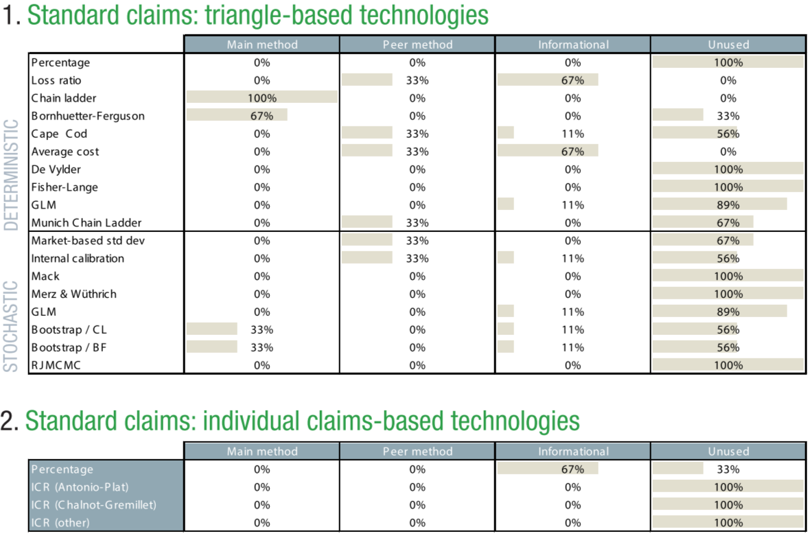
Lebanon (3)

Slide 33
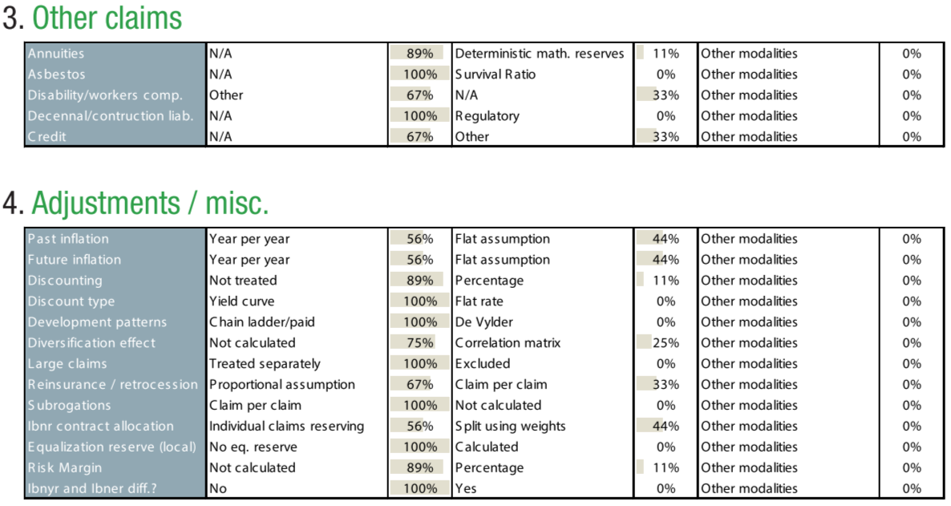
Lebanon (4)

Slide 34
Contents
Protocole
Africa: Kenya
Asia: Hong Kong
Europa: Austria
Latam: Brazil
Middle East: Lebanon
North America: Canada
Oceania: Australia
World results
Questions

Slide 35
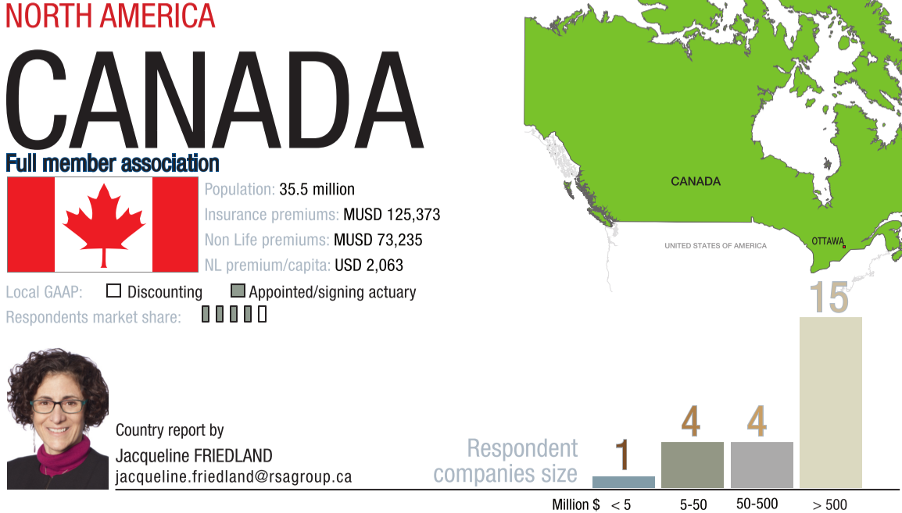
North America: example of Canada

Slide 36
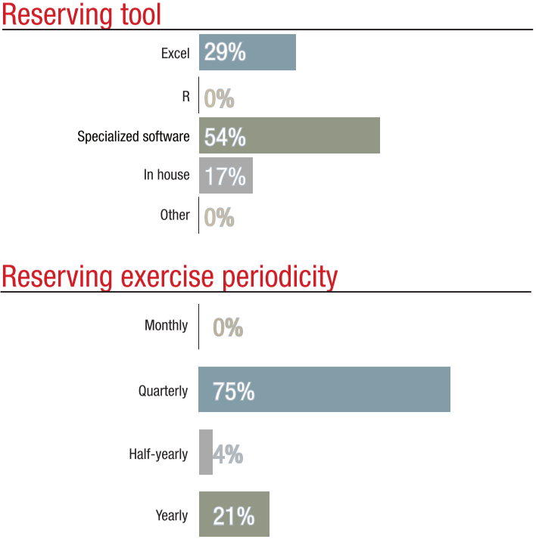
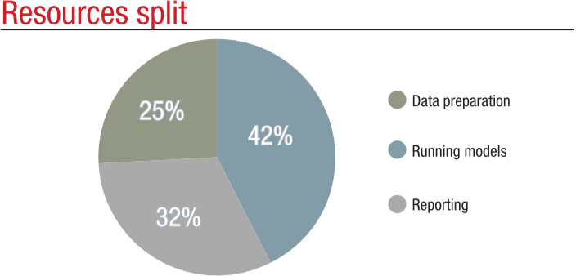
Canada (2)

Slide 37
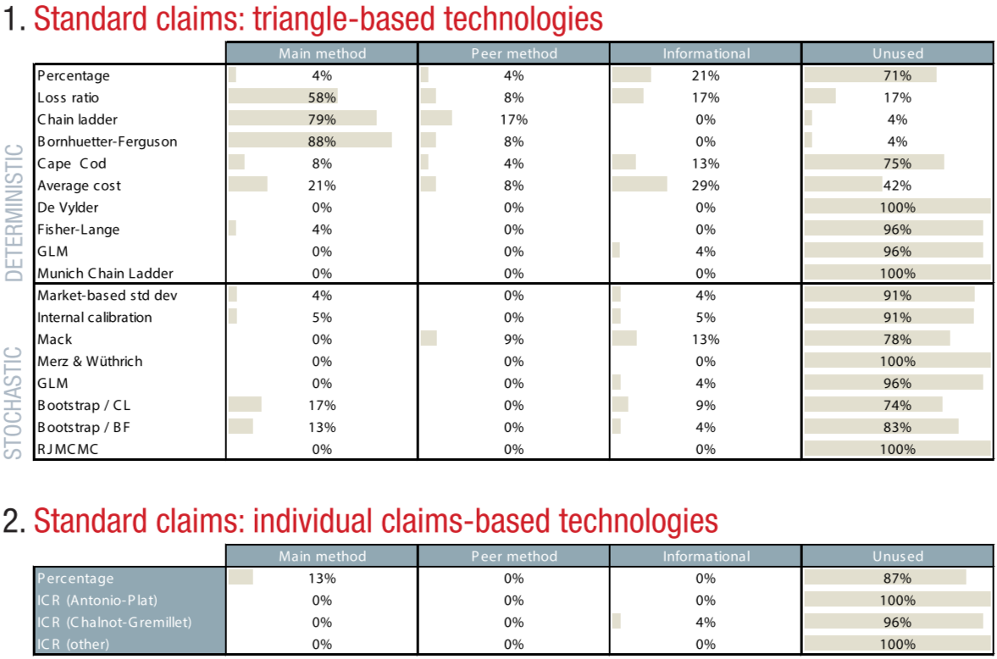
Canada (3)

Slide 38
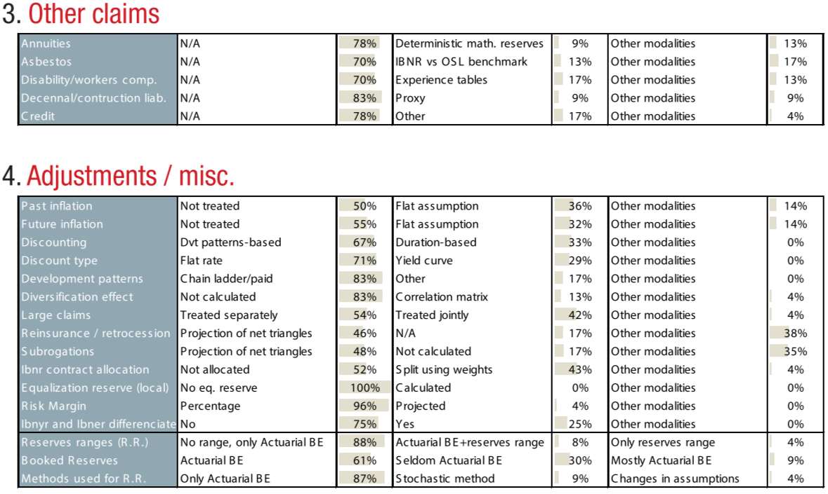
Canada (4)

Slide 39
Contents
Protocole
Africa: Kenya
Asia: Hong Kong
Europa: Austria
Latam: Brazil
Middle East: Lebanon
North America: Canada
Oceania: Australia
World results
Questions

Slide 40
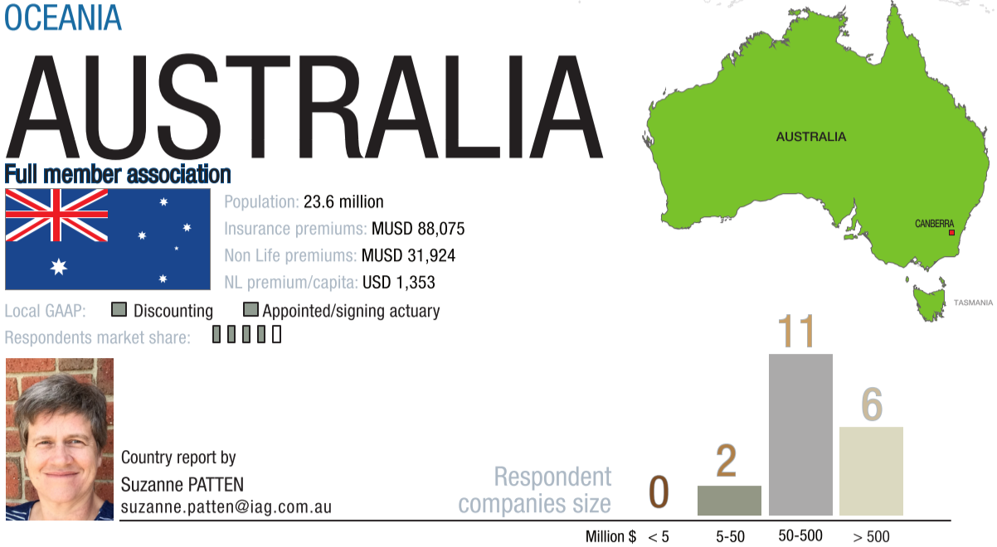
Oceania: example of Australia

Slide 41
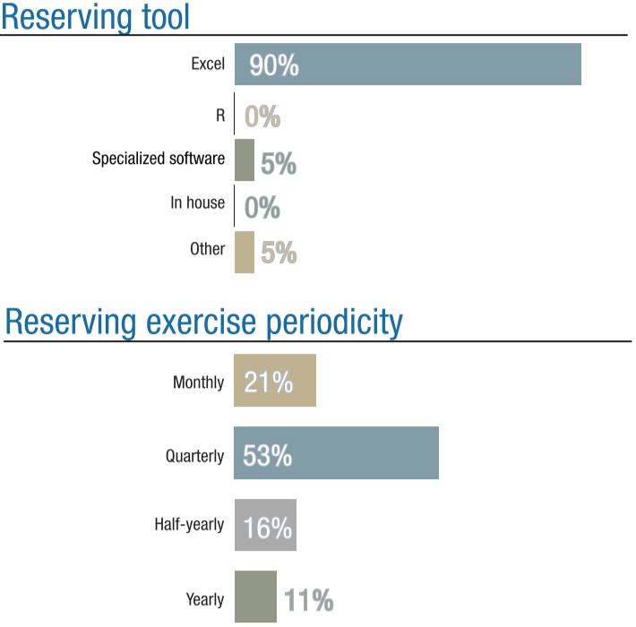
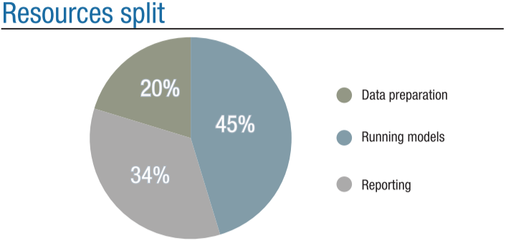
Australia (2)

Slide 42
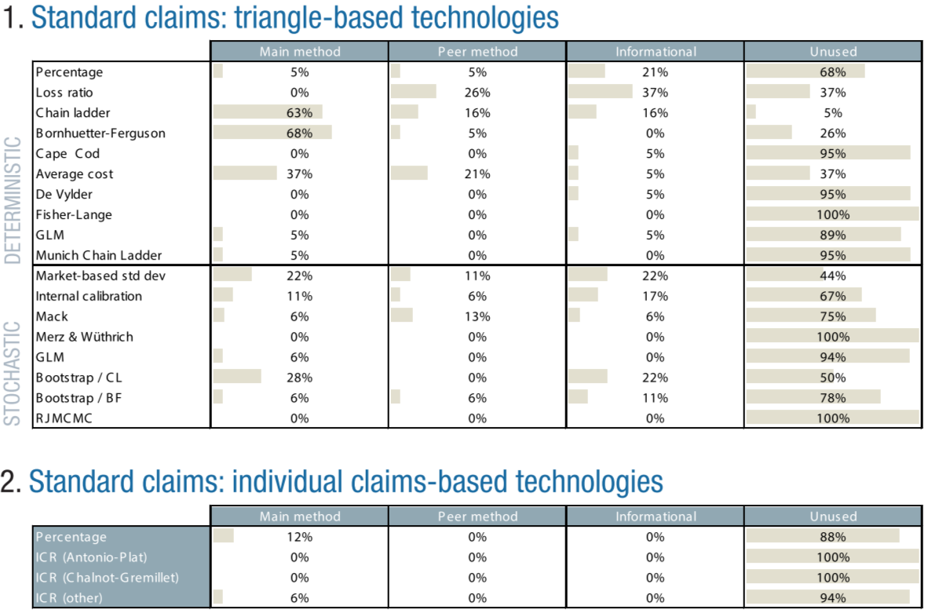
Australia (3)

Slide 43
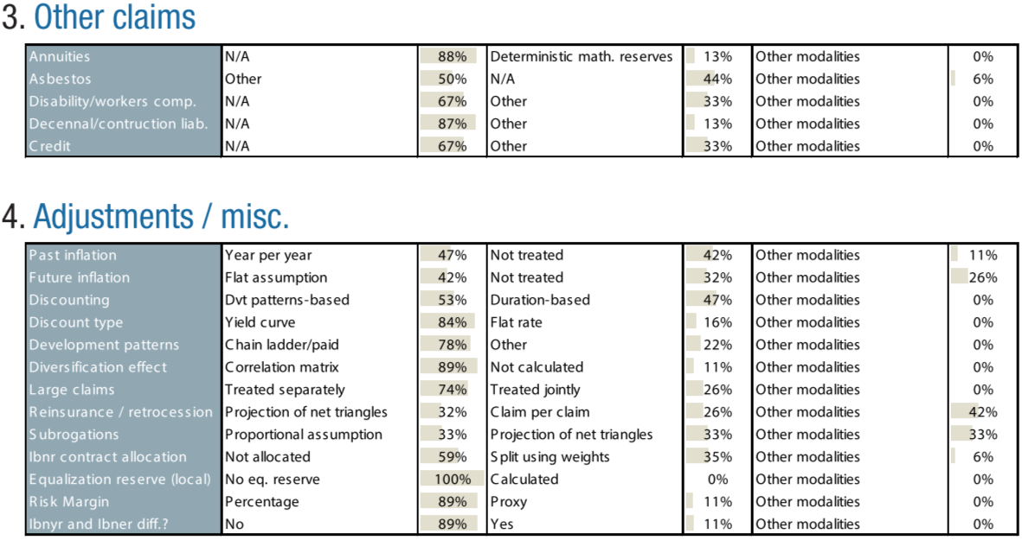
Australia (4)

Slide 44
Contents
Protocole
Africa: Kenya
Asia: Hong Kong
Europa: Austria
Latam: Brazil
Middle East: Lebanon
North America: Canada
Oceania: Australia
World results
Questions

Slide 45
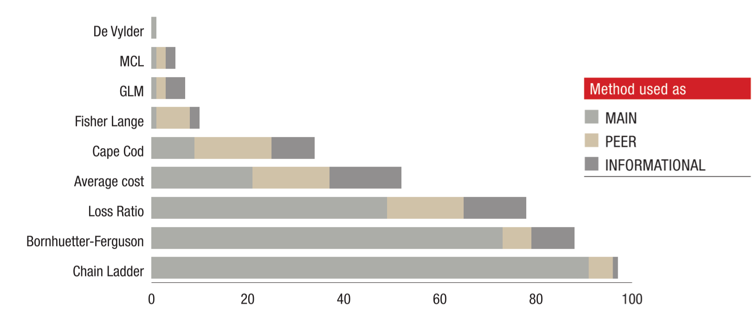
Main deterministic methods used

Slide 46
Use of stochastic methods

Slide 47
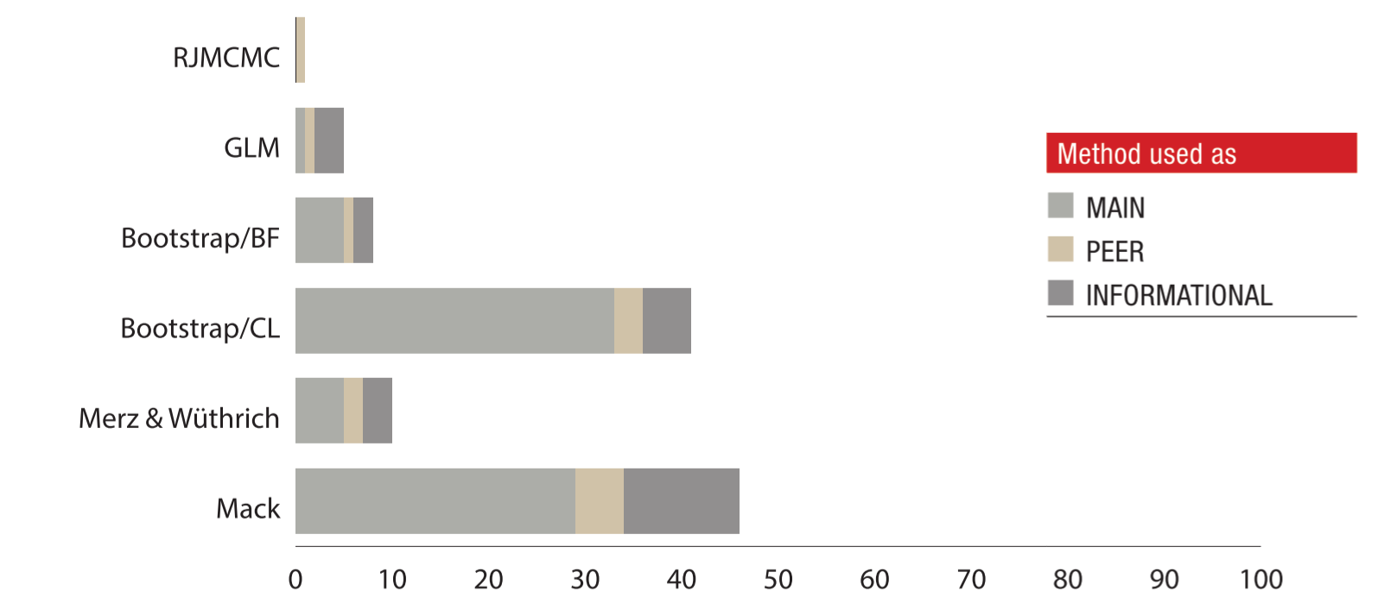
Main stochastic methods used

Slide 48
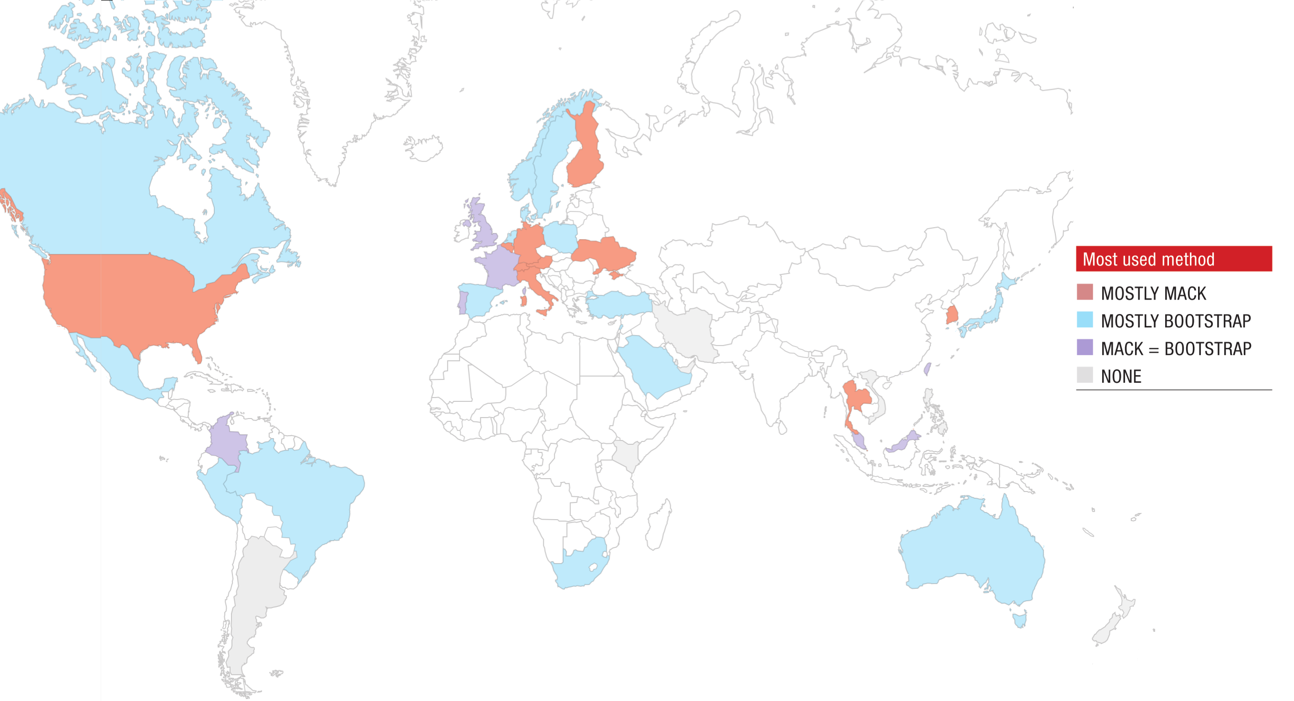
Mack vs Boostrap

Slide 49
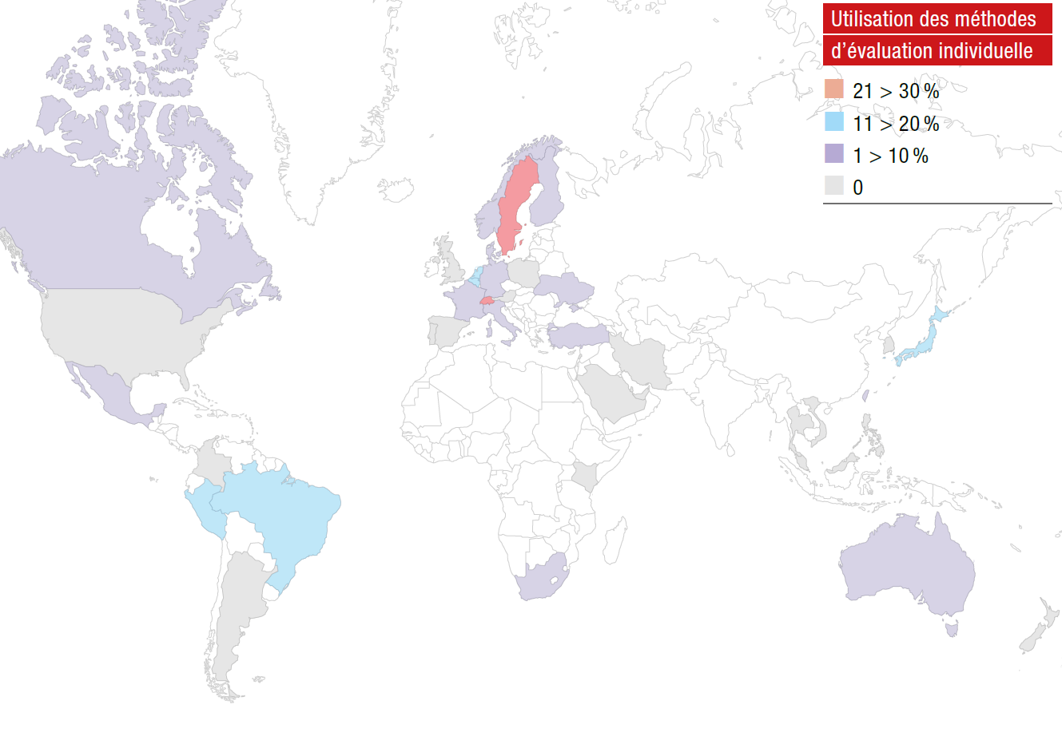
Use of individual claims reserving methods

Slide 50
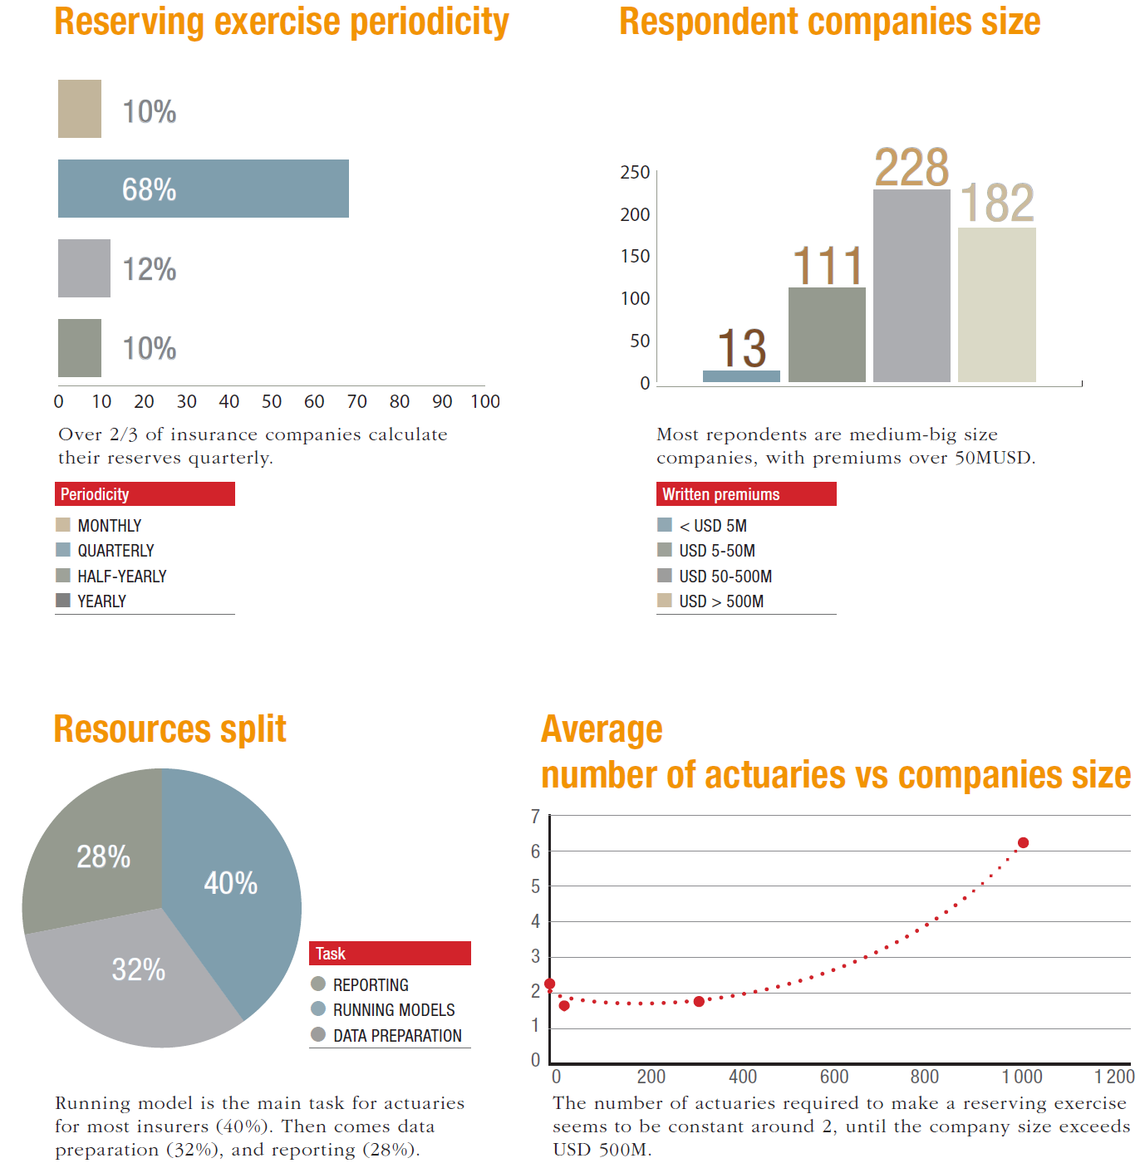
Process

Slide 51
Software used per country & misc.

Slide 52
Specific sections
Solvency II
USGAAP/RBC vs IFRS/Solvency II
“On an overall basis, the RBC framework is more uniform and easier to implement in a consistent manner across all companies. On the other hand, Solvency II framework is more nuanced but allows a Company to estimate its own risk margins. Hence I believe the Solvency II regime leads to more individual regulatory scrutiny.” - Chandu Patel
Future of reserving
“Are the actuarial teams sufficiently trained in computer science to handle the latest technology, and for example switch to individual claims reserving?” - Suzanne Patten & the WPNLReserving team

Slide 53
Contents
Protocole
Africa: Kenya
Asia: Hong Kong
Europa: Austria
Latam: Brazil
Middle East: Lebanon
North America: Canada
Oceania: Australia
World results
Questions

Slide 54
Thank you for your attention!
Questions?
The full report is available on the ASTIN website

