Slide 1
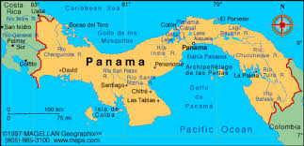
ASTIN AFIR/ERM 2017 Colloquium

Slide 2
Pricing
Cyber Security Insurance using Copulas
Dr. Jacquelyn Rees-Ulmer,
Dr. Rahul A. Parsa, and
Ramona Lee, ACAS

Slide 3
Dr. Jacquelyn Rees-Ulmer
Chair, Department of Supply Chain & Information Systems
Dean's Faculty Fellow in Management Information Systems
Professor of Management Information Systems
Email: jrulmer@iastate.edu
Expertise : Information Security, Machine Learning, Text Mining, Genetic Algorithms

Slide 4
Dr. Rahul A. Parsa
Senior Lecturer and Fellow of Des Moines Programs
Email: raparsa@iastate.edu
Expertise: Copulas, Statistics, Data Analytics

Slide 5
Ramona Lee, ACAS
Actuarial Administrator at Iowa Insurance Division
e-mail: LeeRamona783@gmail.com –
www.linkedin.com/in/ramonalee/
Property & Casualty (P&C) Actuary and Professional Risk Manager, Regulator
Enjoy working with insurance companies in a positive, instructive manner, to ensure compliance with state laws and regulations, and sharing technical actuarial information with consumers clearly, concisely, yet thoroughly, such that they are able to better understand the products they purchase. Enjoy improving processes and actuarial problem-solving, testing methods to better understand and estimate future outcomes.

Slide 6

Outline
Cyber Security – The problem
Cyber Insurance Concerns
Notation
Description of the problem
MVN Copula Method
Naïve Bayes Method
Estimation of the Cost

Slide 7
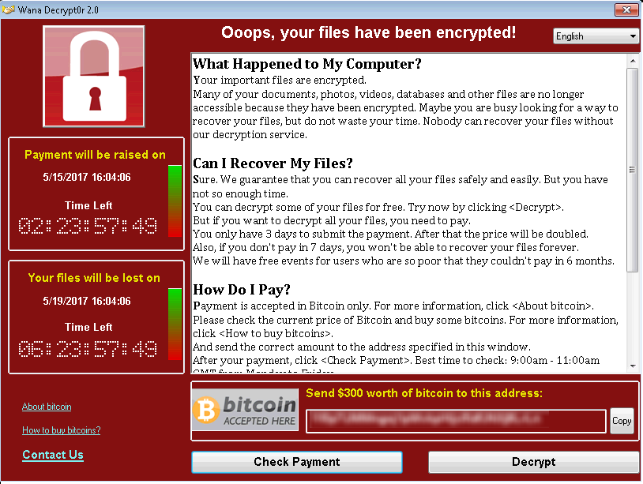
The Problem
Cybercrime costs expected at $2.1T world-wide by 2019 for data breaches alone (Morgan, 2016)
Doesn’t take into account ransomware or other attacks, such as loss of intellectual property

Slide 8

The Problem - Context
Cyber Security previously not strategic concern by companies
    Cyber Security “ROI” difficult to calculate
    Chief Information Security Officer (CISO) way down the chain of command (if exists at all!)
    Problem complexity – let the techies fix it!

Slide 9
The Problem - Context
Cyber Security was “just” an IT issue
  Responsible personnel traditionally at lower levels of IT organization
    Firewall, antivirus management
    Little to no authority of infrastructure/architecture decisions
    “Fire-fighting” mentality
    Funding Model:
      Fear, Uncertainty, & Doubt (FUD)

Slide 10
The Problem - Context
Why is Cyber Security such a problem?
  Most business software/systems have security as afterthought
    Many traditional design processes do not take security into account from beginning
    Applies to:
      Purchased systems
      Open-source systems
      Systems built in-house (proprietary systems)

Slide 11
The Problem - Context
Business reasons for lack of built-in security:
  Time-to-market pressures for software
    Not enough time to debug and test
  Functionality over security
    More functions - > greater complexity -> greater likelihood of errors
  Ease-of-use over security
    Default is little-to-no security

Slide 12
The Problem - Context
Framing Cyber Security as a Risk Management Process
  Risk Assessment Process
    Identify assets
    Estimate value
    Estimate likelihood of loss
      Annualized Loss Expectancy (ALE)
    Higher ALE values get more attention
    Flawed process, but provides insight

Slide 13

The Problem - Context
Risk Management for Cyber Security
  Accept, Transfer, Mitigate (ATM)
    Accept risk
      Explicit
      Implicit
    Transfer risk
      Outsourcing security operations
      Cyber Insurance
    Mitigate risk
      Protect, Detect, Recover

Slide 14
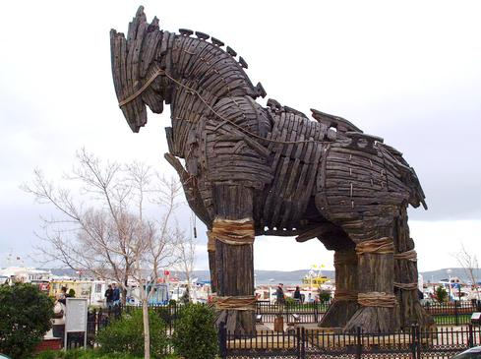
The Problem - Context
Mitigate Risk
  Protect, Detect, Recover (PDR)
    Challenges
      Technical
      Human

Slide 15
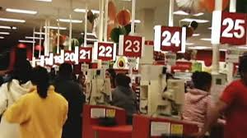
The Problem - Context
Mitigate Risk, continued
  Detection is hard
    Many false-positives in intrusion detection
    Human nature to trust
      Social engineering attacks
      Phishing emails

Slide 16

The Problem - Context
Mitigate Risk, continued
  Recovery
    Often overlooked
    Not just for Disasters!
    Incident can quickly escalate to disaster

Slide 17
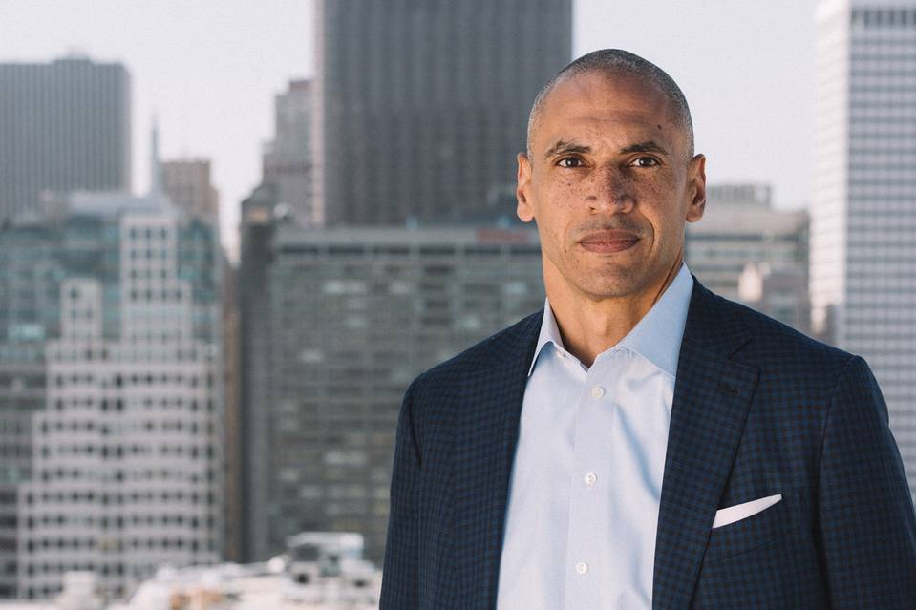
The Problem
Cyber Security now has attention of corporate boards (Zakrzewski, 2017)
  Allows for broader view of problem
  Risk management framework
  Integrate with SaaS, IaaS, etc.

Slide 18
CyberInsurance
Has been slow to take off but gaining in acceptance
Concerns:
  Not enough data to build pricing models
    Refuted
  Attacks are evolving, so history not as useful
    True
  Too expensive
    In hindsight, underpriced

Slide 19
CyberInsurance
Academic concerns:
  Correlated losses
    Networked systems
      Too easy for bad things to travel quickly
    Homogeneity of systems
      Role of Microsoft OS and Office Suite technology stacks
      Just like in agriculture, monoculture/homogeneous crops lead to bigger risks of failure (all susceptible to one pathogen)

Slide 20
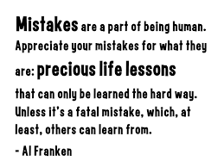
Cyber Insurance -
Lessons Learned from
Other Insurance Coverages

Slide 21

Cyber Insurance Concerns
  Attacks are evolving; history not as useful
  Capacity
  Correlated Losses

Slide 22
Cyber Insurance Concerns
  Attacks are evolving; history not as useful
  Capacity
  Correlated Losses

Slide 23
Catastrophes
One way to look at Cyber Threats
Modeling
Event
Loss
Cost

Slide 24
Cyber Insurance Concerns
  Attacks are evolving; history not as useful
  Capacity
  Correlated Losses

Slide 25
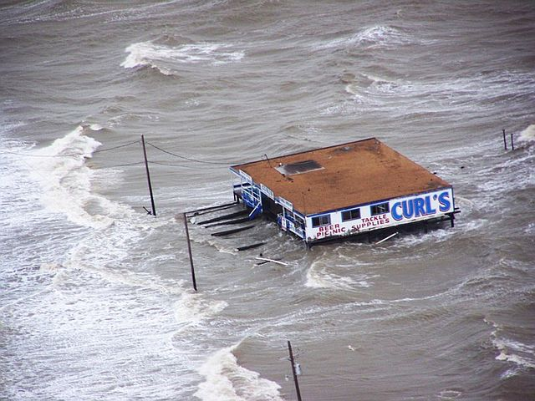
Catastrophes – Capacity
Diversification
Limits
Risk Transfer
  Reinsurance
  Financial Instruments

Slide 26

Terrorism – Close?
TRIA (TERRORISM RISK INSURANCE , Market Challenges May Exist for Current Structure and Alternative Approaches, GAO )
Large & Small Exposures
Risk Transfer
  Limits
  Reinsurance
  Government

Slide 28
Cyber Insurance Concerns
  Attacks are evolving; history not as useful
  Capacity
  Correlated Losses

Slide 29
Concerns - Catastrophes
Natural Earthquakes
Earthquakes as result of some human action
  Policy exclusions

Slide 30
Concerns - Exposures
Sources of Information
  Exposed to attack
  Attempted attacks
  Intercepted attacks
  Successful attacks

Slide 31
Pandemics
Network
Travel
  Speed of growth
Source of diseases
  Reactive
  Proactive

Slide 32
The Cyber Pricing Problem
It is assumed that businesses are in a network
The cyber attack could come from a direct attack or indirectly from other business that are on the network
It is assumed that more money a business invests in cyber security the less it will be attacked.

Slide 33
Research Question
How to better price cyber insurance given potentially correlated losses?

Slide 34
Notation
Y = Money spent by the company of interest on Cyber-security
X_{i}= Money spent by company i on Cyber-security

Slide 35
Assumption
Money spent on Cyber security has to be 0 or higher. So, Y ≥ o
Similarly, X_{i}’s ≥ o
The distribution of Y and X_{i}’s will be positively skewed.
Joint distribution Y and X_{i}’s given by MVN Copula

Slide 36
Assumption Cont.
P(no attack) = F(y) or F(x_{i}).
Thus, P(of an Attack) = S(y) or S(X)
Since, the there is a network connecting them, the
P(Cyber Attack ) = S(Y|X_{i}’s).

Slide 37
Estimating the Probability of an Attack

Slide 38
Copula
Ideal Copulas will have the following properties:
ease of computation
closed form for conditional density
different degrees of association available for different pairs of variables.
Good Candidates are:
Gaussian or MVN Copula
t-Copula

Slide 39
MVN Copula
CDF for MVN is Copula is
Where G is the multivariate normal cdf with zero mean, unit variance, and correlation matrix R.
Density of MVN Copula is
Where v is a vector with ith element

Slide 40
Copula vs. Normal Density
Bivariate Normal Copula with Beta and Gamma marginals
Bivariate Normal Distribution

Slide 41
Copula vs. Normal
Contour plot of the Bivariate Normal Copula with Beta and Gamma marginals
Contour plot of the Bivariate Normal Distribution

Slide 42
Conditional Distribution in
MVN Copula
The conditional distribution of y given x₁ ….x_{n-1} is
Where

Slide 43
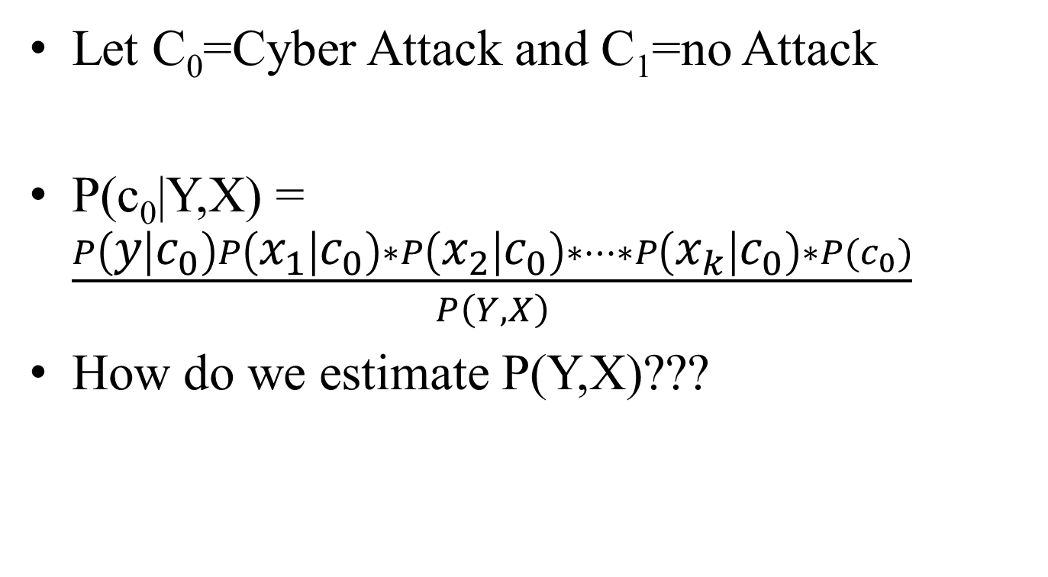
Naïve Bayes Equation
Let C₀=Cyber Attack and C₁=no Attack
P(c₀|Y,X) = $\frac{P\left(y | c_{0}\right)P\left(x_{1} | c_{0}\right)∗P\left(x_{2} | c_{0}\right)∗…∗P\left(x_{k} | c_{0}\right)∗P(c_{0})}{P\left(Y,X\right)}$
How do we estimate P(Y,X)???

Slide 44
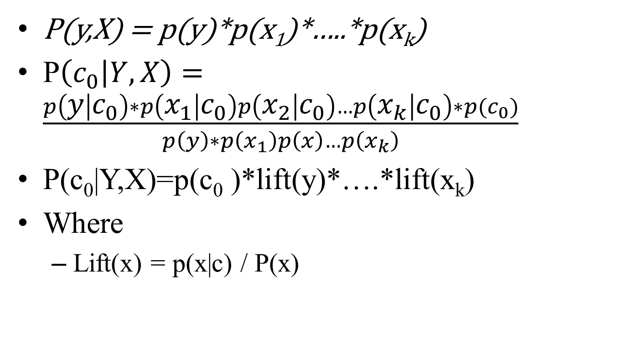
Evidence of Lift
P(y,X) = p(y)*p(x₁)*…..*p(x_{k})
P$\left(c_{0} | Y,X\right)=\frac{p\left(y | c_{0}\right)∗p\left(x_{1} | c_{0}\right)p\left(x_{2} | c_{0}\right)…p\left(x_{k} | c_{0}\right)∗p(c_{0})}{p\left(y\right)∗p\left(x_{1}\right)p\left(x\right)…p\left(x_{k}\right)}$
P(c₀|Y,X)=p(c₀ )*lift(y)*….*lift(x_{k})
Where
  Lift(x) = p(x|c) / P(x)

Slide 45
Estimating the Loss
Given the Probability of an attack, p:
  we will assume that an organization has N records.
  If a record is breached, the loss is given by U
Let n = # of Records breached
n~ Bin(N, p)
Let U ~ f(u)
E(Total Loss) = E(n) * E(U)
Var(Total Loss) = E(n)*Var(u)+Var(n)*E(U)²

Slide 46
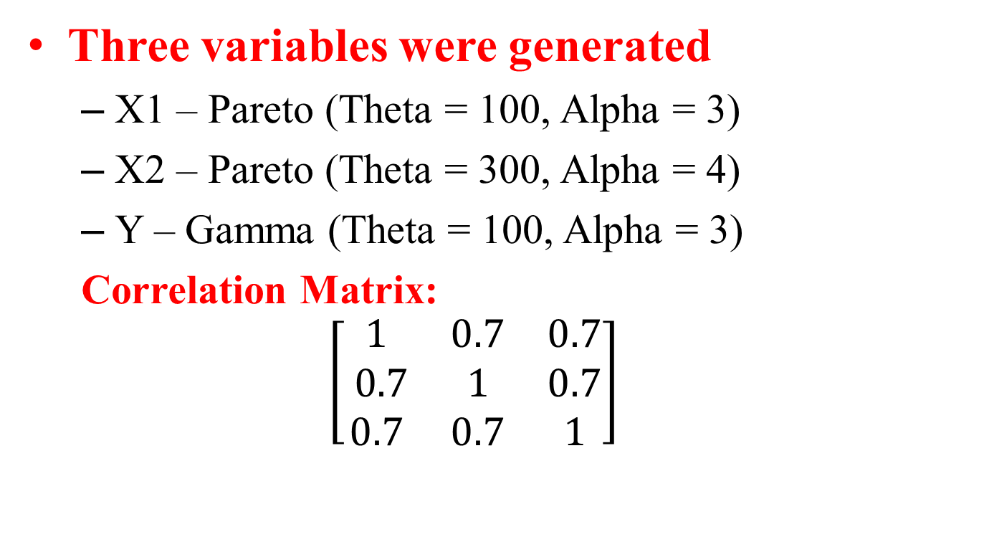
Example
Three variables were generated
  X1 – Pareto (Theta = 100, Alpha = 3)
  X2 – Pareto (Theta = 300, Alpha = 4)
  Y – Gamma (Theta = 100, Alpha = 3)
  Correlation Matrix:
  $$\left[\begin{matrix}1 & 0.7 & 0.7 \\ 0.7 & 1 & 0.7 \\ 0.7 & 0.7 & 1\end{matrix}\right]$$

Slide 47
MLE’s
X1: Alpha = 3.44, Theta = 161.11
X2: Alpha = 1.04, Theta = 112
Y: Alpha = 3076, Theta = 85.93
R:
R
1.000 | 0.711 | 0.699
0.711 | 1.000 | 0.713
0.699 | 0.713 | 1.000

Slide 48
Probabilities
X1 | X2 | X3 | F(X3/X1,X2)
441.92 | 265.29 | 696.59 | 0.74
69.33 | 428.01 | 507.18 | 0.52
66.54 | 168.36 | 752.37 | 0.99
1.08 | 7.64 | 150.11 | 0.69
3.75 | 3.00 | 191.93 | 0.85
1.97 | 9.09 | 90.27 | 0.20
50.55 | 122.41 | 161.87 | 0.02
351.55 | 405.24 | 672.62 | 0.59
1.81 | 46.72 | 215.61 | 0.70
21.82 | 26.63 | 232.22 | 0.55

Slide 49
Example Cont.
Let N = | 10,000
Let U ~ Gamma (3,100) |  | E(U) | 300
 |  | Var(U) | 30000

Slide 50
Example Cont.
F(X3/X1,X2) | E(n) | Var(n) | E(Loss) | Var(loss)
0.74 | 2617.51 | 1932.38 | 785253.60 | 252439118.37
0.52 | 4793.89 | 2495.75 | 1438167.60 | 368434435.43
0.99 | 81.76 | 81.09 | 24527.10 | 9750682.14
0.69 | 3070.05 | 2127.53 | 921014.10 | 283578942.76
0.85 | 1463.46 | 1249.29 | 439037.10 | 156339482.48
0.20 | 7964.43 | 1621.21 | 2389329.60 | 384842246.26
0.02 | 9776.82 | 218.20 | 2933046.90 | 312942348.24
0.59 | 4128.57 | 2424.06 | 1238571.60 | 342022679.17
0.70 | 3018.57 | 2107.39 | 905571.90 | 280222713.39
0.55 | 4463.06 | 2471.17 | 1338919.20 | 356297217.59

Slide 51
Questions to Ponder
On Demand Insurance
Blockchain
Artificial Intelligence
?
?

Slide 52




Gracias

Slide 53


Pixie

