Slide 1
Business School
Evolutionary hierarchical credibility
Greg Taylor
School of Risk and Actuarial Studies
University of New South Wales
Sydney, Australia
ASTIN and AFIR/ERM Colloquia, 20-24 August 2017, Panama

Slide 2
Acknowledgements and disclaimers
Principal financial support for this research provided by a grant from the Australian Actuaries Institute
Also supported under Australian Research Council’s Linkage Projects funding scheme (project number LP130100723)
The views expressed herein are those of the author and are not necessarily those of either supporting body

Slide 3
Overview
Motivation
Formal framework
Hierarchical models
  Static
  Evolutionary
Kalman filter
  In general
  Application to hierarchical model
Numerical example
Conclusion

Slide 4
Overview
Motivation
Formal framework
Hierarchical models
  Static
  Evolutionary
Kalman filter
  In general
  Application to hierarchical model
Numerical example
Conclusion

Slide 5
Motivation: hierarchies (1)
What is a hierarchy?
Nodes

Slide 6
Motivation: hierarchies (2)
Example: the ANZSIC occupational codes
  A = Agriculture, Forestry and Fishing
    A1 = Agriculture
    A2 = Aquaculture
  B = Mining
    B6 = Coal mining
    B7 = Oil and gas extraction
    B8 = Metal ore mining
B
A
B6
B7
B8
A1
A2

Slide 7
Motivation: hierarchies (3)
There may be an observation at each node
  e.g. claim frequency
One may wish to estimate the claim frequency parameters underlying these observations
One can use hierarchical credibility
  Taylor (1979)
  Sundt (1979,1980)
0.070
B
0.100
A
0.025
B6
0.050
B7
0.100
B8
0.120
A1
0.010
A2
0.035

Slide 8
Motivation: static versus evolutionary hierarchies
Suppose that claim frequencies at the node evolve over time
Now an parameter estimate is required at each node at each point of time
How?
B
A
B6
B7
B8
A1
A2

Slide 9
Overview
Motivation
Formal framework
Hierarchical models
  Static
  Evolutionary
Kalman filter
  In general
  Application to hierarchical model
Numerical example
Conclusion

Slide 10
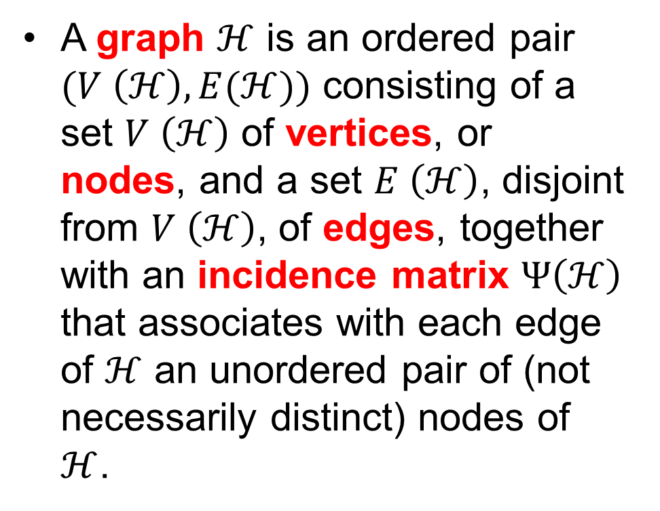
Graph theory (1)
A graph $ℋ$ is an ordered pair $(V \left(ℋ\right),E(ℋ))$ consisting of a set $V \left(ℋ\right)$ of vertices, or nodes, and a set $E \left(ℋ\right)$, disjoint from $V \left(ℋ\right)$, of edges, together with an incidence matrix $Ψ\left(ℋ\right)$ that associates with each edge of $ℋ$ an unordered pair of (not necessarily distinct) nodes of $ℋ$.
Example
Node
Edge

Slide 11
Graph theory (2)
Incidence matrix
  Edge 1 is incident with nodes 1 and 2
Example
Node | Edge
 | 1 | 2 | 3 | 4 | 5 | 6
1 | 1 | 1 | 0 | 0 | 0 | 0
2 | 1 | 0 | 1 | 0 | 0 | 0
3 | 0 | 1 | 1 | 1 | 1 | 0
4 | 0 | 0 | 0 | 1 | 0 | 0
5 | 0 | 0 | 0 | 0 | 1 | 1
6 | 0 | 0 | 0 | 0 | 0 | 1
1
2
3
Node
4
5
6
Edge

Slide 12
Graph theory (3)
Adjacency matrix
  Indicates, for each node, which nodes are adjacent, i.e. related by a single edge
Example
Node | Node
 | 1 | 2 | 3 | 4 | 5 | 6
1 | 0 | 1 | 1 | 0 | 0 | 0
2 | 1 | 0 | 1 | 0 | 0 | 0
3 | 1 | 1 | 0 | 1 | 1 | 0
4 | 0 | 0 | 1 | 0 | 0 | 0
5 | 0 | 0 | 1 | 0 | 0 | 1
6 | 0 | 0 | 0 | 0 | 1 | 0
Node
Edge

Slide 13
Graph theory: tree
Example
A tree is special case of a graph in which any two nodes are connected by exactly one path
A hierarchy is the same as a tree
Root
Leaves

Slide 14
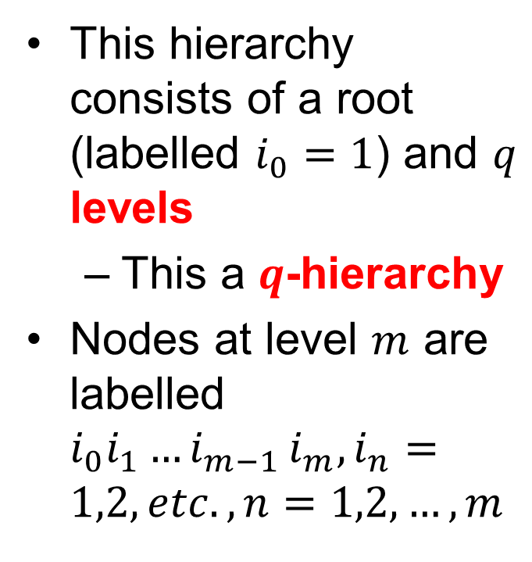
Larger hierarchies (trees): labelling of nodes
This hierarchy consists of a root (labelled $i_{0}=1$) and $q$ levels
  This a $q$-hierarchy
Nodes at level $m$ are labelled $i_{0}i_{1}{…i}_{m−1}i_{m},i_{n}=1,2,etc., n=1,2,…,m$

Slide 15
Overview
Motivation
Formal framework
Hierarchical models
  Static
  Evolutionary
Kalman filter
  In general
  Application to hierarchical model
Numerical example
Conclusion

Slide 16
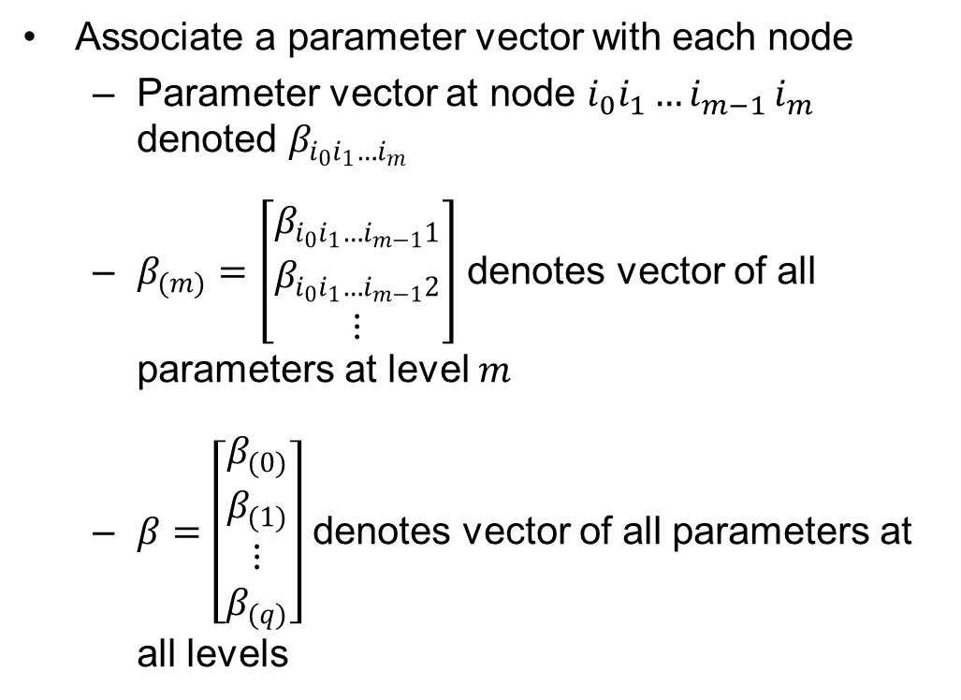
Hierarchical model: notation
Associate a parameter vector with each node
  Parameter vector at node $i_{0}i_{1}{…i}_{m−1}i_{m}$ denoted $β_{i_{0}i_{1}…i_{m}}$
  $β_{(m)}=\left[\begin{matrix}β_{i_{0}i_{1}…i_{m−1}1} \\ β_{i_{0}i_{1}…i_{m−1}2} \\ ⋮\end{matrix}\right]$ denotes vector of all parameters at level $m$
  $β=\left[\begin{matrix}β_{(0)} \\ β_{(1)} \\ \begin{matrix}⋮ \\ β_{(q)}\end{matrix}\end{matrix}\right]$ denotes vector of all parameters at all levels

Slide 17
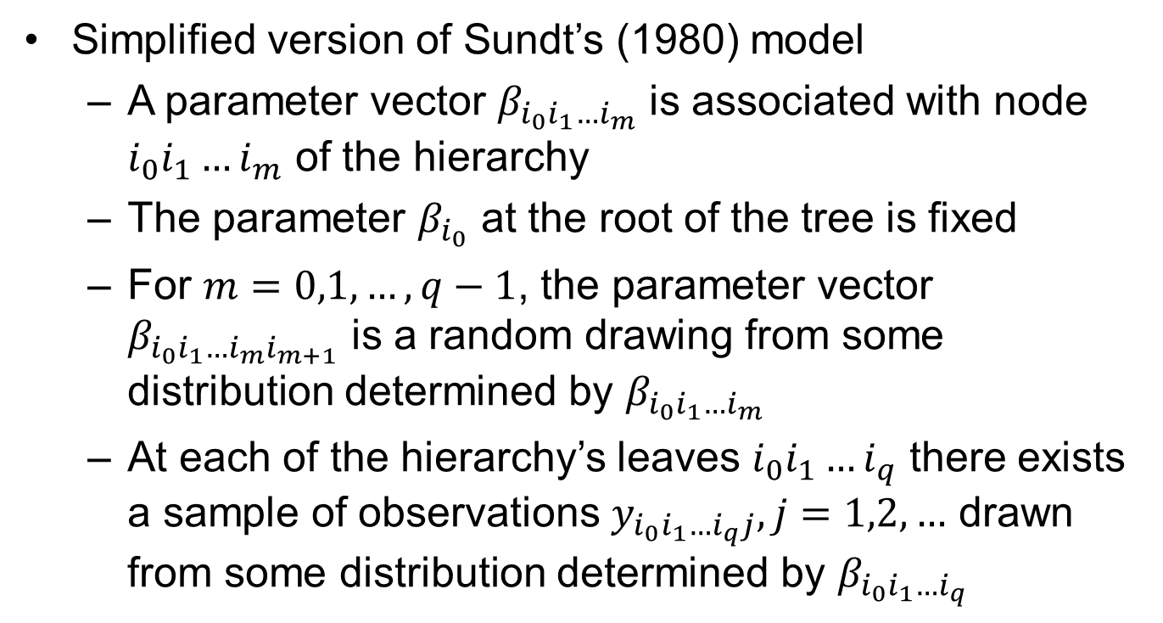
Static hierarchical model: formal statement
Simplified version of Sundt’s (1980) model
  A parameter vector $β_{i_{0}i_{1}…i_{m}}$ is associated with node $i_{0}i_{1}…i_{m}$ of the hierarchy
  The parameter $β_{i_{0}}$ at the root of the tree is fixed
  For $m=0,1,…,q−1$, the parameter vector $β_{i_{0}i_{1}…i_{m}i_{m+1}}$ is a random drawing from some distribution determined by $β_{i_{0}i_{1}…i_{m}}$
  At each of the hierarchy’s leaves $i_{0}i_{1}…i_{q}$ there exists a sample of observations $y_{i_{0}i_{1}…i_{q}j},j=1,2,…$ drawn from some distribution determined by $β_{i_{0}i_{1}…i_{q}}$

Slide 18
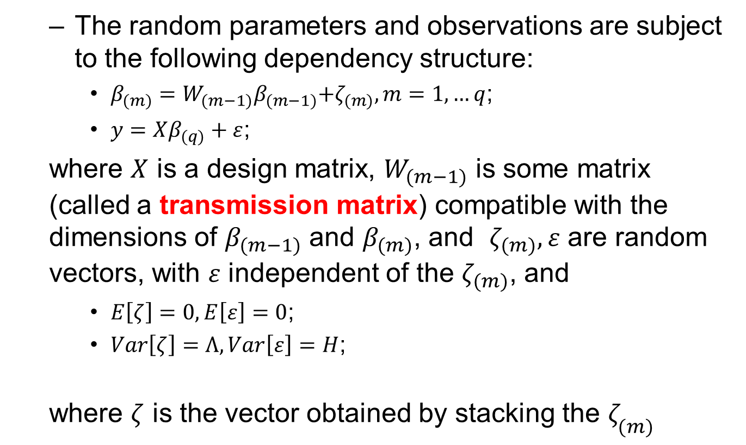
Static hierarchical model: formal statement (cont’d)
  The random parameters and observations are subject to the following dependency structure:
    $β_{(m)}=W_{(m−1)}β_{(m−1)}{+ζ}_{(m)},m=1,…q$;
    $y=Xβ_{(q)}+ε$;
  where $X$ is a design matrix, $W_{(m−1)}$ is some matrix (called a transmission matrix) compatible with the dimensions of $β_{(m−1)}$ and $β_{(m)}$, and $ζ_{(m)},ε$ are random vectors, with $ε$ independent of the $ζ_{(m)}$, and
    $E\left[ζ\right]=0,E\left[ε\right]=0$;
    $Var\left[ζ\right]=Λ,Var\left[ε\right]=H$;
  where $ζ$ is the vector obtained by stacking the $ζ_{(m)}$

Slide 19
Overview
Motivation
Formal framework
Hierarchical models
  Static
  Evolutionary
Kalman filter
  In general
  Application to hierarchical model
Numerical example
Conclusion

Slide 20
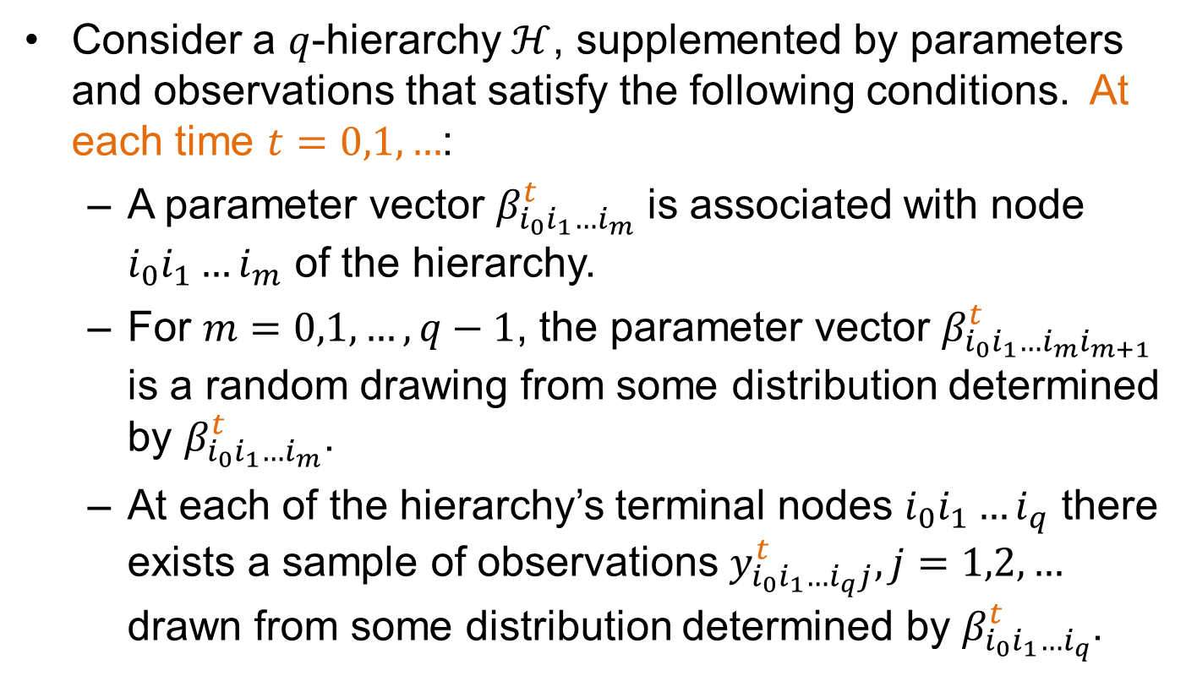
Evolutionary hierarchical model: formal statement
Consider a $q$-hierarchy $ℋ$, supplemented by parameters and observations that satisfy the following conditions. At each time $t=0,1,…$:
  A parameter vector $β_{i_{0}i_{1}…i_{m}}^{t}$ is associated with node $i_{0}i_{1}…i_{m}$ of the hierarchy.
  For $m=0,1,…,q−1$, the parameter vector $β_{i_{0}i_{1}…i_{m}i_{m+1}}^{t}$ is a random drawing from some distribution determined by $β_{i_{0}i_{1}…i_{m}}^{t}$.
  At each of the hierarchy’s terminal nodes $i_{0}i_{1}…i_{q}$ there exists a sample of observations $y_{i_{0}i_{1}…i_{q}j}^{t},j=1,2,…$ drawn from some distribution determined by $β_{i_{0}i_{1}…i_{q}}^{t}$.

Slide 21
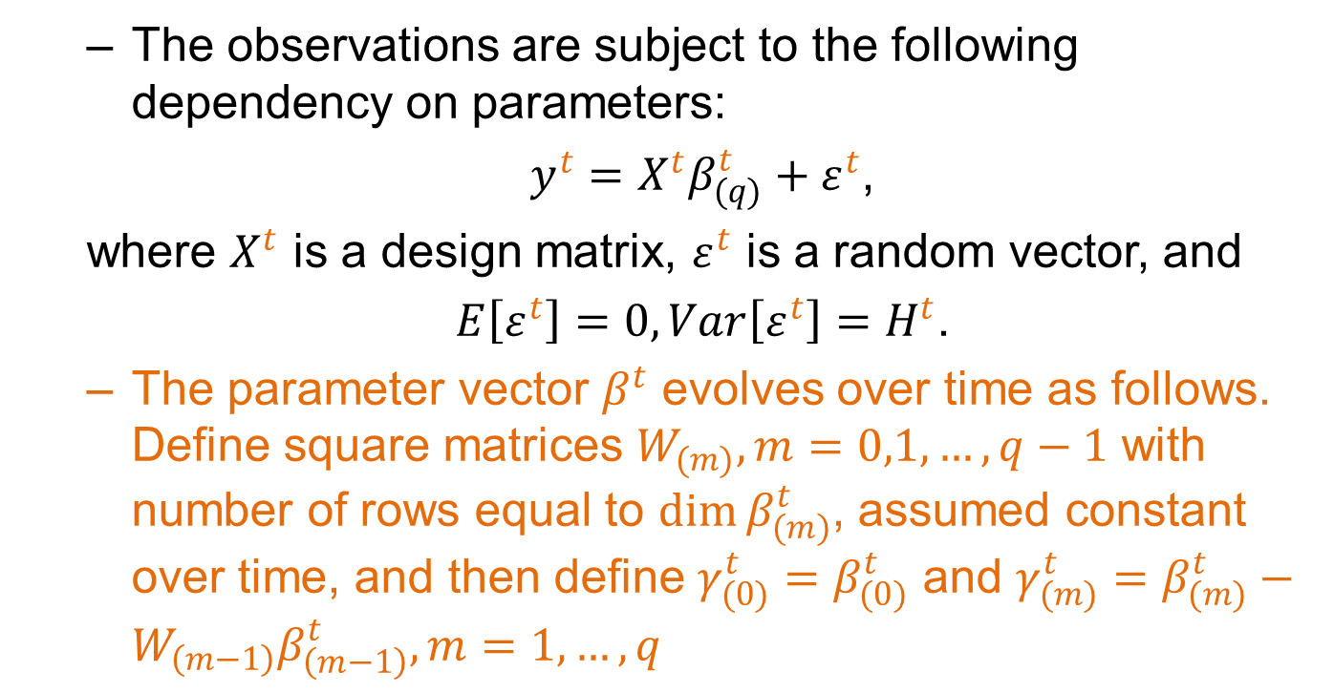
Evolutionary hierarchical model: formal statement (cont’d)
  The observations are subject to the following dependency on parameters:
  $y^{t}=X^{t}β_{(q)}^{t}+ε^{t}$,
  where $X^{t}$ is a design matrix, $ε^{t}$ is a random vector, and
  $E\left[ε^{t}\right]=0,Var\left[ε^{t}\right]=H^{t}$.
  The parameter vector $β^{t}$ evolves over time as follows. Define square matrices $W_{(m)},m=0,1,…,q−1$ with number of rows equal to $\dim{β_{(m)}^{t}}$, assumed constant over time, and then define $γ_{(0)}^{t}=β_{(0)}^{t}$ and $γ_{(m)}^{t}=β_{(m)}^{t}−W_{\left(m−1\right)}β_{\left(m−1\right)}^{t}, m=1,…,q$

Slide 22
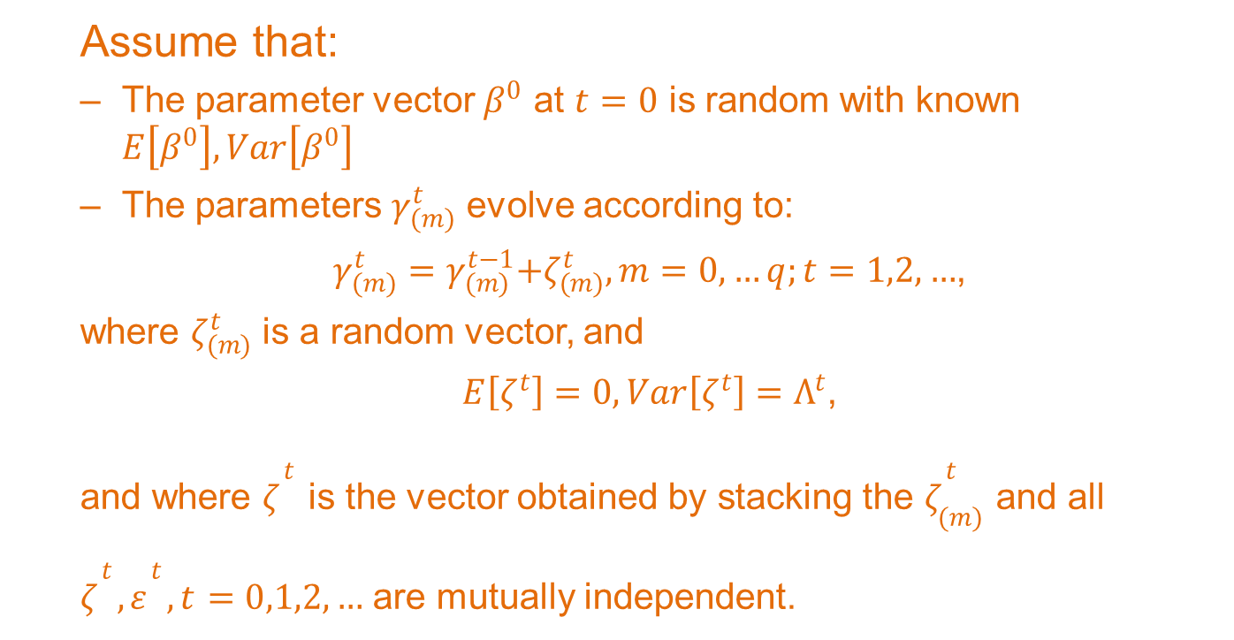
Evolutionary hierarchical model: formal statement (cont’d)
  Assume that:
  The parameter vector $β^{0}$ at $t=0$ is random with known $E\left[β^{0}\right],Var\left[β^{0}\right]$
  The parameters $γ_{(m)}^{t}$ evolve according to:
  $γ_{(m)}^{t}=γ_{(m)}^{t−1}{+ζ}_{(m)}^{t},m=0,…q;t=1,2,…$,
  where $ζ_{(m)}^{t}$ is a random vector, and
  $E\left[ζ^{t}\right]=0, Var\left[ζ^{t}\right]=Λ^{t}$,
  and where $ζ^{t}$ is the vector obtained by stacking the $ζ_{(m)}^{t}$ and all $ζ^{t},ε^{t},t=0,1,2,…$ are mutually independent.

Slide 23
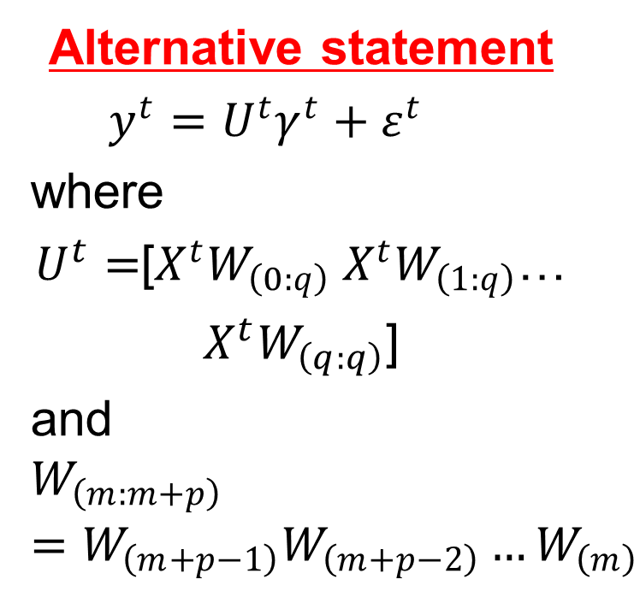

Alternative form of model
Original model
$$y^{t}=X^{t}β_{(q)}^{t}+ε^{t}$$
Alternative statement
$y^{t}=U^{t}γ^{t}+ε^{t}$
where
$U^{t}=$[${X^{t}W}_{\left(0:q\right)} {X^{t}W}_{\left(1:q\right)}$…
$X^{t}W_{\left(q:q\right)}$]
and
$$W_{\left(m:m+p\right)}=W_{\left(m+p−1\right)}W_{\left(m+p−2\right)}…W_{\left(m\right)}$$

Slide 24
Overview
Motivation
Formal framework
Hierarchical models
  Static
  Evolutionary
Kalman filter
  In general
  Application to hierarchical model
Numerical example
Conclusion

Slide 25
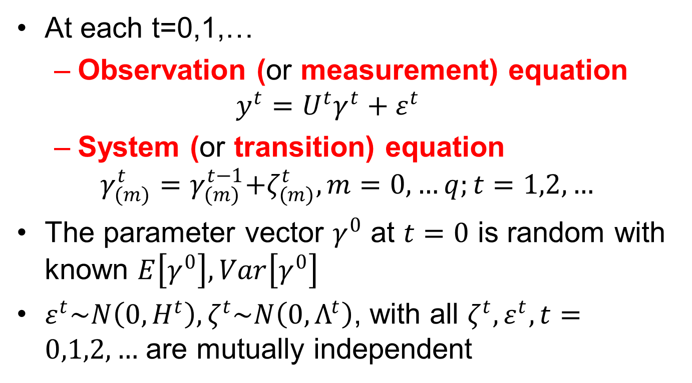
Kalman filter (slightly simplified): model formulation
At each t=0,1,…
  Observation (or measurement) equation
  $$y^{t}=U^{t}γ^{t}+ε^{t}$$
  System (or transition) equation
$$γ_{(m)}^{t}=γ_{(m)}^{t−1}{+ζ}_{(m)}^{t},m=0,…q;t=1,2,…$$
The parameter vector $γ^{0}$ at $t=0$ is random with known $E\left[γ^{0}\right],Var\left[γ^{0}\right]$
$ε^{t}\sim N\left(0,H^{t}\right), ζ^{t}\sim N\left(0,Λ^{t}\right)$, with all $ζ^{t},ε^{t},t=0,1,2,…$ are mutually independent

Slide 26
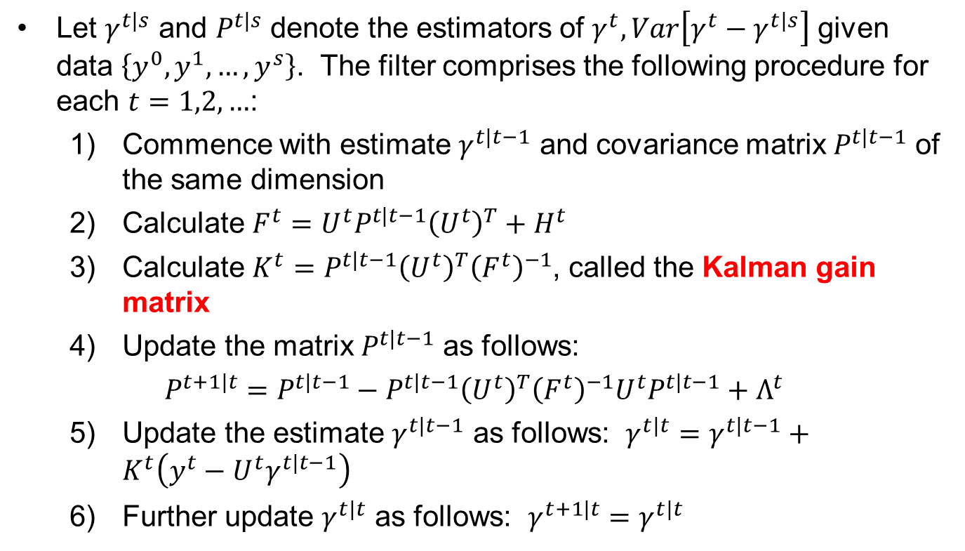
Kalman filter: parameter estimation algorithm
Let $γ^{t|s}$ and $P^{t|s}$ denote the estimators of $γ^{t},Var\left[γ^{t}−γ^{t|s}\right]$ given data $\left\{y^{0},y^{1},…,y^{s}\right\}$. The filter comprises the following procedure for each $t=1,2,…$:
  Commence with estimate $γ^{t|t−1}$ and covariance matrix $P^{t|t−1}$ of the same dimension
  Calculate $F^{t}=U^{t}P^{t|t−1}{\left(U^{t}\right)}^{T}+H^{t}$
  Calculate $K^{t}=P^{t|t−1}{\left(U^{t}\right)}^{T}{\left(F^{t}\right)}^{−1}$, called the Kalman gain matrix
  Update the matrix $P^{t|t−1}$ as follows:
  $P^{t+1|t}=P^{t|t−1}−P^{t|t−1}{\left(U^{t}\right)}^{T}{\left(F^{t}\right)}^{−1}U^{t}P^{t|t−1}+Λ^{t}$
  Update the estimate $γ^{t|t−1}$ as follows: $γ^{t|t}=γ^{t|t−1}+K^{t}\left(y^{t}−U^{t}γ^{t|t−1}\right)$
  Further update $γ^{t|t}$ as follows: $γ^{t+1|t}=γ^{t|t}$
Credibility type of estimator

Slide 27
Overview
Motivation
Formal framework
Hierarchical models
  Static
  Evolutionary
Kalman filter
  In general
  Application to hierarchical model
Numerical example
Conclusion

Slide 28
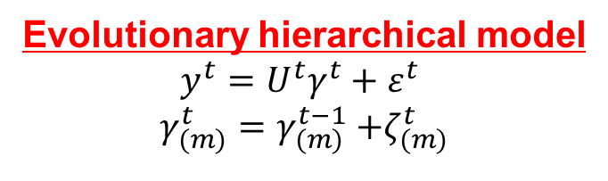
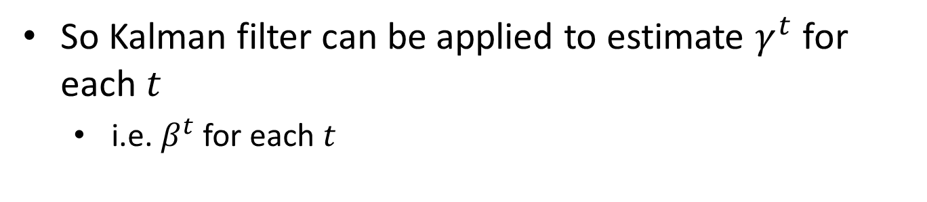
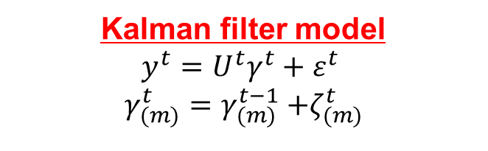
Comparison of evolutionary hierarchical and Kalman filter models
Evolutionary hierarchical model
$$y^{t}=U^{t}γ^{t}+ε^{t}$$
$$γ_{(m)}^{t}=γ_{(m)}^{t−1}{+ζ}_{(m)}^{t}$$
Kalman filter model
$$y^{t}=U^{t}γ^{t}+ε^{t}$$
$$γ_{(m)}^{t}=γ_{(m)}^{t−1}{+ζ}_{(m)}^{t}$$
So Kalman filter can be applied to estimate $γ^{t}$ for each $t$
  i.e. $β^{t}$ for each $t$

Slide 29
Overview
Motivation
Formal framework
Hierarchical models
  Static
  Evolutionary
Kalman filter
  In general
  Application to hierarchical model
Numerical example
Conclusion

Slide 30
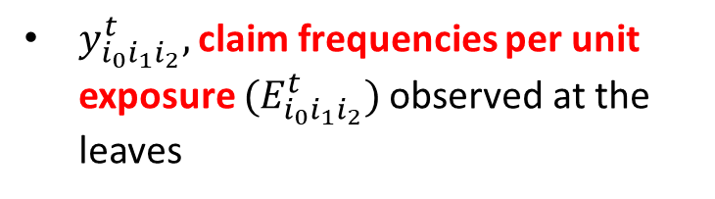
Numerical example: definition of hierarchy
Level 0: Single node {1}
Level 1: Nodes {11,12,13}
Level 2: Nodes {111,112,121,122,123,124,131,132,133,134}
111
112
121
122
123
124
131
132
133
134
$y_{i_{0}i_{1}i_{2}}^{t},$claim frequencies per unit exposure ${(E}_{i_{0}i_{1}i_{2}}^{t})$observed at the leaves

Slide 31
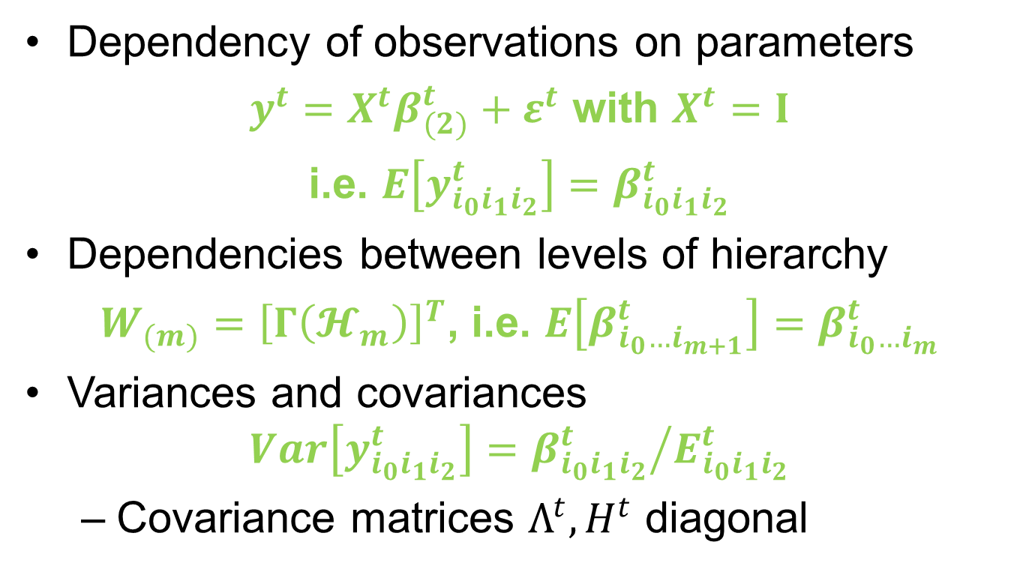
Numerical example: model structure
Dependency of observations on parameters
$y^{t}=X^{t}β_{(2)}^{t}+ε^{t}$ with $X^{t}=I$
i.e. $E\left[y_{i_{0}i_{1}i_{2}}^{t}\right]=β_{i_{0}i_{1}i_{2}}^{t}$
Dependencies between levels of hierarchy
$W_{(m)}={\left[Γ\left(𝓗_{m}\right)\right]}^{T}$, i.e. $E\left[β_{i_{0}…i_{m+1}}^{t}\right]=β_{i_{0}…i_{m}}^{t}$
Variances and covariances
$$Var\left[y_{i_{0}i_{1}i_{2}}^{t}\right]={β_{i_{0}i_{1}i_{2}}^{t}}/{E_{i_{0}i_{1}i_{2}}^{t}}$$
  Covariance matrices $Λ^{t},H^{t}$ diagonal

Slide 32
Numerical example: true parameters

Slide 33
Numerical example: simulated data
All nodes trendless except:
  Node 121: upward trend of 0.015 per period added
  Node 124: flat reduction of 0.040 made in each period
  Node 132: downward trend of 0.020 per period added

Slide 34
Numerical example: results (1)
Node 121: increasing trend in true frequency

Slide 35

Numerical example: results (2)
Node 124: one-off downward shift in true frequency at $t=1$

Slide 36
Numerical example: results (3)
Node 132: decreasing trend in true frequency

Slide 37
Overview
Motivation
Formal framework
Hierarchical models
  Static
  Evolutionary
Kalman filter
  In general
  Application to hierarchical model
Numerical example
Conclusion

Slide 38
Conclusion
Evolutionary hierarchical model has been formulated
Parameter estimates obtained by application of the Kalman filter
  Filter update estimates from one epoch to the next as further data are observed
Application of the Kalman filter conceptually straightforward, but
  Tree structure of the model parameters can be extensive
  Some effort is required to retain organization of the updating algorithm
  Achieved by suitable manipulation of the adjacency matrix associated with the tree
  Adjacency matrix then recruited to play its role in Kalman filter matrix calculations

Slide 39
References
Sundt B (1979). A hierarchical credibility regression model. Scandinavian Actuarial Journal, 107-114.
Sundt B (1980). A multi-level hierarchical credibility regression model. Scandinavian Actuarial Journal, 25-32.
Taylor G C (1979). Credibility analysis of a general hierarchical model, Scandinavian Actuarial Journal, 1979(1), 1-12.

Slide 40
Questions?

