Slide 1
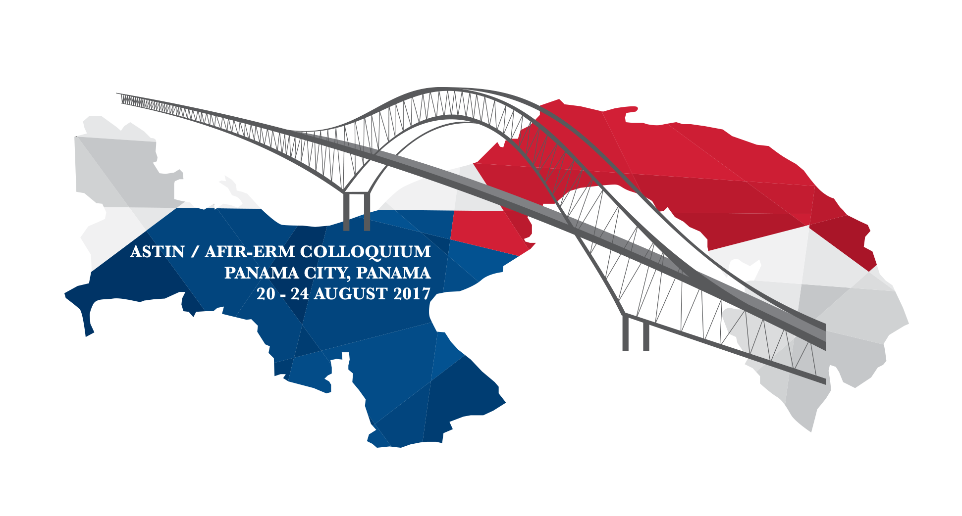
INAIL LIFE TABLES FOR WORK-RELATED INJURED OR ILL PEOPLE
Panama City, August 21–24, 2017
Laura Baradel – Actuary at Inail
Daniela Martini – Actuary at Inail
2017 ASTIN / AFIR Colloquium

Slide 2
AGENDA
ITALIAN INSURANCE AGAINST ACCIDENTS AT WORK
  INAIL: National Institute for insurance against accidents at work
  Compulsory Insurance
  Object of insurance
  INAIL benefits
PURPOSE OF THE STUDY
SECTION I: INAIL ANNUITIES’ PORTFOLIO
  SECTION II: INAIL LIFE TABLES
INAIL LIFE TABLES FOR WORK-RELATED INJURED OR ILL PEOPLE

Slide 3
ITALIAN INSURANCE AGAINST ACCIDENTS AT WORK

Slide 4
ITALIAN INSURANCE AGAINST ACCIDENTS AT WORK
Italian State establishes the obligation to insure workers involved in hazardous activities against the risk of possible accidents in the workplace or diseases caused by these working activities, identifying the employer as the party liable to sustain the economic cost.
INAIL LIFE TABLES FOR WORK-RELATED INJURED OR ILL PEOPLE

Slide 5
ITALIAN INSURANCE AGAINST ACCIDENTS AT WORK
National Institute for insurance against accidents at work
INAIL
Italian National Institute for insurance against accidents at work (INAIL) is a non-profit public body, subject to supervision by the Ministry of Labour and Social Security and the Ministry of the Economy and Finance.
INAIL provides compulsory insurance against accidents at work and occupational diseases.
INAIL LIFE TABLES FOR WORK-RELATED INJURED OR ILL PEOPLE

Slide 6
ITALIAN INSURANCE AGAINST ACCIDENTS AT WORK
Compulsory insurance
The insurance is compulsory for all employers who employ subordinate workers
(and/or workers with equivalent status) in activities identified as dangerous by law;
Craftsmen and self-employed farmers are obliged to insure themselves;
A specific Law (n. 493/99) introduced the insurance obligation also for housewives.
INAIL LIFE TABLES FOR WORK-RELATED INJURED OR ILL PEOPLE

Slide 7
ITALIAN INSURANCE AGAINST ACCIDENTS AT WORK
Object of insurance
ACCIDENT AT WORK
An accident at the workplace is an accident due to a violent cause - rapid and in a short period of time - which takes place during work and leads either to death, a permanent disability to work or a temporary total disability, requiring the worker to take sick leave for more than three days.
INAIL LIFE TABLES FOR WORK-RELATED INJURED OR ILL PEOPLE

Slide 8
ITALIAN INSURANCE AGAINST ACCIDENTS AT WORK
Object of insurance
OCCUPATIONAL DISEASE
An occupational disease is an illness contracted as a result of an exposure over a period of time to risk factors arising from work activity.
INAIL LIFE TABLES FOR WORK-RELATED INJURED OR ILL PEOPLE

Slide 9
  ITALIAN INSURANCE AGAINST ACCIDENTS AT WORK
  INAIL benefits
INAIL provides economic, health care and additional benefits to workers who suffer from accidents or occupational diseases.
INAIL LIFE TABLES FOR WORK-RELATED INJURED OR ILL PEOPLE

Slide 10
  ITALIAN INSURANCE AGAINST ACCIDENTS AT WORK
  INAIL benefits
Main economic benefits are as follows:
• Daily indemnity for temporary total disability to work, paid as from the fourth day following the event until clinical recovery;
• Direct annuity for permanent disability, paid for events up to 24 July 2000;
• Compensation for impairment of psycho-physical integrity, i.e. “biological damage”, paid for events from 25 July 2000. For persisting consequences of degree between 6% and 15% a lump-sum compensation is provided. From degrees 16% upwards annuities are paid;
• Annuity to survivors of workers who have died due to the accident or the occupational disease, as long as the requirements of the law are met.
INAIL LIFE TABLES FOR WORK-RELATED INJURED OR ILL PEOPLE

Slide 11
  ITALIAN INSURANCE AGAINST ACCIDENTS AT WORK
  INAIL benefits
Workers who are accident victims are entitled to obtain medical and surgical health care benefits provided by the National Health Service, including clinical tests, in order to ensure recovery of health and of the maximum working capacity.
Under agreements with the Regions, INAIL provides, at its own expense at its local offices, initial day care including rehabilitation care until the recovery of the worker, as well as:
Prostheses and other medical aids;
Thermal treatments.
INAIL LIFE TABLES FOR WORK-RELATED INJURED OR ILL PEOPLE

Slide 12
PURPOSE OF THE STUDY

Slide 13
  PURPOSE OF THE STUDY
For actuarial valuations of long term liability (pricing, reserving ...), INAIL uses specific ratios that, in compliance with law (Consolidated Law n. 1124/1965, art. 39), must be reviewed at least every five years.
In order to comply with law requirements and to take into account the recent changes in risk at work, INAIL “Statistical and Actuarial Office” has carried out a study focused at monitoring mortality (i.e. demographic hypothesis for such ratios) among Inail annuitants.
INAIL LIFE TABLES FOR WORK-RELATED INJURED OR ILL PEOPLE

Slide 14
  PURPOSE OF THE STUDY
PURPOSE OF THE STUDY
CREATE
INAIL ANNUITANTS
LIFE TABLE
COMPARING WITH
ISTAT: Italian National Institute for Statistic
ISTAT TABLES
FOR ITALIAN POPULATION
INAIL LIFE TABLES FOR WORK-RELATED INJURED OR ILL PEOPLE

Slide 15
SECTION I: INAIL ANNUITIES’ PORTFOLIO

Slide 16
SECTION I AGENDA
  REGULATORY FRAMEWORK
  Consolidated Law n. 1124/1965
  Legislative Decree n. 38/2000
  PERMANENT DISABILITY ANNUITIES
  Consolidated Law annuities’ data sheet
  Decree 38/2000 annuities’ data sheet
  INAIL portfolio of permanent disability annuities
  WORKERS’ SURVIVORS’ ANNUITIES
  Workers’ survivors’ annuities’ data sheet
  INAIL portfolio of survivors’ annuities
INAIL LIFE TABLES FOR WORK-RELATED INJURED OR ILL PEOPLE

Slide 17
REGULAMENTORY FRAMEWORK

Slide 18
REGULATORY FRAMEWORK
25 July 2000
CONSOLIDATED LAW
n. 1124/1965
LEGISLATIVE DECREE
n. 38/2000
INAIL LIFE TABLES FOR WORK-RELATED INJURED OR ILL PEOPLE

Slide 19
REGULATORY FRAMEWORK
Consolidated Law n. 1124/1965
The Consolidated Law n. 1124/1965 applies to accidents that occurred - and occupational diseases reported - before 25 July 2000 and provides economic compensation for the diminished capacity for work.
New regulations for indemnities are applied to events occurred since 25 July 2000, the date when Decree n. 38/2000 was published in the Official Journal.
INAIL LIFE TABLES FOR WORK-RELATED INJURED OR ILL PEOPLE

Slide 20
REGULATORY FRAMEWORK
Legislative Decree n. 38/2000
Legislative Decree n. 38/2000 redefined the overall role of INAIL, starting to consider worker’s injury as a violation of the basic right to health; compensation for “biological damage” was therefore provided.
With regard to occupational diseases, Decree n. 38/2000 updated the “Tables of impairments”, including about 400 items not previously considered (e.g. aesthetic damage, damage to the reproductive system, etc...).
INAIL LIFE TABLES FOR WORK-RELATED INJURED OR ILL PEOPLE

Slide 21
PERMANENT DISABILITY ANNUITIES

Slide 22
PERMANENT DISABILITY ANNUITIES
PERMANENT DISABILITY ANNUITIES
Regulated by:
Consolidated Law
n. 1124/1965
Legislative Decree
n. 38/2000
INAIL LIFE TABLES FOR WORK-RELATED INJURED OR ILL PEOPLE

Slide 23
PERMANENT DISABILITY ANNUITIES
Consolidated Law annuities’ data sheet
PERMANENT DISABILITY ANNUITY
for events prior to 25 July 2000
NATURE OF THE BENEFIT
Economic compensation for the diminished capacity for work appraised on the basis of the tables attached to the Consolidated Law 1124/1965.
REQUIREMENTS FOR ENTITLEMENT TO THE BENEFIT
• work origin of the accident or the disease;
• degree of permanent disability between 11% and 100%.
INAIL LIFE TABLES FOR WORK-RELATED INJURED OR ILL PEOPLE

Slide 24
PERMANENT DISABILITY ANNUITIES
Consolidated Law annuities’ data sheet
STARTING DATE
From the day following the clinical recovery.
DURATION
Lifelong.
CALCULATION OF THE ANNUITY
The amount of the annuity is calculated on:
• the salary received in the year prior to the date of the accident or the declaration of the disease (within the minimum and maximum limits laid down by the law);
• the degree of disability recognised.
INAIL LIFE TABLES FOR WORK-RELATED INJURED OR ILL PEOPLE

Slide 25
PERMANENT DISABILITY ANNUITIES
Decree 38/2000 annuities’ data sheet
PERMANENT DISABILITY ANNUITY
for events occurred since 25 July 2000
NATURE OF THE BENEFIT
Economic compensation for “lesion of a person’s psycho-physical integrity” defined on the basis of the tables attached to Legislative Decree n. 38/2000.
REQUIREMENTS FOR ENTITLEMENT TO THE BENEFIT
• work origin of the accident or the disease;
• degree of permanent disability between 16% and 100%.
INAIL LIFE TABLES FOR WORK-RELATED INJURED OR ILL PEOPLE

Slide 26
PERMANENT DISABILITY ANNUITIES
Decree 38/2000 annuities’ data sheet
STARTING DATE
From the day following the clinical recovery.
DURATION
Lifelong.
CALCULATION OF THE ANNUITY
The annuity is the sum of two components:
Fixed amount (depending on the degree of impairment) as compensation of biological damage;
Amount depending on the salary and the degree of disability as compensation of economic consequences.
INAIL LIFE TABLES FOR WORK-RELATED INJURED OR ILL PEOPLE

Slide 27
  PERMANENT DISABILITY ANNUITIES
  INAIL portfolio of permanent disability annuities
Permanent disability annuities at 31 December 2013
At the end of 2013, INAIL permanent disability annuities’ portfolio is mainly made up of annuities regulated by Consolidated Law (more than 84% of cases); annuities caused by accidents are 78,7%, those due to occupational diseases are 21,3%.
INAIL LIFE TABLES FOR WORK-RELATED INJURED OR ILL PEOPLE

Slide 28

  PERMANENT DISABILITY ANNUITIES
  INAIL portfolio of permanent disability annuities
AVERAGE VALUES
In order to underline the differences between the two group of annuitants, the next tables show, for each group, the average values of the most important variables:
degree at the event;
age at the event;
age at the valuation date (in the study: 31 December 2013);
claim age (years from the starting date of annuity to valuation date).
In SECTION II (describing the construction of Inail Life Tables)
we’ll show how claim age affects substantially the level of mortality.
INAIL LIFE TABLES FOR WORK-RELATED INJURED OR ILL PEOPLE

Slide 29
  PERMANENT DISABILITY ANNUITIES
  INAIL portfolio of permanent disability annuities
Permanent disability annuities at 31 December 2013
Average values
GROUP 1. Consolidated Law annuities
Consolidated Law annuitants have an average impairment degree at the event of 28,6%, an average age at the event of about 40 years and a very high average claim age (30,6 years).
INAIL LIFE TABLES FOR WORK-RELATED INJURED OR ILL PEOPLE

Slide 30
  PERMANENT DISABILITY ANNUITIES
  INAIL portfolio of permanent disability annuities
Permanent disability annuities at 31 December 2013
Average values
GROUP 2. Decree 38/2000 annuities
Decree 38/2000 annuitants have a lower average impairment degree at the event (26,0%), a higher average age at the event (about 47 years) and a lower average claim age (5,7 years).
INAIL LIFE TABLES FOR WORK-RELATED INJURED OR ILL PEOPLE

Slide 31
  PERMANENT DISABILITY ANNUITIES
  INAIL portfolio of permanent disability annuities
CLASSES OF DEGREE
The following tables compare classes of degree distribution of the two groups of annuities, showing that most of permanent disabilities has a degree less or equal to 40% (over 85% of cases for both statistical groups).
INAIL LIFE TABLES FOR WORK-RELATED INJURED OR ILL PEOPLE

Slide 32
  PERMANENT DISABILITY ANNUITIES
  INAIL portfolio of permanent disability annuities
Permanent disability annuities at 31 December 2013
Classes of degree distribution
GROUP 1. Consolidated Law annuities
INAIL LIFE TABLES FOR WORK-RELATED INJURED OR ILL PEOPLE

Slide 33
  PERMANENT DISABILITY ANNUITIES
  INAIL portfolio of permanent disability annuities
Permanent disability annuities at 31 December 2013
Classes of degree distribution
GROUP 2. Decree 38/2000 annuities
INAIL LIFE TABLES FOR WORK-RELATED INJURED OR ILL PEOPLE

Slide 34
WORKERS’ SURVIVORS’ ANNUITIES

Slide 35
  WORKERS’ SURVIVORS ANNUITIES
  Workers’ survivors’ annuities’ data sheet
ANNUITY TO SURVIVORS
NATURE OF THE BENEFIT
Economic.
REQUIREMENTS FOR ENTITLEMENT TO THE BENEFIT
The death of the worker caused by the accident or by the occupational disease.
STARTING DATE
From the day subsequent to the worker’s death.
INAIL LIFE TABLES FOR WORK-RELATED INJURED OR ILL PEOPLE

Slide 36
WORKERS’ SURVIVORS ANNUITIES
Workers’ survivors’ annuities’ data sheet
ENTITLED TO THE BENEFIT
spouse: until death or re-marriage.
legitimate, natural or recognised or adoptive children:
  until 18 years of age for all children and, however, not beyond 26 years of age, if students;
  adults unfit for work: as long as such incapacity lasts.
In the absence of spouse and children:
• natural or adoptive parents: if economically dependent, until death;
• brothers and sisters: if economically dependent and co-habiting, in the same terms as those valid for children.
INAIL LIFE TABLES FOR WORK-RELATED INJURED OR ILL PEOPLE

Slide 37
WORKERS’ SURVIVORS ANNUITIES
Workers’ survivors’ annuities’ data sheet
CALCULATION OF THE ANNUITY
With regard to the annual salary of the dead worker, the annuity is calculated as follows:
• 50% to the spouse;
• 20% to each child (40% if child orphaned of both parents).
In the absence of spouse and children:
• 20% to each natural or adoptive parent;
• 20% to each brother and sister.
INAIL LIFE TABLES FOR WORK-RELATED INJURED OR ILL PEOPLE

Slide 38
  PERMANENT DISABILITY ANNUITIES
  INAIL portfolio of survivors’ annuities
Survivors’ annuities at 31 December 2013
Survivors’ annuities’ portfolio at the end of 2013 is mainly made up of annuity paid to spouses (about 86% of cases).
INAIL LIFE TABLES FOR WORK-RELATED INJURED OR ILL PEOPLE

Slide 39
SECTION II: INAIL LIFE TABLES

Slide 40
SECTION II AGENDA
  METHOD
    Statistical period of observation
    Average lifespan method
    Piecewise smoothing
    Mortality rates projection
  PERMANENT DISABILITY ANNUITANTS’ LIFE TABLES
    High claim age annuitants’ life tables
    Low claim age annuitants’ life tables
      Injured life tables
      Ill people life tables
    Specific mortality rates
INAIL LIFE TABLES FOR WORK-RELATED INJURED OR ILL PEOPLE

Slide 41
SECTION II PLAN
  WORKERS’ SURVIVORS’ ANNUITANTS’ LIFE TABLES
    Surviving widow(er)s’ life table
    Orphans’ life table
  CONCLUSIONS
    Average mortality rates
    Life expectancy
INAIL LIFE TABLES FOR WORK-RELATED INJURED OR ILL PEOPLE

Slide 42
METHOD

Slide 43
METHOD
STATISTICAL PERIOD OF OBSERVATION
              1 January 1996 to 31 December 2013
              Aggregates considered in the study, cleaned out from the outliers found during data check phase:
Annuities in payment at the beginning | 1.380.258
New annuities during the period (entries) | 433.058
Ended annuities during the period (exits) | 1.016.963
Annuities in payment at the end | 796.353
INAIL LIFE TABLES FOR WORK-RELATED INJURED OR ILL PEOPLE

Slide 44
METHOD
Mortality rates have been calculated using "average lifespan method”, being valid the hypothesis of uniform distribution of entries and exits;
Empirical data have been smoothed using "piecewise smoothing" technique;
In order to take into account the "longevity risk", mortality rates have been projected.
INAIL LIFE TABLES FOR WORK-RELATED INJURED OR ILL PEOPLE

Slide 45
METHOD
Average lifespan method
Exposed to risk of elimination have been computed considering, for each annuitants age, annuities in payment at the beginning of the statistical period, entries during the period, exits by any causes during the period (for example cause for elimination is the fall of the degree under 16%) and annuities in payment at the end of the period.
Frequencies of deaths are “pure rates", i.e. not depending on any other cause for elimination.
We obtained empirical frequencies of deaths as the ratio between annuities ended for death (d_{x}) and annuities exposed to risk (E_{x}), cleaned from any other cause for elimination:
d_{x}
q_{x} =
E_{x}
INAIL LIFE TABLES FOR WORK-RELATED INJURED OR ILL PEOPLE

Slide 46
METHOD
Piecewise smoothing
              Empirical data have been smoothed using "piecewise smoothing" technique.
              In particular:
                for central ages (where data are richer) a moving average has been adopted;
                for extreme ages (in case of rare or missing data) ISTAT Tables of Italian population have been used.
ISTAT: Italian National Institute for Statistic
INAIL LIFE TABLES FOR WORK-RELATED INJURED OR ILL PEOPLE

Slide 47
METHOD
Mortality rates projection
              In order to take into account the "longevity risk", mortality rates have been projected using forecasting factors described in the study called "The demographic future of the country”, issued by ISTAT in 2011.
              ISTAT study adopted Lee-Carter parametric model, obtaining mortality trend from Italian population Life Tables of the period 1974-2008 and considering a forecasting period from 2011 to 2065.
INAIL LIFE TABLES FOR WORK-RELATED INJURED OR ILL PEOPLE

Slide 48
  PERMANENT DISABILITY ANNUITANTS’ LIFE TABLES

Slide 49
PERMANENT DISABILITY ANNUITANTS’ LIFE TABLES
Mortality analysis of permanent disability annuitants has been done separately for:
events regulated by Consolidated Law n. 1124/1965;
events regulated by Legislative Decree n. 38/2000.
The two groups have different average values, especially claim age, i.e. years from the starting date of annuity to valuation date (in the study: 31 December 2013).
INAIL LIFE TABLES FOR WORK-RELATED INJURED OR ILL PEOPLE

Slide 50
PERMANENT DISABILITY ANNUITANTS’ LIFE TABLES
Data show that claim age is the variable that mostly affects the mortality level; indeed, in the early years following the event, until the stabilization of impairing after-effects, the level of mortality is higher for all ages.
              For the sake of simplicity, in the following analysis, the annuities regulated by Consolidated Law n. 1124/1965 (with a claim age higher than 13 years) will be called “High claim age annuities”; the annuities regulated by Legislative Decree n. 38/2000 (with a claim age equal or lower than 13 years) will be called “Low claim age annuities”.
INAIL LIFE TABLES FOR WORK-RELATED INJURED OR ILL PEOPLE

Slide 51
PERMANENT DISABILITY ANNUITANTS’ LIFE TABLES
The elements to take into account to release mortality rates for work accidents or occupational diseases victims are:
choice of a suitable observation period;
change in mortality depending on the type of event (accident, occupational disease);
change in mortality depending on the impairment degree.
INAIL LIFE TABLES FOR WORK-RELATED INJURED OR ILL PEOPLE

Slide 52
PERMANENT DISABILITY ANNUITANTS’ LIFE TABLES
High claim age annuitants
              HIGH CLAIM AGE ANNUITANTS
              OBSERVATION PERIOD: 2006-2013
              The higher level of mortality of the years between 1996 and 2005 affected mortality frequencies, so the shorter observation period 2006-2013, characterized by a lower mortality, has been considered.
              TYPE OF EVENT: empirical frequencies have been calculated separately for work-related injured and ill people. Since mortality raw rates are very similar, life tables not dependent on type of event have been created.
INAIL LIFE TABLES FOR WORK-RELATED INJURED OR ILL PEOPLE

Slide 53
PERMANENT DISABILITY ANNUITANTS’ LIFE TABLES
High claim age annuitants
IMPAIRMENT DEGREE: data have been grouped in 20 percentage points classes of degree:
Empirical frequencies (x 1.000)
Only two life tables have been released: the first one for degrees up to 60% and the second one for degrees from 61% to 100%. Class 81%-100% annuitants have a very high mortality, but there was an unsufficient number of events to calculate a specific life curve for this class.
INAIL LIFE TABLES FOR WORK-RELATED INJURED OR ILL PEOPLE
Notes:
.

Slide 54
PERMANENT DISABILITY ANNUITANTS’ LIFE TABLES
High claim age annuitants
Probability of death (x 1.000) of Inail permanent disability annuitants with high claim age
Comparison with Italian population (ISTAT 2013)
INAIL LIFE TABLES FOR WORK-RELATED INJURED OR ILL PEOPLE

Slide 55
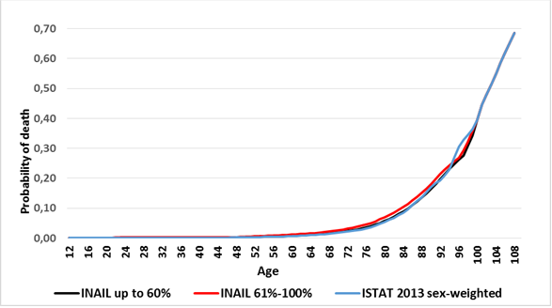
PERMANENT DISABILITY ANNUITANTS’ LIFE TABLES
High claim age annuitants
Probability of death of Inail permanent disability annuitants with high claim age
Comparison with Italian population (ISTAT 2013)
INAIL LIFE TABLES FOR WORK-RELATED INJURED OR ILL PEOPLE

Slide 56
PERMANENT DISABILITY ANNUITANTS’ LIFE TABLES
Low claim age annuitants
              LOW CLAIM AGE ANNUITANTS
              OBSERVATION PERIOD: 2000-2013
              TYPE OF EVENT: empirical frequencies have been calculated separately for accidents and occupational diseases; since data showed that ill people level of mortality is higher than that of injured one, life tables distinguished for type of event have been constructed.
INAIL LIFE TABLES FOR WORK-RELATED INJURED OR ILL PEOPLE

Slide 57
              PERMANENT DISABILITY ANNUITANTS’ LIFE TABLES
              Low claim age annuitants - Injured
              LOW CLAIM AGE ANNUITANTS - INJURED
IMPAIRMENT DEGREE: data have been grouped in 20 percentage points classes of degree:
Empirical frequencies (x 1.000)
              Only two life tables have been released: the first one for degrees up to 60% and the second one for degrees from 61% to 100%.
INAIL LIFE TABLES FOR WORK-RELATED INJURED OR ILL PEOPLE

Slide 58
PERMANENT DISABILITY ANNUITANTS’ LIFE TABLES
Low claim age annuitants - Injured
Probability of death (x 1.000) of Inail permanent disability annuitants
with low claim age - Injured
Comparison with Italian population (ISTAT 2013)
INAIL LIFE TABLES FOR WORK-RELATED INJURED OR ILL PEOPLE

Slide 59
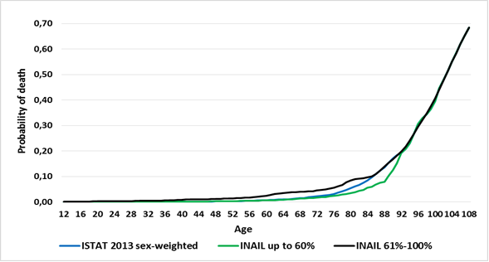
PERMANENT DISABILITY ANNUITANTS’ LIFE TABLES
Low claim age annuitants - Injured
Probability of death of Inail permanent disability annuitants
with low claim age - Injured
Comparison with Italian population (ISTAT 2013)
INAIL LIFE TABLES FOR WORK-RELATED INJURED OR ILL PEOPLE

Slide 60
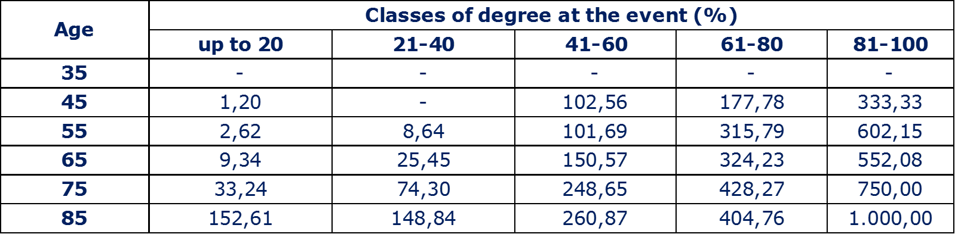
              PERMANENT DISABILITY ANNUITANTS’ LIFE TABLES
              Low claim age annuitants – Ill people
              LOW CLAIM AGE ANNUITANTS – ILL PEOPLE
IMPAIRMENT DEGREE: data have been grouped in 20 percentage points classes of degree:
Empirical frequencies (x 1.000)
              Only two life tables have been released: the first one for degrees up to 60% and the second one for degrees from 61% to 100%.
INAIL LIFE TABLES FOR WORK-RELATED INJURED OR ILL PEOPLE

Slide 61
PERMANENT DISABILITY ANNUITANTS’ LIFE TABLES
Low claim age annuitants – Ill people
Probability of death (x 1.000) of Inail permanent disability annuitants
with low claim age – Ill people
Comparison with Italian population (ISTAT 2013)
INAIL LIFE TABLES FOR WORK-RELATED INJURED OR ILL PEOPLE

Slide 62
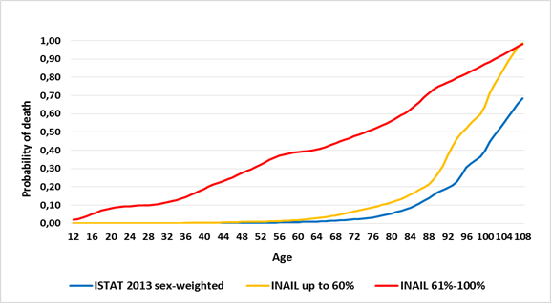
PERMANENT DISABILITY ANNUITANTS’ LIFE TABLES
Low claim age annuitants – Ill people
Probability of death of Inail permanent disability annuitants
with low claim age – Ill people
Comparison with Italian population (ISTAT 2013)
INAIL LIFE TABLES FOR WORK-RELATED INJURED OR ILL PEOPLE

Slide 63

PERMANENT DISABILITY ANNUITANTS’ LIFE TABLES
Specific mortality rates
                SPECIFIC MORTALITY
mortality due to the event that caused disability
Specific mortality rates are useful to calculate the so-called “Family Insurance” ratio, the second-order ratio that allows INAIL to assess the future expenditure resulting from possible establishment of survivors’ annuities.
As for generic mortality, have been constructed:
  for high claim age annuitants two specific mortality curves: one for degrees up to 60% and one for degrees from 61% to 100%;
  for low claim age annuitants, indeed, four curves, depending on type of event and class of impairment.
INAIL LIFE TABLES FOR WORK-RELATED INJURED OR ILL PEOPLE

Slide 64
PERMANENT DISABILITY ANNUITANTS’ LIFE TABLES
Specific mortality rates
              Specific mortality rates of Inail permanent disability annuitants (x 1.000)
INAIL LIFE TABLES FOR WORK-RELATED INJURED OR ILL PEOPLE

Slide 65
PERMANENT DISABILITY ANNUITANTS’ LIFE TABLES
Specific mortality rates
Data show that:
high claim age annuitants have specific mortality rates generally low;
low claim age injured annuitants have significant specific mortality rates only for impairments higher than 60%;
low claim age ill annuitants have a high specific mortality increasing with age, especially for serious illness.
INAIL LIFE TABLES FOR WORK-RELATED INJURED OR ILL PEOPLE

Slide 66
  WORKERS’ SURVIVORS’ LIFE TABLES

Slide 67
WORKERS’ SURVIVORS’ LIFE TABLES
INAIL data, extracted for the observation period 1996-2013, allowed the establishment of specific technical bases for:
surviving widow(er)s
orphans
Life table for orphans (or brothers and sisters) unfit for work has been released adapting disabled table of Italian National Institute of Social Security (INPS) to INAIL statistical group;
Since INAIL statistical group of parents entitled to benefit is not large enough, mortality rates for these survivors are equal to Italian population ones, sex weighted (81% females, 19% males).
INAIL LIFE TABLES FOR WORK-RELATED INJURED OR ILL PEOPLE

Slide 68
WORKERS’ SURVIVORS’ LIFE TABLES
Surviving widow(er)s’ life table
Since spouses are entitled to the benefit until death or re-marriage, probability of elimination considered both causes of exit.
              Probability of death of widow(er)s (x 1.000)
              Comparison with Italian population (ISTAT 2013)
              INAIL surviving widow(er)s’ mortality is similar to Italian population’s one
INAIL LIFE TABLES FOR WORK-RELATED INJURED OR ILL PEOPLE

Slide 69
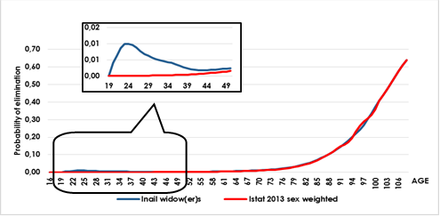
WORKERS’ SURVIVORS’ LIFE TABLES
Surviving widow(er)s’ life table
Probability of elimination (death and re-marriage) of widow(er)s
Comparison with Italian population (Istat 2013)
Re-marriage probability is significant only for ages between 20 and 40.
INAIL LIFE TABLES FOR WORK-RELATED INJURED OR ILL PEOPLE

Slide 70
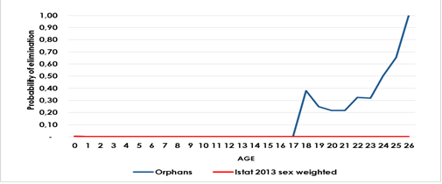
WORKERS’ SURVIVORS’ LIFE TABLES
Orphans’ life table
Since orphans (or brothers and sisters) are entitled to the benefit until death or end of studies, probability of elimination considered both causes of exit.
              Probability of elimination (death and end of studies) of orphans
              Comparison with Italian population (ISTAT 2013)
Orphans probability of death is that of Italian population; end of studies’ empirical frequencies derived, indeed, from INAIL database.
26 is the maximum age at which one student is entitled to receive Inail annuity
INAIL LIFE TABLES FOR WORK-RELATED INJURED OR ILL PEOPLE

Slide 71
  CONCLUSIONS

Slide 72
CONCLUSIONS
Average mortality rates
INAIL annuitants’ mortality analysis shows a strong correlation between mortality rates and the following variables:
          annuitants’ age;
          claim age;
          type of event;
          impairment degree.
          Average mortality rates (x 1.000)
INAIL LIFE TABLES FOR WORK-RELATED INJURED OR ILL PEOPLE

Slide 73
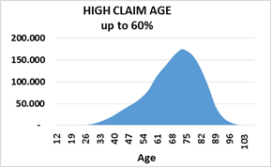
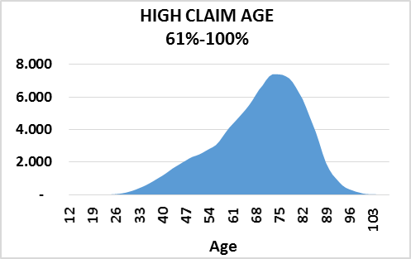
CONCLUSIONS
Average mortality rates
In case of high claim age, after the stabilization of impairing after-effects, the impairment degree doesn’t affect a lot the level of mortality; mortality rates depend substantially from high age of exposed to risk.
HIGH CLAIM AGE
Age distribution of Exposed to risk
at 2013.12.31
Average Claim Age: 30,6
Average Age: 71,3
Average mortality rate:
35,58‰
Average mortality rate:
44,03‰
INAIL LIFE TABLES FOR WORK-RELATED INJURED OR ILL PEOPLE

Slide 74
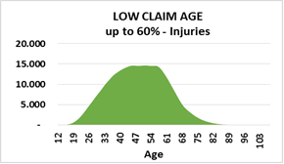
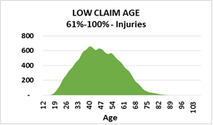
CONCLUSIONS
Average mortality rates
For low claim age, indeed, impairment degree affects the level of mortality.
LOW CLAIM AGE – INJURED
Age distribution of Exposed to risk
at 2013.12.31
Average Claim Age: 5,9
Average Age: 51,3
Average mortality rate:
4,07‰
Average mortality rate:
14,70‰
INAIL LIFE TABLES FOR WORK-RELATED INJURED OR ILL PEOPLE

Slide 75
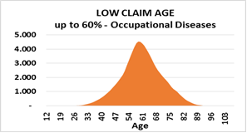
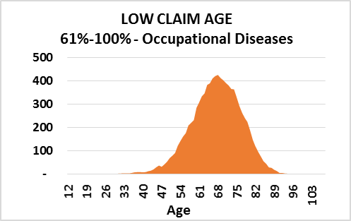
CONCLUSIONS
Average mortality rates
LOW CLAIM AGE – ILL PEOPLE
Age distribution of Exposed to risk
at 2013.12.31
Average Claim Age: 4,5
Average Age: 61,8
Average mortality rate:
31,59‰
Average mortality rate:
449,56‰
INAIL LIFE TABLES FOR WORK-RELATED INJURED OR ILL PEOPLE

Slide 76
CONCLUSIONS
Life expectancy
Life expectancy of Inail permanent disability annuitants
Comparison with Italian population (ISTAT 2013)
INAIL LIFE TABLES FOR WORK-RELATED INJURED OR ILL PEOPLE

Slide 77
CONCLUSIONS
Life expectancy
Life expectancy of INAIL annuitants reiterates the concept that:
for higher claim ages together with low and mid impairment degree, mortality of Inail permanent disabilities annuitants is wholly similar to Italian population mortality;
for lower claim ages there is a substantial difference between accidents and occupational diseases, with particular emphasis on the most serious diseases, including all forms of cancer (even those related with asbestos), that cause a very low life expectancy.
INAIL LIFE TABLES FOR WORK-RELATED INJURED OR ILL PEOPLE

Slide 78
CONCLUSIONS
RESULTS OF THE STUDY
For the first time INAIL realized annuitants’ Life Tables distinguished for high and low claim-age and for injured and ill people.
NEXT STEP
In the next years INAIL Statistical and Actuarial Office is going to carry out a study about the correlation between mortality and worker’s profession.
INAIL LIFE TABLES FOR WORK-RELATED INJURED OR ILL PEOPLE

Slide 79
THANKS FOR YOUR ATTENTION!
Panama City, August 21–24, 2017
2017 ASTIN / AFIR Colloquium
For any information, please contact:
Laura Baradel
l.baradel@inail.it - phone +39 0654872303
Daniela Martini
d.martini@inail.it - phone +39 0654872334

